Slide 1
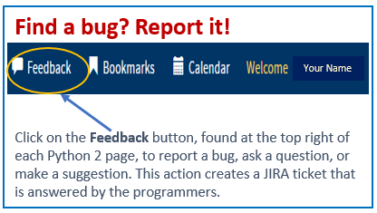
Python 2 Thesis Support
How to Delete an Extra Thesis Dashboard

Slide 2
Python 2 Thesis Support
Students, see pp. 2−3
Ed Techs, see pp. 4−5
Only in-progress and future extraneous dashboards need to be, or are able to be, deleted.
June 2018 graduates and earlier will have duplicate thesis entries because of the transfer over from legacy Python; do not worry about these.
1

Slide 3
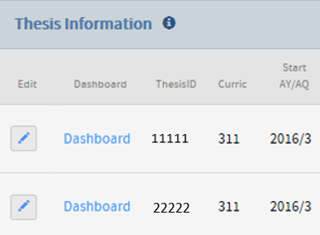
Python 2 Thesis Support
How to delete an extra dashboard–Students
You can delete a dashboard as long as the proposal step has NOT been completed. If the proposal has already been completed, contact your Ed Tech, who will be able to perform the deletion.
In Python, click Student Information from the left-hand menu.
Scroll down to Thesis Information.
Here, you will find
the dashboards. The section looks like this:
You may want to take
note of which Thesis ID you want to delete.
Proceed to next slide.
2

Slide 4
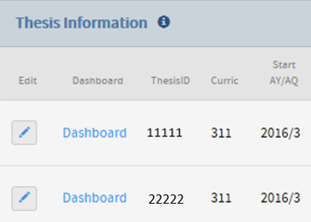
Python 2 Thesis Support
How to delete an extra dashboard–Students, continued
Click on the Edit pencil to the left of the dashboard you want to delete.
The Student Thesis Editor window will appear. Scroll down to the bottom and find the three buttons.
Select the orange Delete Thesis button.
NOTE: If you are co-authoring a thesis, be sure to delete the dashboard with the single author.
3

Slide 5
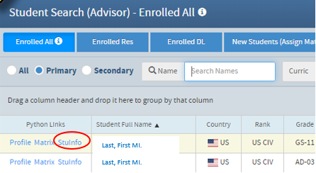
Python 2 Thesis Support
How to delete an extra dashboard–Ed Techs
You have permissions to delete a dashboard up until the TRAF has been approved.
Find the student’s Python record using the Students module from your Educational Advisor folder.
Enter the student’s last name (in full or part) in the Name field.
Click on the student’s StuInfo link.
Proceed to next slide.
4

Slide 6
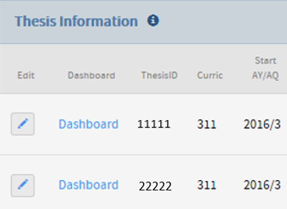
Python 2 Thesis Support
How to delete an extra dashboard–Ed Techs, continued
Select the student’s Student Info bar at the top of the page.
Scroll down to the Thesis Information section.
You may want to use the Thesis ID to help remember which dashboard you want to delete.
Click on the Edit pencil to the left of the unwanted dashboard.
When the Student Thesis Editor window appears, scroll to the bottom and select the orange Delete Thesis button.
5

Slide 7
Python 2 Thesis Support
For additional information and guidance, consult the TPO website at https://nps.edu/web/thesisprocessing/python-help
For Thesis Module support, contact Thesis Processing:
thesisprocessingoffice@nps.edu
6

