Slide 1

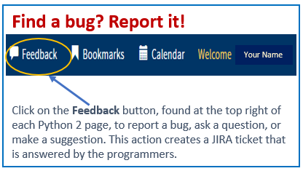
Python 2 Thesis Support
All Users:
Business Rules for Estimated
Departure Date

Slide 2
Python 2 Thesis Support
Business Rules for Estimated Departure Date (EDD)
in Python 2’s Thesis Dashboard
Introduction:
Based on NPS Academic Council policy, a student’s Estimated Departure Date (EDD) determines the due date for Thesis Acceptance by the Thesis Processing Office (TPO).
A student must have a “Thesis Accepted” email from the TPO, or an extension on file, to detach from NPS.
1

Slide 3
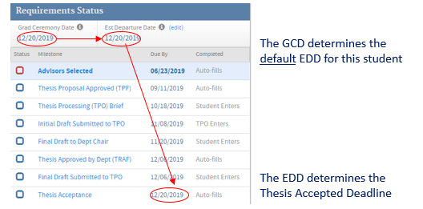
Python 2 Thesis Support
Default EDDs:
When a dashboard is created prior to the routing of the Thesis Proposal Form, students don’t yet have their detach orders, and thus, they do not know the date by which they need to check out from NPS. For planning purposes,
Python 2 sets default EDDs in the thesis dashboard’s Requirements Status section as follows:
U.S. students (military): The default date is the student's expected Graduation Ceremony Date. If detach date is earlier or later, please update this field.
International students: The default date is the student’s expected Graduation Ceremony Date.
U.S. students (civilian): The default date is the Academic Council deadline for their graduation quarter, NOT Graduation Day. Note: The default date before Oct. 12, 2023, was the Graduation Ceremony Date. The EDD on all existing civilian dashboards was updated to the new defaults during a system update.
Staff and faculty students: The date is usually the employment or appointment end date. If no date is entered, the default date is about 3 years from the onboard date.
Extension students: Extension expiration.
Proceed to the next slide for how to edit an EDD.
2

Slide 4
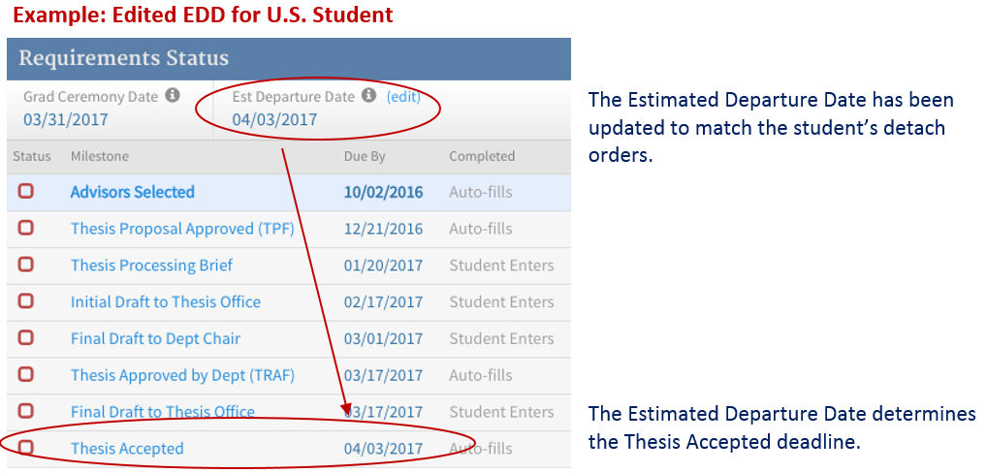
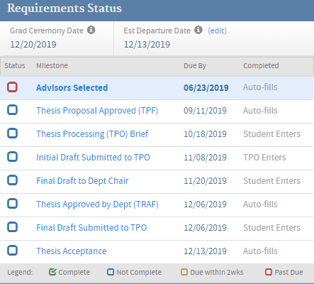
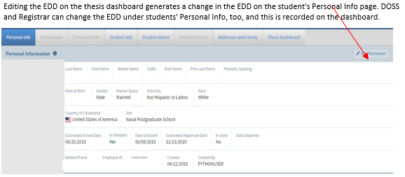
Python 2 Thesis Support
Editing the EDD:
Using the "edit" button next to Est. Departure Date on the thesis dashboard (refer to image below), EDD can be updated by the student, Admissions, Registrar, DOSS, educational advisors (ed techs, program officers, academic associates), and International Graduate Programs Office.
  Students may not modify the default date by more than +/- 14 days. For assistance, contact Student Services or IGPO if you are an international student.
  If EDD is more than 7 days after the Graduation Ceremony Date (which also is displayed on the dashboard), the Thesis Accepted due date will be set at no more than 7 days after Graduation Ceremony Date.
  If a thesis has multiple authors, each student can modify his or her own EDD via their dashboard, but the Thesis Accepted due date will be the earliest EDD of those authors.
  Student Services and the Registrar’s staff may edit the EDD from the Person Editor’s Summary tab. These users have no restrictions on the date allowed for EDDs.
3

Slide 5
Python 2 Thesis Support
Notification of EDD changes:
When students change their EDD during their graduation quarter, an email notification is sent to their education advisors (ed tech, PO, and AA), advisors, Student Services, military service representative, and TPO.
4

Slide 6
Python 2 Thesis Support
For additional information and guidance, consult the TPO website at https://nps.edu/web/thesisprocessing/python-help
For support, contact Thesis Processing:
  thesisprocessingoffice@nps.edu
Typo,
the TPO Dragon
5

