Slide 1

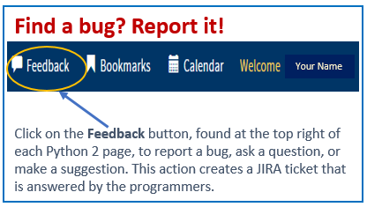
Python 2 Thesis Support
Service Reps:
List Management Tool for Thesis Publication Email Notifications

Slide 2
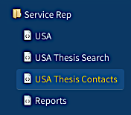
Python 2 Thesis Support
Service Reps:
List Management Tool for Thesis Publication Email Notifications
Objective:
Service reps have the option to create and maintain email lists to whom thesis publication announcements emails are sent.
This supports the timely dissemination of relevant research reports by NPS students who are in their service branch.
Review slides, then start here
1

Slide 3
Python 2 Thesis Support
Summary
  Military service reps can elect to generate and maintain email lists to whom thesis publication announcements are sent automatically by Python
  Use your Python menu tree’s Service Rep node to enter and update emails for those you wish to receive publication announcements
  Using this Python 2 function is optional
  Email recipients can be internal or external to NPS
  Each publication announcement email represents one thesis for an NPS student in your service branch; you can further define distribution by curricula
  Security and Distribution:
    Publicly releasable—announcements include the thesis abstract and a link to the thesis PDF in Calhoun
    Controlled Unclassified [CUI]—announcements include the thesis abstract and a link to the library’s Restricted Resources Collection page
    Classified—No announcements are sent
2

Slide 4
Python 2 Thesis Support
Who determines who receives thesis publication announcements?
General, default distribution is to student author(s) and faculty advisors of a given thesis
Students have the option on the Python thesis dashboard to add additional recipients (see PAL [Publication Announcement List] Announcements field, edit)
Service Reps have the option via their Python menu tree Service Rep node to add recipients
  By students in their service branch, broadly
  Example: Theses by any Army officer graduating that quarter
  By students in their service branch, in designated curricula
  Example: Theses by any Army officer graduating that quarter who is in curriculum 311
Departments have the option to add recipients for theses identified by author’s service and curriculum
3

Slide 5
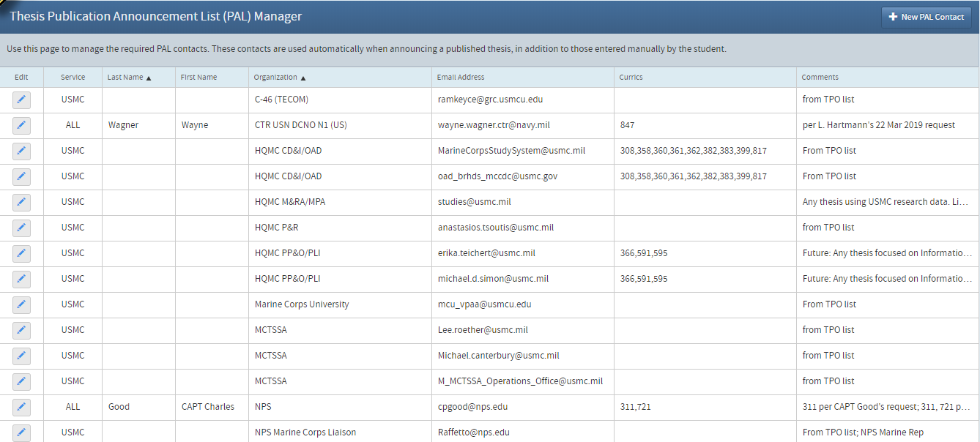
Python 2 Thesis Support
The USMC has long maintained a PAL for new theses by Marines, and recipients have received these emails from Thesis Processing.
4

Slide 6
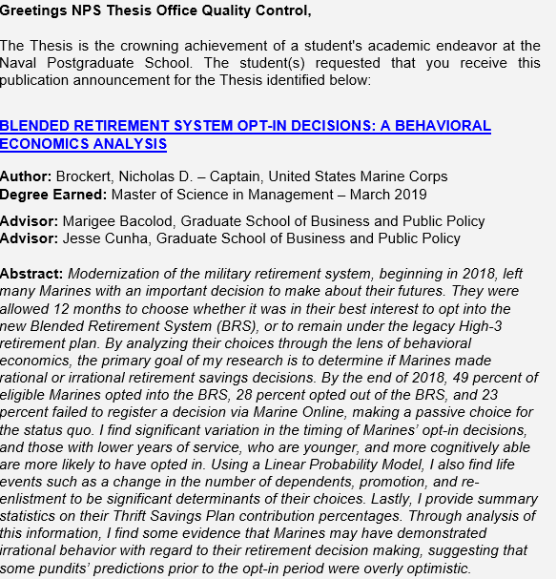
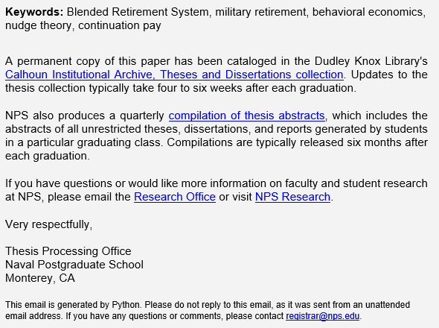
Python 2 Thesis Support
What Is a Thesis Publication Announcement?
Here is an example of an announcement for a publicly releasable thesis
Continued…
Past letter
5

Slide 7
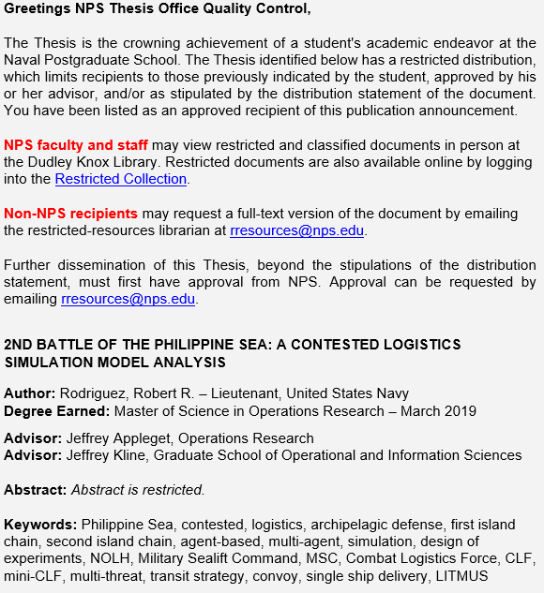
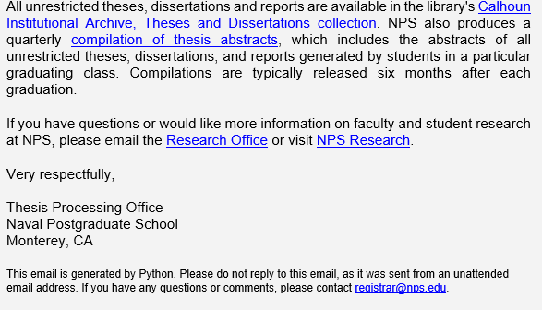
Python 2 Thesis Support
What Is a Thesis Publication Announcement?
Here is an example of an announcement for a CUI thesis
Continued…
6

Slide 8
Python 2 Thesis Support
When are publication announcements sent out?
  Emails are auto-generated approximately 4–6 weeks after the end of each quarter.
  Python 2 should speed up this process.
Who keeps and reviews the NPS “master” list?
  The Thesis Processing Office (TPO) will have a master list of distribution emails made by service reps and departments via Python; this is separate from the students’ recipient lists.
  TPO will review and edit the master list for duplicates and alert list POCs to bounce-back emails; TPO does not review the students’ list of recipients.
What alternatives do we have for announcing theses?
  Service reps and department POCs can add themselves to their Python Thesis Contacts List Manager and then selectively and manually forward publication announcements.
7
MAY 2018

Slide 9
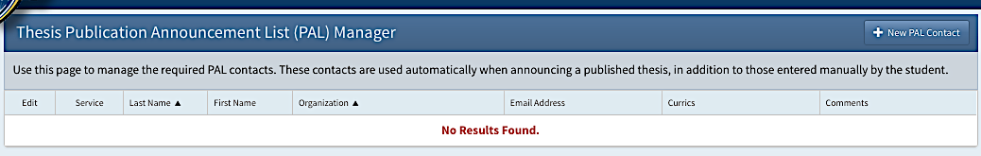
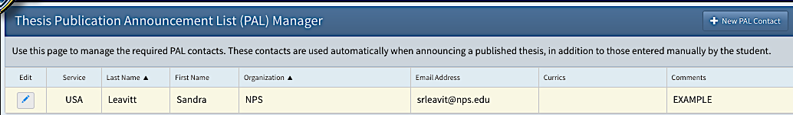
Python 2 Thesis Support
Your List Manager
This is what your List Manager looks like before any entries
Use this button to add a contact
The Army Rep’s List Manager looks like this after adding someone using +New PAL Contact
Dr. Leavitt will now receive thesis publication announcements for graduating Army officers
8

Slide 10
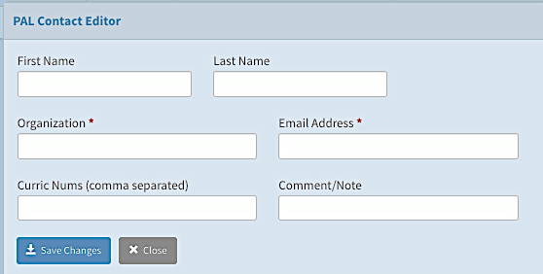
Python 2 Thesis Support
Adding Contacts
This pop-up box appears when you click on +New PAL Contact
Only Organization and Email Address are required fields
Then, Save Changes and Close the pop-up
The data populate on your List Manager, with pop-up fields as column headings
9

Slide 11
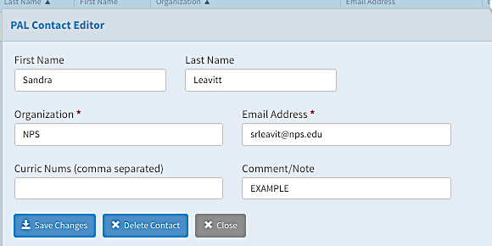
Python 2 Thesis Support
Editing and Deleting Contacts
Use the List Manager’s “Edit” button to make changes to a contact’s data in its pop-up window
Add curriculum numbers to limit email announcements to a given recipient
Add comments, such as when to check email validity with the organization or name of your POC
You also delete contacts from this pop-up window
10

Slide 12
Python 2 Thesis Support
For additional information and guidance, consult the TPO website at https://nps.edu/web/thesisprocessing/python-help
For support, contact Thesis Processing:
  thesisprocessingoffice@nps.edu
11

