Slide 1

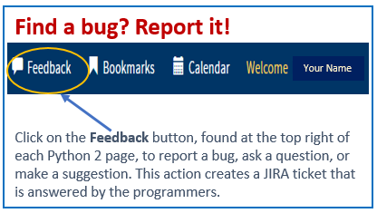
Python 2 Thesis Support
Students:
New Thesis Proposals

Slide 2
Python 2 Thesis Support
Summary
  Student creates Thesis Block and Python Thesis Dashboard by following these instructions.
  Student enters information required for the Thesis Proposal Form (TPF) milestone—details covered in the slides that follow—data can be changed later as research evolves:
    Thesis Data section
      Thesis Type correct?
      Thesis Title
      Co-authors to add?
      File-sharing site URL
      Faculty Advisors
      Proposal Abstract (n/a, if not required by department)
      Keywords
      Relevancy Topics
    Security and Compliance section
      Security classification and distribution statement for Main Document and Final Abstract
      Compliance Tasks by Student
      Compliance Tasks by Advisor
  Student routes the TPF online in Python: Open and review form, answer funding question, and
  select “Start Document Routing” in the Student Acknowledgement section.
  Advisors, PO, AA, and Department Chair sequentially record their approvals on the TPF.
2

Slide 3
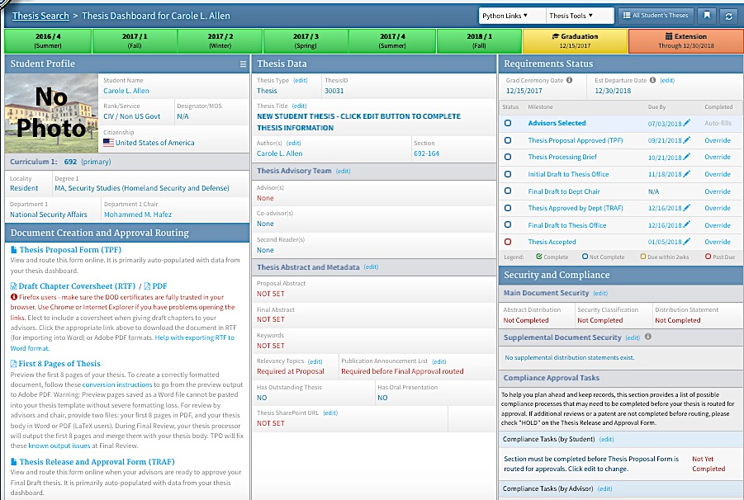
Python 2 Thesis Support
FIRST, CHECK YOUR DASHBOARD’S STUDENT PROFILE INFORMATION FOR ACCURACY!
If you find errors, edit the information by going to your Student Information and Student Profile pages under “Python Links.”
Or, contact your ed tech or registrar@nps.edu to make the corrections.
Your Name
Is your graduation quarter correct? If not, contact your ed tech.
Your Name
Your Name
3

Slide 4
Python 2 Thesis Support
NOW YOU’RE READY! DATA REQUIRED FOR THESIS PROPOSAL FORMS:
You will enter data into the Thesis Data and the Security and Compliance sections.
CAN I MAKE CHANGES LATER? YES! All data entered can be edited until you route your Thesis Release and Approval Form (TRAF) during your final quarter, except while your Thesis Proposal Form (TPF) is routing for approvals. After TPF approval, education advisors have permissions to edit advisor and co-author information; students can edit all other data; faculty advisors can edit Compliance Tasks.
Your Name
Your Name
Your Name
4

Slide 5
Python 2 Thesis Support
SUMMARY—TO COMPLETE UNDER THESIS DATA:
  Thesis Type
  Thesis Title
  Co-authors, if any
  Faculty Advisors
  Proposal Abstract
  Keywords
  Relevancy Topics
  File-sharing URL
Your Name
Questions?
Slides 6–31 provide detailed instructions.
5

Slide 6
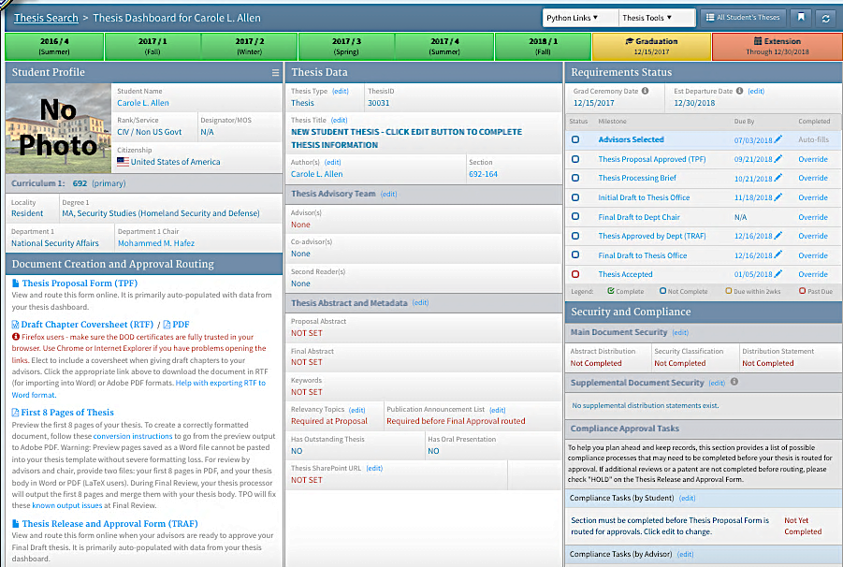
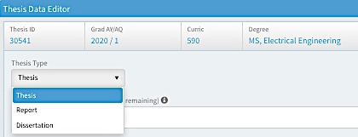
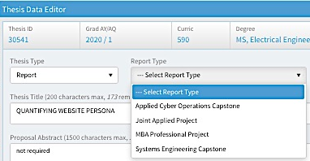
Python 2 Thesis Support
COMPLETE THE FOLLOWING UNDER THESIS DATA:
  Thesis Type—Is yours correct? The type displays
  on the Cover Page and Title Page of your final
  document.
    If not correct, click on the (edit)
    button next to the term “Thesis Type.”
    This opens the Thesis Data Editor window,
    shown in part below.
    Select Thesis, Report, or Dissertation.
    If you selected “Report,” next select the
    report type from the second drop-down
    menu.
6

Slide 7
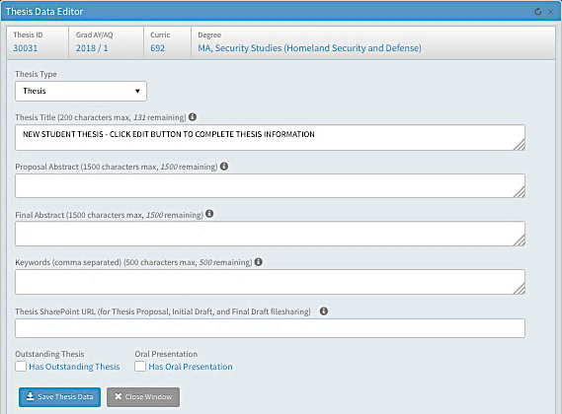
Python 2 Thesis Support
COMPLETE THE FOLLOWING UNDER THESIS DATA:
  Thesis Title—Click on the (edit) button next
  to the term “Thesis Title.”
  This opens the Thesis Data Editor window,
  shown in part below.
  In Thesis Data Editor,
  enter your working Thesis Title.
  For more information,
  click on the black “information”
  icon next to this field’s title.
  FUTURE EDITS: You may edit your
  thesis title up until you route your
  Thesis Release and Approval Form
  (TRAF) for department
  approval of your Final Draft thesis.
7

Slide 8
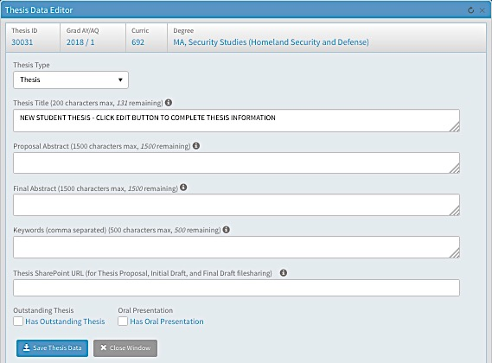
Python 2 Thesis Support
COMPLETE THE FOLLOWING UNDER THESIS DATA, continued:
Proposal Abstract—
If you have a proposal abstract, enter or paste it here. If not, enter “n/a.”
Keywords—Type in basic keywords related to your thesis topic. You can edit these up until you route your TRAF. You will eventually need keywords for your Final Draft thesis. Or, enter “n/a.”
Thesis SharePoint URL—OPTIONAL. If ITACS has sent you a thesis SharePoint site URL, copy and paste or type it in here, starting with https://….
You can also add a SharePoint URL later. It will be a live link from your dashboard. You can use this site to provide files for review to your advisors, department officers, and thesis processor.
When done, click on “Save Thesis Data,” and then “Close Window.”
8

Slide 9
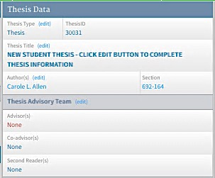
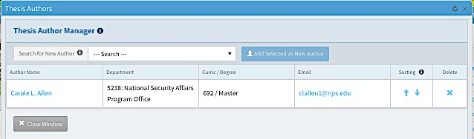
Python 2 Thesis Support
COMPLETE THE FOLLOWING UNDER THESIS DATA, continued:
  Co-authors—If you do not have co-authors, skip to Step 7.
  If you have co-author(s), click on the (edit) button next to the word “Author(s).”
  This opens the Thesis Author Manager, shown below.
  NOTE: If your name appears incorrectly, contact registrar@nps.edu
  to have it corrected.
  NOTE: For multi-authored theses, only ONE author should create a thesis dashboard. When the co-authors’ names are added, Python will automatically create linked dashboards for each co-author. All team members will share the same dashboard, with identical Thesis IDs. Therefore, when any member of the team logs into their own dashboard, they will be accessing the shared dashboard, and changes made to the dashboard of one team member will be reflected in all dashboards.
Your Name
Your Name
Your email address
9

Slide 10
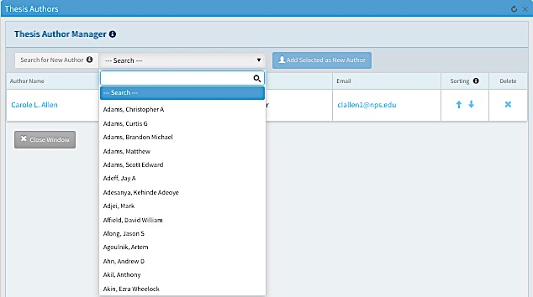
Python 2 Thesis Support
Python 2 Thesis Support
COMPLETE THE FOLLOWING UNDER THESIS DATA, continued:
  Co-authors, continued
  Click on the “Search” field to display a blank entry field and student names in a drop-down menu.
  Start typing in your co-author’s last name. Then select him or her from the drop-down menu.
  NOTE: Your co-author must have a curriculum Track assigned in Python to appear on this list.
  If you do not find your co-author’s name, ask him or her to log into Python and follow the instructions to assign a curriculum track here.
Your Name
Your email address
10

Slide 11
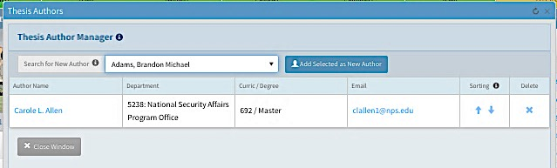
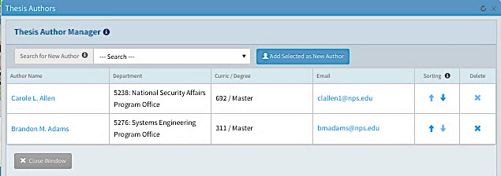
Python 2 Thesis Support
COMPLETE THE FOLLOWING UNDER THESIS DATA, continued:
  Co-authors, continued
  Once you have selected your co-author’s name, click on the blue “Add Selected as New Author” button.
  Your co-author will now appear with yours in the list of authors. Author names are listed in the order they were added.
  Repeat steps 6a to 6c to add additional authors.
  To change the order in which authors will appear on the thesis itself, use the “Sorting” arrows to reorder them, first to last.
  Delete co-authors by clicking on the ”X” in the Delete column.
  NOTE: After a thesis proposal has been approved in Python, only Ed Techs and POs, not students, have permissions to add or delete co-authors.
Co-author’s Name
Your Name
Your email address
Your Name
Your email address
Co-author’s Name
Co-author’s email address
When done, click on “Close Window.”
11

Slide 12
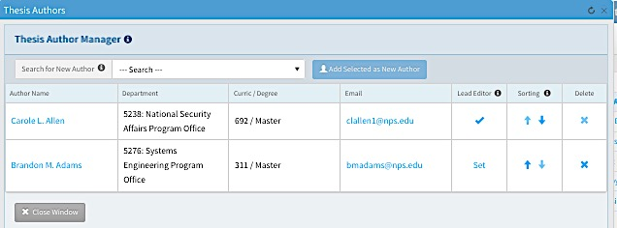
Python 2 Thesis Support
COMPLETE THE FOLLOWING UNDER THESIS DATA, continued:
  Co-authors, continued
  If you are part of a Systems Engineering Capstone Report team, you are able to add up to 17 names.
  SE Capstone Report teams also must select one Lead Editor before, in their final quarter, they request an Initial Draft Review from thesis processing. This does not need to be done at the Thesis Proposal Form stage!
  To select a Lead Editor, click on the word “Set.”
  This changes the field value to a checkmark, indicating the Lead Editor.
Systems Engineering Capstone Reports ONLY
Co-author’s Name
Your Name
Your email address
Your Name
Your email address
Co-author’s Name
Co-author’s email
address
12

Slide 13
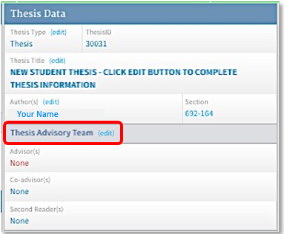
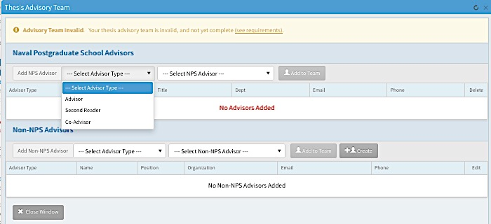
Python 2 Thesis Support
COMPLETE THE FOLLOWING UNDER THESIS DATA, continued:
  Advisors—To add advisors, click on the (edit) button next to the word “Thesis Advisory Team” on the dashboard.
  This opens the Thesis Advisory Team window, shown below.
  RULES:
  —You must have at least one Advisor. Most departments require more than one advisory team member. Consult your department.
  —If you have only one Advisor, he or she must be an NPS faculty member and must use the advisory role of “Advisor,” not Co-Advisor or Second Reader.
  —Non-NPS Advisors can use the advisory roles of Co-advisor or Second Reader.
13

Slide 14
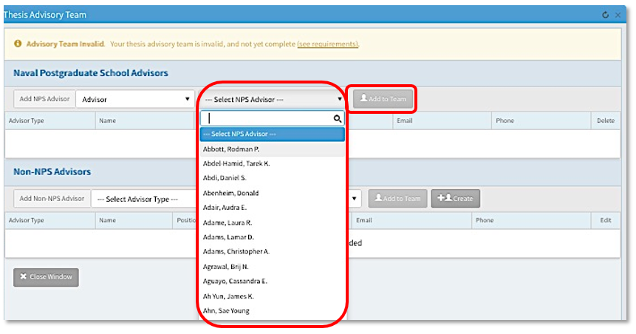
Python 2 Thesis Support
COMPLETE THE FOLLOWING UNDER THESIS DATA, continued:
  Advisors, continued
  To add an NPS advisor, first Select Advisor Type from the first drop-down menu.
  Then, select an NPS advisor by clicking in the “Select NPS Advisor” field; this brings up a drop-down list of NPS faculty members.
  Start typing your advisor’s last name in the field until his or her name appears in the drop-down.
  Click on the “Add to Team” button.
14

Slide 15
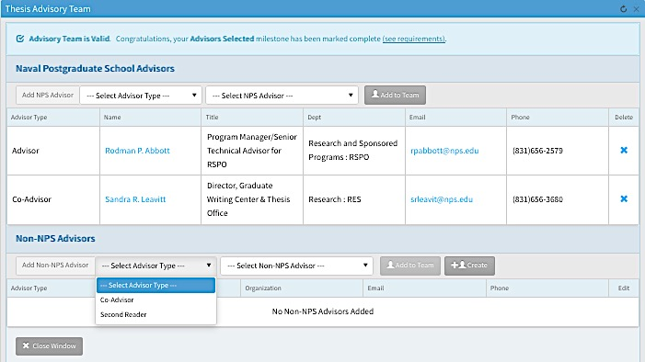
Python 2 Thesis Support
COMPLETE THE FOLLOWING UNDER THESIS DATA, continued:
  Advisors, continued
  Repeat steps 8a to 8d to add additional advisory roles and advisors from NPS.
  To add a Non-NPS Advisor, select his or her advisor type, which can be either Co-Advisor or Second Reader.
15

Slide 16
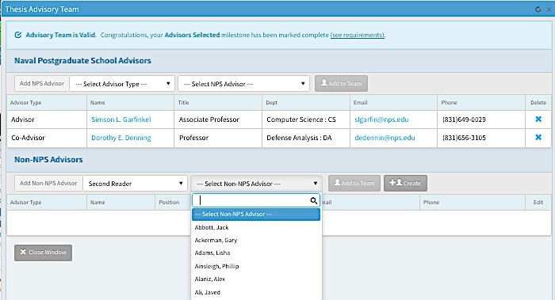
Python 2 Thesis Support
COMPLETE THE FOLLOWING UNDER THESIS DATA, continued:
  Advisors, continued
  First, look for your non-NPS advisor’s name under “Select Non-NPS Advisor” using the same drop-down selection technique you used for NPS advisors.
  Then, if he or she is not found in the drop-down menu, click on the “+Create” button.
16

Slide 17
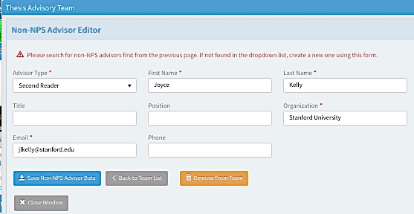
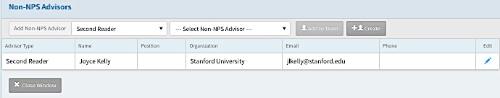
Python 2 Thesis Support
COMPLETE THE FOLLOWING UNDER THESIS DATA, continued:
  Advisors, continued
  Fill in as much information as possible.
  Required fields: Advisor Type, First Name, Last Name, Organization, and Email (as shown here).
  Click on the “Save Non-NPS Advisor Data” button, then close the window.
  If necessary, this is also where you or your education advisor will remove Non-NPS Advisors from your advisory team, using the orange “Remove from Team” button.
  Back on the Thesis Advisory Team window, use the “Edit” pencil when you need to return to the Non-NPS advisor’s information page.
17

Slide 18
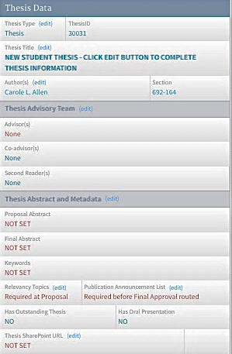
Python 2 Thesis Support
COMPLETE THE FOLLOWING UNDER THESIS DATA, continued:
  Relevancy Topics
  Click on the (edit) button next to Relevancy Topics on the dashboard.
  This opens the Edit Relevancy Topics window shown on the next slide.
  NOTE: You can edit your relevancy topics up until your TRAF is routed for approval in your graduation quarter.
Your Name
18

Slide 19
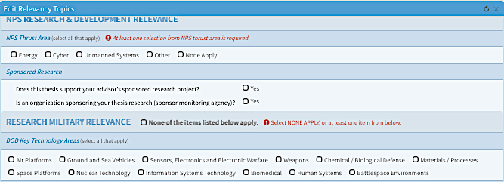
Python 2 Thesis Support
COMPLETE THE FOLLOWING UNDER THESIS DATA, continued:
  Relevancy Topics, continued
  There are two sections to complete: NPS Research & Development Relevance and Research Military Relevance.
  You must at least select “None Apply” in each section. Your accurate answers, however, will help NPS connect you to others with similar interests and communicate the importance of student research.
(Topic choices continued on Slide 21)
19

Slide 20
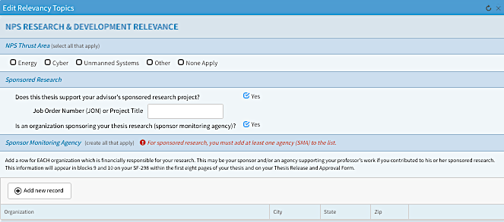
Python 2 Thesis Support
COMPLETE THE FOLLOWING UNDER THESIS DATA, continued:
  Relevancy Topics, continued
  Under the NPS Research & Development Relevance section, if you answer Yes to either of the Sponsored Research questions, you will be prompted to enter additional information.
  If necessary, consult your advisor to answer these questions.
20

Slide 21
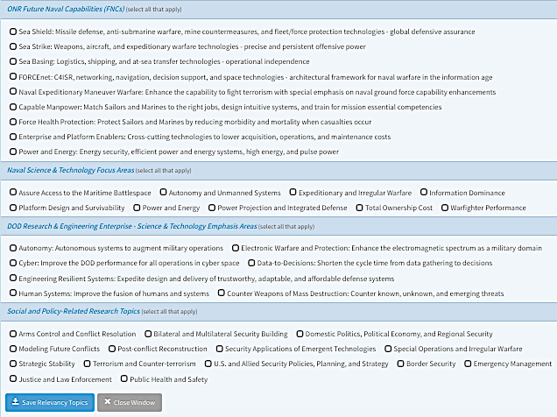
Python 2 Thesis Support
COMPLETE THE FOLLOWING UNDER THESIS DATA, continued:
  Relevancy Topics,
  continued
  Under the Research Military Relevance section, check any that apply.
  Then, click “Save Relevancy Topics” and Close Window.
21

Slide 22
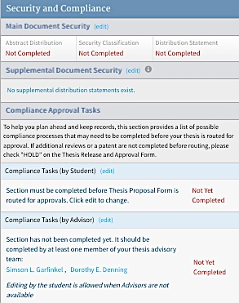
Python 2 Thesis Support
COMPLETE THE FOLLOWING UNDER SECURITY AND COMPLIANCE:
You and your advisors may not yet be sure what the distribution statement will be for your Final Draft thesis document, but most departments require their students to make an educated guess at the proposal stage.
Distribution statements can be changed up until your Thesis Release and Approval Form (TRAF) is routed for departmental approvals during your graduation quarter.
Most students will only designate a security classification for their main thesis document and its abstract.
Some may have supplementary documents or items that need their own security and distribution markings. Only main thesis document security and distribution estimates are required at the proposal stage.
Main Document Security—Click on the (edit) button next to “Main Document Security” on your dashboard.
This opens the Edit DoD Security & Distribution Data window, shown on the next slide.
22

Slide 23
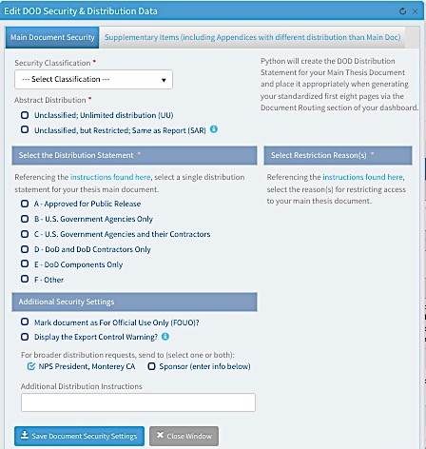
Python 2 Thesis Support
COMPLETE THE FOLLOWING UNDER SECURITY AND COMPLIANCE, continued:
Select a Security Classification, either Unclassified and Classified.
  If you select Classified, no other security-or distribution-related selections are made in Python.
  Instead, you will need to select Abstract Distribution and Main Document Distribution in secure facilities at NPS.
  Once you Save Document Security Settings with Classified selected, Python removes your thesis title, abstract, and keywords, replacing them with the phrase “ON FILE.”
  You will route your TPF and TRAF in Python, but no topic-related details about your thesis will be included.
23

Slide 24
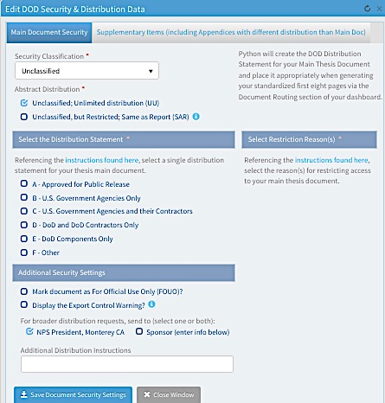
Python 2 Thesis Support
COMPLETE THE FOLLOWING UNDER SECURITY AND COMPLIANCE, continued:
Once Unclassified has been selected, you need to select a preliminary Abstract Distribution.
Your choices are:
  Unclassified, unlimited distribution (UU). Most students choose this option.
  Unclassified, but Restricted; Same as Report [thesis] (SAR)
24

Slide 25
Python 2 Thesis Support
COMPLETE THE FOLLOWING UNDER SECURITY AND COMPLIANCE, continued:
Next, select your main document Distribution Statement from letters A through F.
From selections you make here, Python will compile the distribution statement for your thesis document!
You can review the statement in the First 8 Pages output on the left of your dashboard.
25

Slide 26
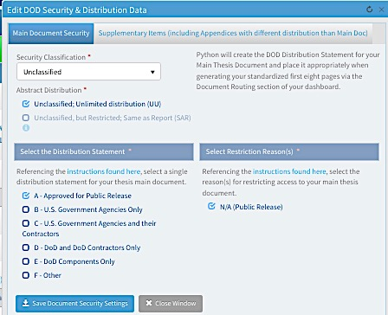
Python 2 Thesis Support
COMPLETE THE FOLLOWING UNDER SECURITY AND COMPLIANCE, continued:
Main document Distribution Statement, continued:
If A – Approved for Public Release is selected, no restriction reasons are applicable.
Select ”Save Document Security Settings” and close the window.
26

Slide 27
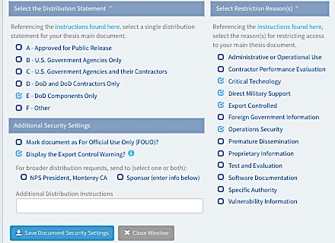
Python 2 Thesis Support
COMPLETE THE FOLLOWING UNDER SECURITY AND COMPLIANCE, continued:
Main document Distribution Statement, continued:
If Distribution Statement B, C, D, or E is selected, you will need to select one or more restriction reasons from the right side of the window.
Only the reasons allowed by DoD for each statement letter are displayed.
NOTE: If you select one or more of the reasons Critical Technology, Direct Military Support, or Export Controlled, the “Display the Export Control Warning?” box is automatically checked.
IMPORTANT: Any draft document with Statements B–F must be shared as a hard copy or encrypted email, or via a secure repository, such as SharePoint.
27

Slide 28
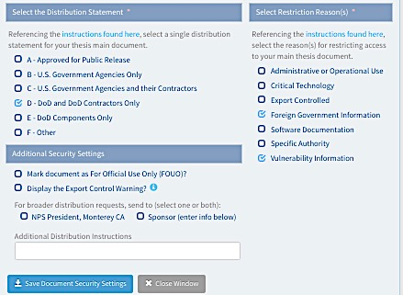
Python 2 Thesis Support
COMPLETE THE FOLLOWING UNDER SECURITY AND COMPLIANCE, continued:
Main document Distribution Statement, continued:
You can also elect to add For Official Use Only (FOUO).
If selected, Python will add FOUO markings to the First 8 Pages of your thesis.
You will still be responsible for adding FOUO markings to the body of your thesis. (Thesis Processors can help. Additional guidance is available here.)
You can indicate if a sponsor or other agency needs to be consulted for broader distribution requests.
When done, click on “Save Document Security Settings,” and “Close Window.”
28

Slide 29
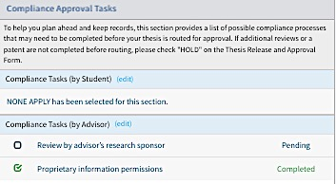
Python 2 Thesis Support
COMPLETE THE FOLLOWING UNDER SECURITY AND COMPLIANCE, continued:
2. Compliance Tasks:
The purpose of this section is to help you and your advisors build in time and track progress in completing approvals for compliance tasks that can slow down your research.
Relevant task(s) or “None Apply” must be selected in each of the two sub-sections before routing the TPF:
  By student
  By advisor
Click on the (edit) button next to each of these sections to open its data-entry window (see next pages).
Students and advisors can enter and edit data in each other’s section. The advisor is ultimately responsible for completing most compliance tasks listed in these sections.
Once data is entered in the Edit Compliance windows, items selected and their status are displayed on the dashboard itself as Pending or Completed. Items are pending until a completed date is recorded in the data-entry window.
29

Slide 30
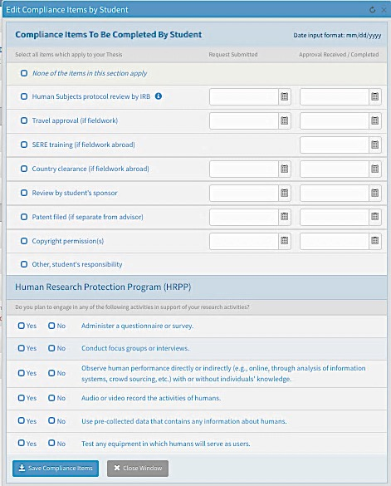
Python 2 Thesis Support
COMPLETE THE FOLLOWING UNDER
SECURITY AND COMPLIANCE, continued:
2a. Compliance Tasks (by Student)
TRACKING (optional except for IRB)
Check those that apply, if any. Most students will check “None of the items in this section apply.”
NOTE: All students must complete the Human Research Protection Program questions, answering Yes or No for each item.
—If “No” is selected for all items in HRPP, then “None of the items in this section apply” above is allowed.
—If “Yes” is selected for any items in HRPP, then “Human Subjects protocol review by IRB” auto-checks above. Your IRB review and/or protocol number will need to be entered later.
TRACKING: Students can then use the Request Submitted and Approval Received/Completed columns to keep track of compliance tasks in one place.
Dates dates do NOT need to be entered for your thesis to be approved by your department or to be accepted by TPO.
SAVE!
30

Slide 31
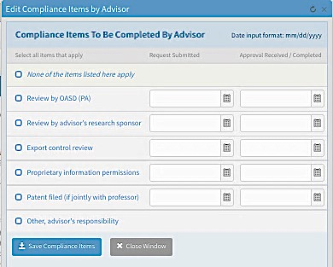
Python 2 Thesis Support
COMPLETE THE FOLLOWING UNDER SECURITY AND COMPLIANCE, continued:
2b. Compliance Tasks (by Advisor)
Check those that apply, if any. Most advisors (or students for them) will check “None of the items listed here apply.”
TRACKING: If an item is checked, then the advisor (or student) can opt to use the Request Submitted and Approval Received/Completed columns to keep track of compliance tasks in one place.
These dates do NOT need to be entered to have the thesis approved by the department or accepted by TPO.
TRACKING (optional)
SAVE!
31

Slide 32
Python 2 Thesis Support
You’re now ready for
Thesis Proposal Form (TPF) approval routing!
32

Slide 33
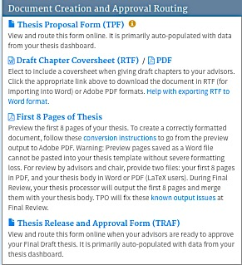
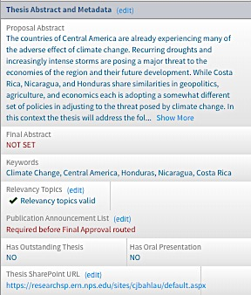
Python 2 Thesis Support
When your advisors say they are ready to sign off on your Thesis Proposal:
Upload your Thesis Proposal content Open your Thesis Proposal Form (TPF)
document to your SharePoint site then… from your Dashboard
…Be sure to let approvers know it’s on SharePoint and
grant them access!
For SharePoint support, email SPresearch@nps.edu
33

Slide 34
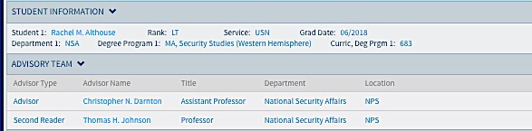
Python 2 Thesis Support
Check the data on your TPF for accuracy!
If it’s not accurate, make edits by returning to your dashboard, making edits on other Python pages, or contacting your ed tech.
This is the top of the TPF.
From here, you can navigate to the Thesis Dashboard, Stop Document [TPF] Routing, or print a copy.
Next you’ll see student and advisor information.
Your name
The TPF will list all student authors and the personal and curricular info as shown here.
Click on someone’s name to display a pop-up window with the person’s contact information.
34

Slide 35
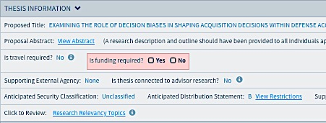
Python 2 Thesis Support
The next section is primarily derived from your dashboard data, but needs you to complete one question.
  Answer the question in red, and enter a dollar amount if the answer is Yes.
35

Slide 36
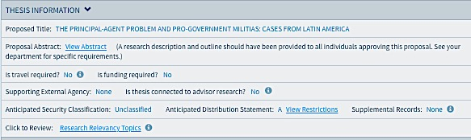
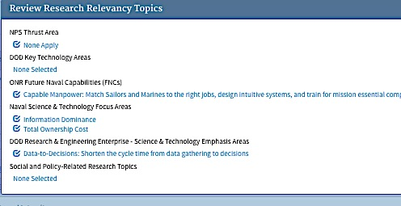
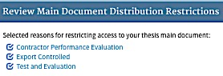
Python 2 Thesis Support
Review the displayed and hidden data carefully.
Click on the three underlined, light-blue text to generate pop-up summary boxes for hidden data.
C
36

Slide 37
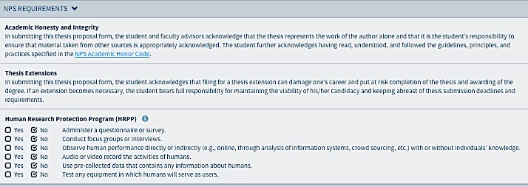
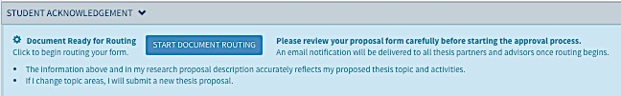
Python 2 Thesis Support
Read this next section carefully.
Read this section and then click on the “Start Document Routing” button.
The TPF is routed first to student author(s), then to faculty advisors, PO, AA, and department chair.
37

Slide 38
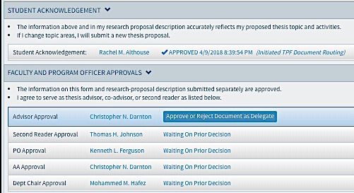
Python 2 Thesis Support
This is what the TPF looks like after the student has started routing.
DELEGATES: Ed Techs and program officers (POs) can record approvals on the TPF by acting as delegates for non-NPS faculty advisors.
Ed techs and program officers can also serve as delegates for NPS faculty advisors.
POs, AAs, and department chairs usually have delegates identified in Python.
Delegates do NOT receive notification of pending approval action needed, but can find pending approval requests in their Thesis Inbox. Delegates act when asked to do so.
Your name
Each faculty member and program officer is sent an email notification, in turn, letting them know your TPF is awaiting their approval.
They access your TPF via their Thesis Inbox or your dashboard.
They access your proposal content via your SharePoint site URL on your dashboard, hard copy, or emailed copy, depending on their expressed preference.
38

Slide 39
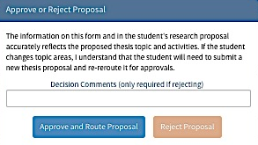
Python 2 Thesis Support
Each reviewer has the option to approve or reject the TPF data or proposal content.
Your name
If you reject the proposal, enter a short explanation as to why. This is sent to the student.
The student contacts you for more information or makes the requested changes and then re-starts the routing from the beginning so that everyone agrees to the same information.
39

Slide 40
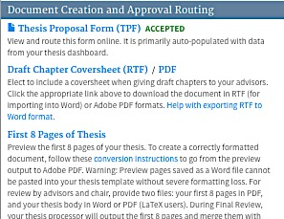
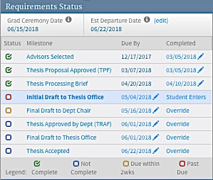
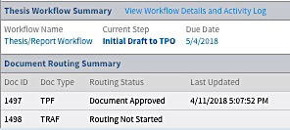
Python 2 Thesis Support
The dashboard records the TPF as “completed” in three places:
Middle-left of dashboard
Top-right
Bottom-left
You’re done!
40

Slide 41
Python 2 Thesis Support
For additional information and guidance, consult the TPO website at https://nps.edu/web/thesisprocessing/python-help
For support, contact Thesis Processing:
  thesisprocessingoffice@nps.edu

