Slide 1
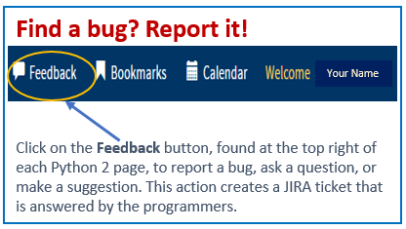
Python 2 Thesis Support
All Users:
Requirements Status: Thesis Dashboard Milestones

Slide 2
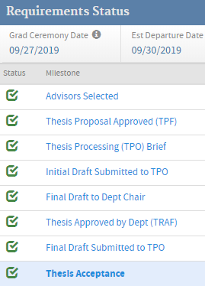
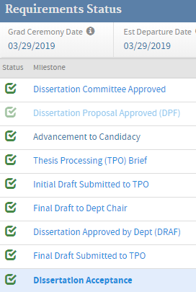
Python 2 Thesis Support
Requirements Status—Python View
Thesis
Dissertation

Slide 3
Python 2 Thesis Support
Thesis dashboard milestones
Milestone 1: Advisors Selected
Milestone 2: Thesis Proposal Approved (TPF) (N/A for dissertations)
Milestone 2A: Advancement to Candidacy (dissertations only)
Milestone 3: Thesis Processing (TPO) Brief
Milestone 4: Initial Draft Submitted to TPO
Milestone 5: Final Draft to Dept Chair
Milestone 6: Thesis/Dissertation Approved by Dept (TRAF/DRAF)
Milestone 7: Final Draft Submitted to TPO
Milestone 8: Thesis/Dissertation Acceptance
1

Slide 4
Python 2 Thesis Support
Definitions, assumptions
EDUCATION ADVISORS: Academic Associates, Program Officers, and Ed Techs assigned to the student curriculums
GCD: Graduation Ceremony Date. This is calculated by checking the Expected Graduation Academic Year/Academic Quarter (AYAQ), or the Extension Expiration date for an extension student.
TPF: Thesis Proposal form (DPF = Dissertation Proposal Form)
TPO: Thesis Processing Office
TRAF: Thesis Release and Approval Forms (DRAF = Dissertation Release and Approval Form)
Global Due Date edits will never overwrite a due date that was changed via the dashboard.
When editing due dates individually, the date must be later than the preceding requirement/milestone and earlier than the following one (exemption: when editing due date for Milestone 7, Final Draft Submitted to TPO).
When setting or editing completion dates, any date may be set.
2

Slide 5
Python 2 Thesis Support
Email notifications
Due Date changes always generate an email to the affected students.
Requirement Completed emails are sent when marking Milestones 4, 5, 7 (Initial Draft Submitted to TPO, Final Draft to Dept Chair, Final Draft Submitted to TPO, respectively) as completed.
Thesis/Dissertation Accepted emails are sent when marking Milestone 8 (Thesis Acceptance) as completed.
3

Slide 6
Python 2 Thesis Support
Advisors selected, Milestone 1
Setting Due Dates Globally: Education Advisors, TPO **
Setting Due Dates Individually: Education Advisors
Default Due Date: 180 days prior to graduation **
Due Date Exemption: Education Advisors may mark this due date as N/A
How Completed: Completion date set automatically once advisory team selections are valid
Editing Completion Dates: After completed, date may be edited by Registrar, TPO, and Education Advisors
Special Rule:
** National Security Affairs (NSA) department (excluding Center for Homeland Defense and Security [CHDS]) uses a custom due date offset value ADDED to the date when the student started instruction. All others use an offset subtracted from the GCD.
4

Slide 7
Python 2 Thesis Support
Thesis proposal approved (TPF/DPF), Milestone 2
Setting Due Dates Globally: Education Advisors, TPO **
Setting Due Dates Individually: Education Advisors
Default Due Date: 100 days prior to graduation **
Due Date Exemption: Education Advisors may mark this due date as N/A
How Completed: Completion date set automatically once the Proposal Document is approved
Editing Completion Dates: After completed, date may be edited by Education Advisors, Registrar, TPO
Special Rules:
For dissertations, this milestone is skipped and automatically marked as N/A on the dashboard. Workflow advances to Milestone 2A.
**The NSA department (excluding CHDS) uses a custom due date offset value ADDED to the date when the student started instruction. All others use an offset subtracted from the GCD.
5

Slide 8
Python 2 Thesis Support
PhD advancement to candidacy, Milestone 2a
Default Due Date: N/A
How Completed: Marked complete once the Registrar marks the student as having advanced to candidacy, via the PhD Tracker tool
Editing Completion Dates: After completed, Registrar may modify the date using the PhD Tracker
Special Rule:
This milestone only appears for dissertations and has no due date
6

Slide 9
Python 2 Thesis Support
Thesis Processing Office (TPO) brief, Milestone 3
Setting Due Dates Globally: TPO
Setting Due Dates Individually: TPO
Default Due Date:
Resident: 63 days before graduation.
DL: 56 days before graduation
Due Date Exemption: N/A
How Completed:
Student enters a valid briefing attendance code during their graduation quarter
Registrar, TPO may manually mark the step as complete and bypass the attendance code and graduation quarter rule
Editing Completion Dates: After completed, date may be edited by Registrar, TPO
7

Slide 10
Python 2 Thesis Support
Initial draft submitted to TPO, Milestone 4
Setting Due Dates Globally: TPO
Setting Due Dates Individually: TPO
Default Due Date:
Theses / Reports: 42 days before graduation
Dissertations: 46 days before graduation
Due Date Exemption: N/A
How Completed: Registrar, TPO may mark as completed.
Editing Completion Dates: After completed, date may be edited by Registrar, TPO
8

Slide 11
Python 2 Thesis Support
Final draft to department chair, Milestone 5
Due Dates Globally: Education Advisors, TPO
Setting Due Dates Individually: Education Advisors
Default Due Date: 30 days before graduation
Due Date Exemption: Education Advisors may mark this due date as N/A
Milestone Exemption: Education Advisors may remove this milestone for their program.
How Completed:
Students mark this step as completed once chair has their final draft. Note: DDM tasks Education Advisors with performing this step for its students.
Education Advisors, Registrar, TPO may mark as completed
Editing Completion Dates: After completed, date may be edited by Education Advisors, Registrar, TPO
9

Slide 12
Python 2 Thesis Support
Thesis approved by dep’t (TRAF/DRAF), Milestone 6
Setting Due Dates Globally: <See below>
Setting Due Dates Individually: TPO
Default Due Date: <See below>
Due Date Exemption: N/A
How Completed: Completion date set automatically once the Release Document (TRAF/DRAF) is approved
Editing Completion Dates: After completed, date may be edited by Registrar, TPO
Special Rules:
As of 6/20/2019, this due date is set using same rules for Milestone 7
This calculated due date for Milestone 6 may still be manually changed via the dashboard
Any Milestone 7 due-date changes (via the dashboard or global tool) will overwrite this due date
Exemption for CHDS: default due date is equal to the Graduation Ceremony Date
10

Slide 13
Python 2 Thesis Support
Final draft submitted to TPO, Milestone 7
Setting Due Dates Globally: TPO
Setting Due Dates Individually: TPO
Default Due Date:
Theses / Reports: 14 days before graduation
Dissertations: 31 days before graduation
Due Date Exemption: N/A
How Completed:
Student marks this step as completed once final draft sent to TPO
Education Advisors, Registrar, TPO may mark as completed
Editing Completion Dates: After completed, date may be edited by Education Advisors, Registrar, TPO
Special Rule
Global and Individual changes to due date are also written to Milestone 6 (see previous slide)
11

Slide 14
Python 2 Thesis Support
Thesis acceptance, Milestone 8
Setting Due Dates Globally: N/A
Setting Due Dates Individually: TPO
Default Due Date: Set to the earliest EDD among all student authors. Checks for the calculated date:
Winter graduation (AQ 1): may not be later than the first Friday of the next quarter
Other quarters (AQ 2, 3, 4): may not be later than 7 days after the GCD
Due Date Exemption: N/A
How Completed: Registrar, TPO may mark as completed
Editing Completion Dates: After completed, date may be edited by Registrar, TPO
12

Slide 15
Python 2 Thesis Support
For additional information and guidance, consult the TPO website at https://nps.edu/web/thesisprocessing/python-help
For support, contact Thesis Processing:
thesisprocessingoffice@nps.edu

