Slide 1


Writing in Teams:
Best Practices for Group Success
Chloe Woida
2018
Graduate Writing Center
Naval Postgraduate School

Slide 2
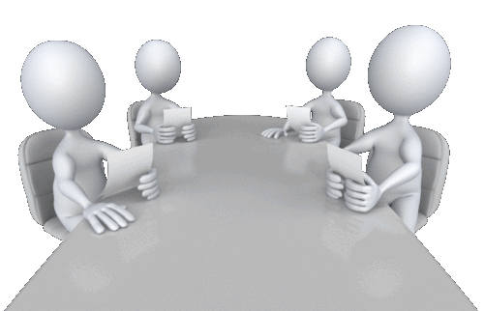
The Team Writing Dream
We’ll have a four person team and divide the work four ways. Each person will only have to write one chapter!
Chapter 3
Chapter 2
Chapter 1
Chapter 4

Slide 3
The Team Writing Dream
We’ll share a clear vision for the outline, and each chapter will integrate seamlessly into the larger whole. We will all write in a similar voice.
Chapter 3
Chapter 2
Chapter 1
Chapter 4

Slide 4
The Team Writing Dream
We’ll all understand our research question in the same way. We’ll see eye to eye on the models to use, the important literature, and research methods.

Slide 5
The Team Writing Dream
Everyone will work at a complementary pace and we can all spend the same amount of time on the project!
Ok!
No problem!
Let’s meet for 3 hours on Thursday evening!
I can do that!

Slide 6
The Difficult Realities

Slide 7
Everyone needs slightly different things from the thesis, so everyone adds a different dimension to the research design. Soon it is so complex that no one is sure how it all fits together.

Slide 8
Provide a history of relevant Joint Pubs!
Apply Mintzberg’s ideas and Chamberlain’s Theory of Strategy!
Assess three providers using
SWOT analysis!
Conduct a policy feasibility analysis for future options!
We need a thorough historical overview!
We need to provide a well-developed plan for the future!

Slide 9
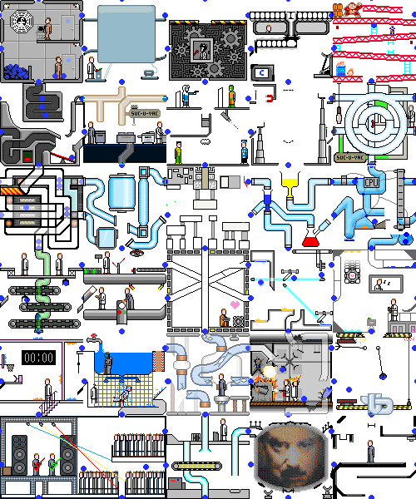

Slide 10
The technical specialist does all the lab work but then is hard to track down when his team members are doing the write up—and they don’t fully understand his notes, his methodology, or his findings!
OR
One team member has to get surgery that keeps him off his feet for weeks, but he doesn’t tell his team about it until a few weeks before he goes into the hospital.
OR
Some team members have completed all their coursework, while some are still taking a full load of classes during the final days of the project. The tasks that need to be done at any given time don’t match up well with the people who have the time to do them.
OR
One person is insecure about their writing ability and doesn’t want to do a lot of writing, but it isn’t clear what they are contributing to the team in exchange.

Slide 11

I’m having a complicated pregnancy!
I’m taking a full load of courses this quarter and you’re not!
I have to get surgery and won’t be able to walk for weeks!
I’m really bad at writing! And editing!

Slide 12
I’m having a complicated pregnancy!
I’m taking a full load of courses this quarter and you’re not!
???
I have to get surgery and won’t be able to walk for weeks!
I’m really bad at writing! And editing!

Slide 13
Each person has a dramatically different writing style and needs different kinds of editing and revision. The chapters work individually, but don’t make sense as a logical whole.
OR
One person writes really rough drafts, but can produce a lot of text very fast. Another person is a perfectionist but also a procrastinator!

Slide 14
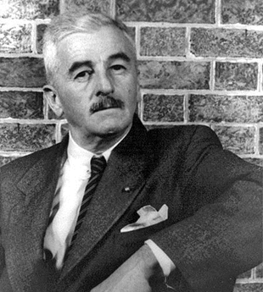

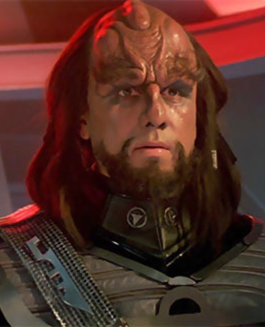
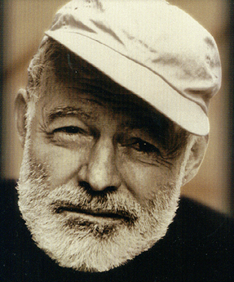
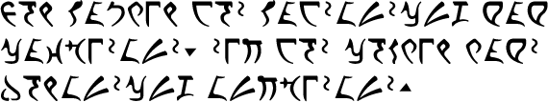
"He did not feel weak, he was merely luxuriating in that supremely gutful lassitude of convalescence in which time, hurry, doing, did not exist, the accumulating seconds and minutes and hours to which in its well state the body is slave both waking and sleeping, now reversed ….“*
“Me want cookie.”
"Manuel drank his brandy. He felt sleepy himself. It was too hot to go out into the town.“*

Slide 15
What makes group projects great? What makes group projects awful?

Slide 16
What makes group projects great? What makes group projects awful?
Great?
Delegating tasks means there can be less work for every individual.
Individuals can contribute based on diverse strengths and avoid tasks they hate.
Team members won’t be alone figuring things out and can problem-solve together.
Team members have a less isolated working experience with more opportunity for camaraderie.
Errors may more easily be caught because more people will be looking for them.
Awful?
Some people will do more work than others.
Having multiple researchers and writers creates tasks that solo writers don’t have.
No one agrees on research design or outline.
Groupthink hampers clarity and creativity
No one takes responsibility, or one person takes on more responsibility than everyone else.
Friendships are damaged by conflict or stress.

Slide 17
Who you don’t want to be:
The flake—You do less than your share, are undependable, or pressure the team to always take the easy path, even when it compromises your end result.
The spare wheel—You’re a marginalized and unnecessary member of the team, not contributing or allowed to contribute anything unique.
The bounty hunter—You feel like the only one who cares, and are forced to hunt down group members and their contributions.
The babysitter—Responding to chronic flakiness and poor work quality, you end up hovering over and micromanaging every action of your teammates.
The fixer—You find yourself, at the last minute, trying to weave together a bunch of incompatible parts.

Slide 18
The Basics:
DO plan for how your group should operate.
DON’T expect team management to “take care of itself.”

Slide 19
Tuckman’s Stages of Group Development
Forming
Storming
Norming
Performing

Slide 20
Forming
“orientation, testing and dependence”

Slide 21
During the Forming Stage:
Think about
  Team Composition: How many people are on your team, and who are they?
  Timeline: What are your shared expectations about your project’s timeline for completion?
  Tools: What tools will you need for team communication, data storage, and writing?

Slide 22
Team Composition – How many?
How many people will be on your team?
DO have the smallest possible team for the job you have to do:
  Partnerships, while not bulletproof, often work.
  Groups of four or more may lead to a white-knuckle ride through the final stretch.

Slide 23
Team Composition – Who?
Who are you working with?
DO use a self-inventory and team inventory to clarify strengths and weaknesses
  self-inventory, informal group discussion, or something more structured
Identify what opportunities and constraints exist based who is on the team
  Different graduation terms or course loads? Special skills? Personal issues? Personality traits? Strengths and weaknesses? Different backgrounds?

Slide 24
Belbin’s Team Roles
Resource Investigator Provide inside knowledge on the opposition and made sure that the team’s idea will carry to the outside world Strengths: Outgoing, enthusiastic. Explores opportunities and develops contacts Allowable weaknesses: Might be over-optimistic, and can lose interest once the initial enthusiasm has passed Don't be surprised to find that: They might forget to follow up on a lead | Teamworker Help the team to gel, using their versatility to identify the work required and complete it on behalf of the team. Strengths: Co-operative, perceptive and diplomatic. Listens and averts friction Allowable weaknesses: Can be indecisive in crunch situations and tends to avoid confrontation Don't be surprised to find that: They might be hesitant to make unpopular decisions | Coordinator Needed to focus on the team’s objectives, draw out team members and delegate work appropriately Strengths: Mature, confident, identifies talent. Clarifies goals. Delegates effectively Allowable weaknesses: Can be seen as manipulative and might offload their own share of the work Don't be surprised to find that: They might over-delegate, leaving themselves little work to do
Plant Tend to be highly creative and good at solving problems in unconventional ways Strengths: Creative, imaginative, free-thinking, generates ideas and solves difficult problems. Allowable weaknesses: Might ignore incidentals, and may be too preoccupied to communicate effectively. Don't be surprised to find that: They could be unorthodox or forgetful | Monitor Evaluator Provide a logical eye, making impartial judgments where required and weighs up the team's options in a dispassionate way Strengths: Sober, strategic and discerning. Sees all options and judges accurately Allowable weaknesses: Sometimes lacks the drive and ability to inspire others and can be overly critical Don't be surprised to find that: They could be overly critical and slow to come to decisions | Specialist Bring in-depth knowledge of a key area to the team Strengths: Single-minded, self-starting and dedicated. They provide specialist knowledge and skills Allowable weaknesses: Can only contribute on a narrow front and tends to dwell on the technicalities Don't be surprised to find that: They may have a tendency to focus only on their subject of choice
Shaper Provide the necessary drive to ensure that the team keep moving and do not lose focus or momentum Strengths: Challenging, dynamic, thrives on pressure. Has the drive and courage to overcome obstacles Allowable weaknesses: Can be prone to provocation, and may sometimes offend people's feelings Don't be surprised to find that: They could risk becoming aggressive and bad-humored in their attempts to get things done | Implementer Needed to plan a workable strategy and carry it out as efficiently as possible Strengths: Practical, reliable, efficient. Turns ideas into actions and organizes work that needs to be done Allowable weaknesses: Can be a bit inflexible and slow to respond to new possibilities Don't be surprised to find that: They might be slow to relinquish their plans in favor of positive changes | Completer Finisher Most effectively used at the end of tasks to polish and scrutinize the work for errors, subjecting it to the highest standards of quality control Strengths: Painstaking, conscientious, anxious. Searches out errors. Polishes and perfects Allowable weaknesses: Can be inclined to worry unduly, and reluctant to delegate Don't be surprised to find that: They could be accused of taking their perfectionism to extremes

Slide 25
Team Composition - Writing
Start to think about how writing tasks will be divided:
Discuss group members’ writing preferences, strengths, and weaknesses.
Don’t make quick assumptions about who should do “all the writing.”
  Writing involves many tasks and while one group member may have great prose style, another might be better at organizing information, or at proofreading and editing
During the thesis process, discuss early on whether you may want to hire an editor. If so, get references from TPO and recommendations from other students well in advance.

Slide 26
Team Composition - Extra Tips
DO test drive your working partnerships in advance on class papers or smaller projects if at all possible.
DON’T wait to remove team members or excuse yourself from a team when things don’t feel right.
If you’re in a position to choose, DON’T join a group when you really want total control over the end product.

Slide 27
Timeline – Finish Early!!!
What is the expected timeline for the project?
DO plan to finish early!
  Multiple authors automatically means more editing will be required.
  A team is less agile than a single author when responding to the unexpected.

Slide 28
Timeline – Planning for key events
Establish inflexible events in your group’s timeline.
  Graduation dates? Availability of data from outside sources? Travel, TTX, or other events upon which your project depends? Upcoming childbirth and sleeplessness? Briefs or presentations related to your project?
Define pre-completion goals and milestones, and when they should be accomplished.
  When should research be completed? When should the literature review (for example) be written? When should the first draft be completed and formatted?

Slide 29
Timeline – further questions
How often will you meet at the beginning, middle, and end of the project?
How much time do you expect to spend working independently versus in a collaborative mode?
Will you need to collaborate remotely? How will you do so?

Slide 30
Tools
What tools will you use to communicate and stay on the same page?
Where will your data be kept and how will it be accessed?
Will you depend heavily on group emails? Collaboration software?
Make sure everything is set up, works, and that all group members have access sooner rather than later.

Slide 31
Storming and Norming
“Resistance to group influence and task requirements” gives way to “in-group feeling and cohesiveness, new standards, and new roles.”

Slide 32
During Storming and Norming Stages:
Think about
  The role of conflict: handling dissent and criticism productively is critical
  Determining narrowed goals, scope, and approach
  Team member dynamics, building trust, and staying connected

Slide 33
The Role of Conflict
DO understand that conflict within your group can be disruptive but also may be necessary and productive.
Differing viewpoints and internal critique help:
  narrow your focus and scope,
  clarify your shared goals and research questions,
  anticipate problems with your methods and findings.

Slide 34
The Role of Conflict
DO respect the role of conflict and tension in making your end product better.
DO give quality feedback. Be respectful. Be patient. Observe both the positive and the negative in what others offer.
DON’T be overly attached to the details, but do stick to your guns when it really matters. Sometimes knowing the difference is a challenge. Be ready to “Let it go!”
DON’T try to quash or avoid conflict before it has had a chance to make your project better. When productive tension is stifled or buried, projects end up bloated, unfocused, sprawling, and hard to finish.

Slide 35
Deciding Goals, Scope, Approach
Disagreements may arise about what the project’s goals are, what to include and exclude, and how to approach the material.
  May agree about the broad topic, but disagree about what smaller piece to tackle or the priorities of the project
  May bring different academic backgrounds and expectations about methods, approach, or rigor
  May differ in level of concern about the interests of outside stakeholders

Slide 36
Deciding Goals, Scope, Approach
Many roads lead to Rome. Sometimes there really is no single best way to structure your project.
  Pick a path that will work and follow it.
Avoid the “clown car” phenomenon, which occurs when too many methodological models or frameworks are incorporated into a project.
  Just say no! Let them go!

Slide 37
Team Dynamics
DO work as a team from the very beginning and keep lines of communication open.
Sometimes team members attempt to avoid conflict by dividing tasks and content and going their separate ways prematurely.
Trying to fuse divergent content or bridge conceptual gaps after much work has been done can be difficult, demoralizing, and damaging to relationships.

Slide 38
Performing
“…interpersonal structure becomes the tool of task activities. Roles become flexible and functional, and group energy is channeled into the task.”

Slide 39
During the Performing Stage:
Think about
  Establishing your team as a unique mechanism with a unique rhythm
  Balancing working independently with working collaboratively
  Bringing it all together

Slide 40
Establishing Team Rhythm
Your team is a unique machine composed of a specific set of components (i.e. group members).
Synergy: the interaction between two or more agents leading to a combined effect greater than the sum of their separate effects.
Your team may not be perfect, but it has key strengths. At the performing stage you should know what these strengths are and how to leverage them.

Slide 41
Working Independently and Together
Establish your team’s particular rhythm for working independently and together
All parts of the writing process done together
All writing done together, in person
Planning and editing done in person, writing done in pairs
Planning and editing done in person, writing done alone
One or two writers, with comments from others
One primary writer, with comments from others
More in-person collaboration
Less in-person collaboration

Slide 42
Working Independently and Together
Different parts of thesis writing: separately or together?
  Pre-writing and brainstorming?
  Thesis proposal and first chapter?
  Literature review and background research?
  Methodology? Analysis?
  Recommendations and conclusion?
  Final editing, revising, and formatting?

Slide 43
Working Independently and Together
How could your hypothetical team approach the division of work for the hypothetical project described below?
Why: DOD seeks to optimize future combined training exercises between two organizations.
What: This project will assess the effectiveness of combined training exercises that took place between 2012-2015.
How: First, the team will use two existing theoretical frameworks to develop a new model for measuring the effectiveness of these events. Second, after developing the new model, the team will apply the model to review the details of each exercise from 2012-2015. Finally, the team will provide recommendations based on the findings.

Slide 44
Bringing it All Together
The challenge of arriving at a uniform voice is often a concern in group writing. There are no quick and easy steps for achieving it.
  Build trust in advance and then bank on it.
  Don’t second guess or micromanage your team.
  Sometimes there’s no substitute for time spent working together face to face.

Slide 45
Questions?

