Slide 1


Introduction to Graduate School Writing and Research
Dr. Sandra Leavitt
Director, Graduate Writing Center
and Thesis Processing Office
Chair, Generative AI Task Force
Spring 2024
Graduate Writing Center
Naval Postgraduate School
Notes:
There are generally two ways to approach the risk of plagiarism—1) with paralyzing fear and a stern warning not to do it, or 2) with confidence, gained by learning how HOW to use sources to look smart and be smart.
Indeed, incorporating source material into your own work is one of the best ways to look and be smart in academia. It is NOT something to fear.
It's not just smart, it’s an expectation.
If you master how to incorporate sources, then YOU will produce work that is
—easier to produce
—higher quality
—and looks better

Slide 2




Four Main Takeaways
New Expectations
Military vs. Academic Writing
The Research Process
Paradox: Quality Sources Produce Original Work

Slide 3


1. Expectations
“Do you agree?”
“Why or why not?”
We expect to hear you.
Learning and research are “organic.”
You need new relationships.
You will strengthen your intellectual skillset:
  Mental agility • Reason • Perspective
  Precision • Integrity • Communication

Slide 4
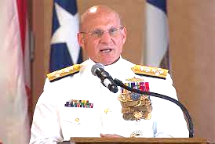
“Seek clarity and understanding.
Trust and effective
communications—
absolute necessities in combat—
must be developed and perfected
in times of peace.”
CNO, Adm. Mike Gilday,
The Charge of Command, Jan. 2022

Slide 5

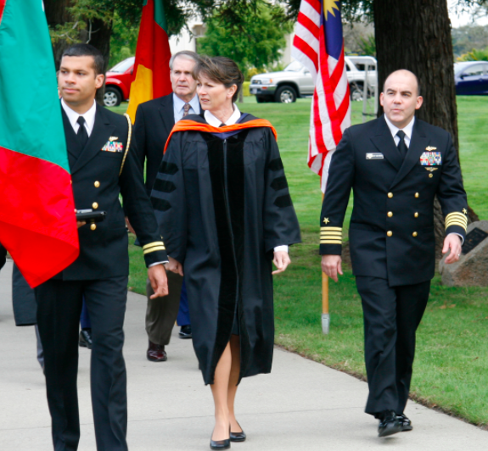
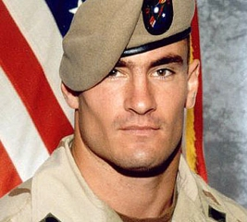

2. Military and Academic Writing Are
Similar and Different
Purpose
Structure
Style

Slide 6
Military Writing
Similar
Different
Academic Writing
Share knowledge to…
get aligned, make decisions
Describe
  Convey orders, objectives, processes
  Record discussions, data, decisions
Persuade with evidence, authority, ethos
Share knowledge to…
educate, debate, discover
Explain
  Explore how and why for new insights, inventions
  Encourage thinking and experimentation
Persuade with evidence,
logical argument, res. integrity
Purpose

Slide 7
Similar
Different
Military Writing
Academic Writing
Standard forms, sentences
“BLUF”
  Topic, scope
  Recommendations
Body
  Relevant facts, known
  Competing solutions
  Hide “behind the scenes” methods and thinking
Standard sections
“BLUF”
  Topic, scope
  Findings
Body
  Relevant facts + unknown
  Competing explanations
  Show and explain
  methods and thinking
Structure

Slide 8

Military Writing
Academic Writing
Accurate
Clear
Concise
Free of grammatical and mechanical errors
Accurate
Clear
Concise
Free of grammatical and mechanical errors
Style Similarities
Good writing is clear thinking made visible.
~Robert Wheeler

Slide 9

Military Writing
Academic Writing
Brevity
Overcapitalization
Mountains of acronyms
Institutional voice︎
Few sources
Even fewer citations
Thoroughness
Capitalization “proper”
Acronym light
Unique voice
✑ ✑ ✑ ✑ ✑
Many sources
Many citations
Style Differences

Slide 10

3. The 4-Phase Research Process
MORE SOURCES
SOME WRITING
MORE ORIGINALITY
MORE WRITING
Write up & Share
Analyze
Hunt & Gather
Research Question
Repeat

Slide 11

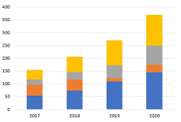



Look for or Create…
Write & Share
Outlines
Drafts
Finals
Analyze
Tables
Charts
Statistics
Process tracing
Hunt & Gather
Theories
Methods
Data
Tests
Explore Questions
Puzzles
Intros
Conclusions

Slide 12
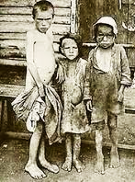
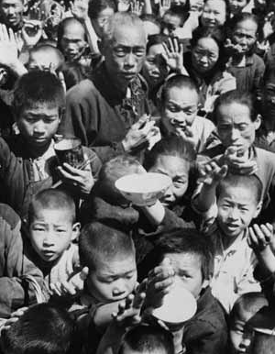
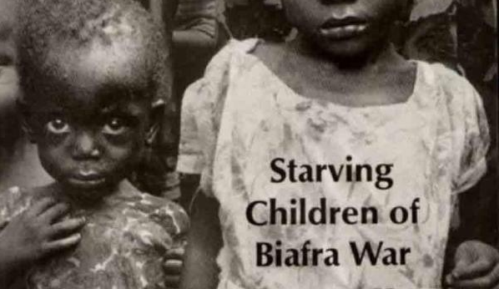
Famine: Weapon or Feature of Conflict?
Ukraine Famine
1932–33
Holodomor:
Intentional “death
by hunger”
4 million died
China
1958–62
Great Leap
Forward
40–60 million
died
Appling the Research Process
Nigeria Civil War
1967–69
Military blockage
100,000 combat deaths vs.
1.5 million starved to death
Yemen Civil War
2017–18
Military blockade
50,000 starved to death

Slide 13
Famine: Weapon or Feature of Conflict?
Res. Question
Hunt & Gather
Analyze
Why do famines happen?
    What have others studied? How?
    What happened, where and when?
    By whom, to whom? How?
What context
do we need?
How have others explained famines?
  Theoretical explanations direct you to potential causes to study
  Natural disasters
  Poverty levels
  Logistical issues
  Int’l responses
  Conflict strategy
  Govt policies
What do
your data
tell you?
Can you explain
your logic?
Where do your results fit with others’? Expand our knowledge?
Why do govts implement policies that cause famine?
Appling the Research Process
Write & Share

Slide 14
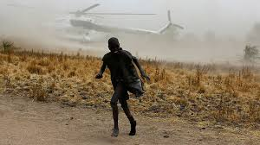
Why do governments implement policies that cause famine?
Possible Explanations
Intentional (Weapon)
  Coercion, submission, capitulation
  Punishment, retaliation, genocide
  Military tactics
    Sieges
    Blockades
Unintentional (Feature)
  Weak states
  War disruptions
  Blocked migration
  Limited aid
  Economic crises
  No strategic interest
Appling the Research Process

Slide 15




4. How sources support your work
By consuming existing knowledge…
  Save time
  Discover
  additional sources
  Increase accuracy, quality

Slide 16



To become a warrior-scholar…
  Model academic norms
  (style, structure, purpose)
  Show you know what
  they know
  Transfer source
  reputations to yourself

Slide 17


For positive reputation transfer, seek
  Established theories, concepts, and definitions
  Transparency about methods and scope
  Citations
  Reputable organizations, publishers, speakers,
  and researchers
        Seek peer-reviewed, academic presses, and other trusted institutions (.edu, .gov, .org, .mil)
        Be alert to bias!
        Think critically, check carefully

Slide 18






Today’s Key Take Aways
New Expectations
Similarities and Differences
Hear from YOU
The Research Process
Quality Sources

