Slide 1


Graduate Writing Center
Naval Postgraduate School
Plagiarism Prevention
Using Sources in Your Researched Writing
12 April 2024
Aileen B. Houston
Deputy Director, Graduate Writing Center

Slide 2



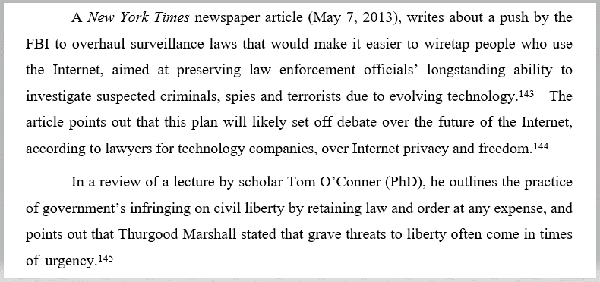
DO YOU SPY
PLAGIARISM?
Essential Rules

Slide 3
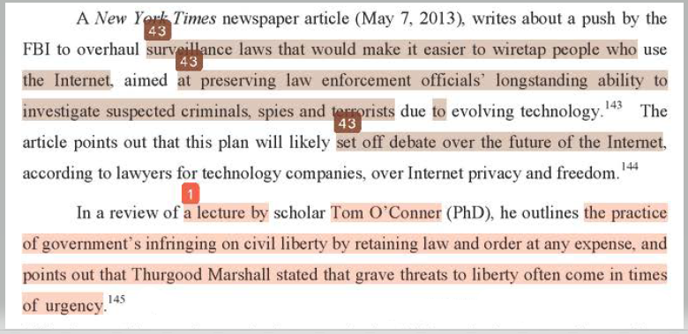
DO YOU SPY
PLAGIARISM?

Slide 4

Plagiarism Prevention | Definitions and Expectations
THE NPS HONOR CODE
Plagiarism
“The use of words, information, insights, or ideas of another without crediting … through proper citation.”

Slide 5
DO YOU SPY
PLAGIARISM?

Slide 6
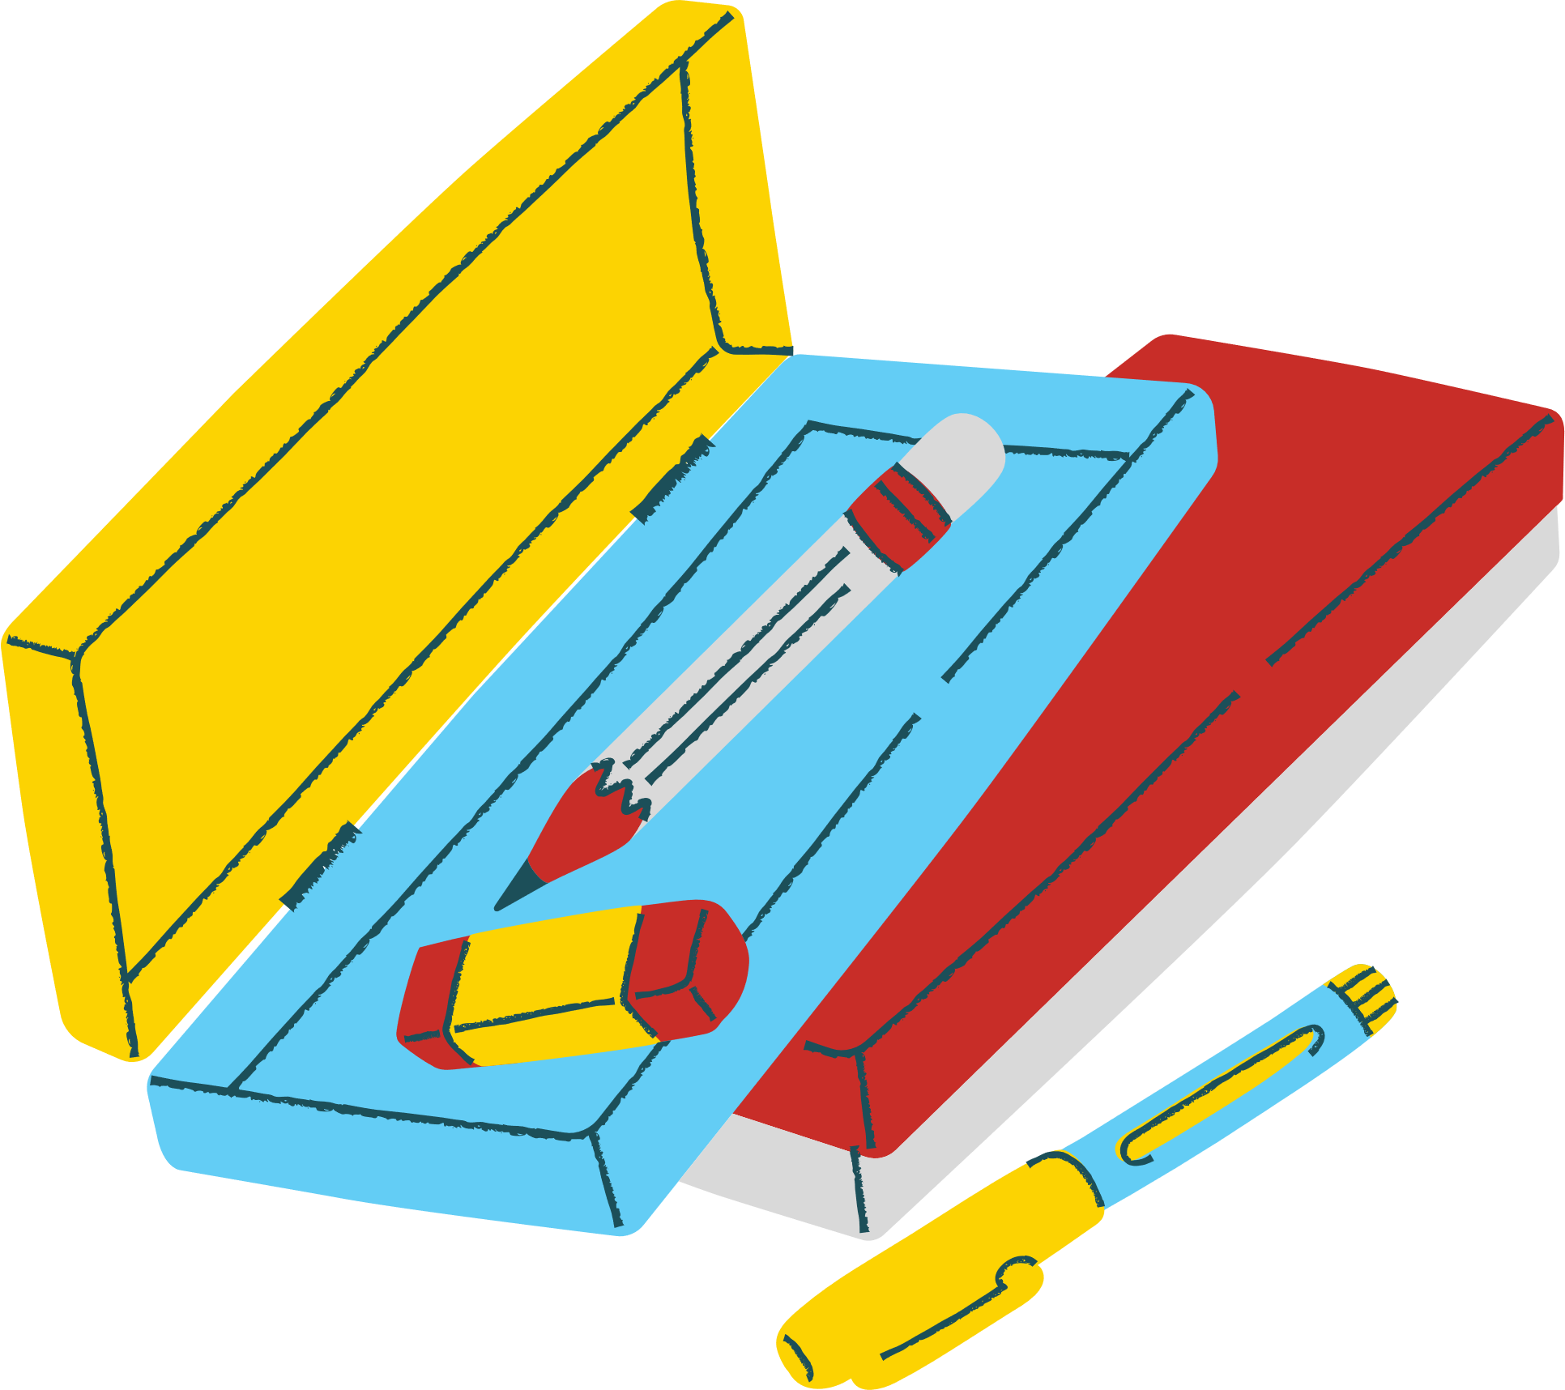
Plagiarism Prevention | Overview
OVERVIEW
2 topics
  Definitions and Expectations
  Conventions
2 goals
  Avoid unintentional plagiarism
  Think critically about source use
1 follow-up
  Full info online

Slide 7


DEFINITIONS &
EXPECTATIONS
Plagiarism Prevention: Using Sources in Your Researched Writing

Slide 8


Plagiarism Prevention | Definitions and Expectations
WHAT IS PLAGIARISM?
Intent
Expectations
Definition
“The use of words, information, insights, or ideas of another without crediting … through proper citation.”
-NPS Honor Code
“Unintentional plagiarism, or sloppy scholarship, is academically unacceptable; intentional plagiarism is dishonorable.”
-NPS Honor Code
Don’t: be sloppy
Don’t: be dishonorable
Do: learn conventions
Do: be strategic

Slide 9




Plagiarism Prevention | Definitions and Expectations
WHAT IS ATTRIBUTION?
“Fully and openly crediting all sources used”
Attribute source material properly = avoid plagiarism

Slide 10


Plagiarism Prevention | Definitions and Expectations
WHAT DO I ATTRIBUTE?
Cite:
ideas, data, images, and words
that are not your own
Don't cite:
your own ideas and findings,
common knowledge for your readers
Distinguish between source evidence and
your own input and thoughts

Slide 11
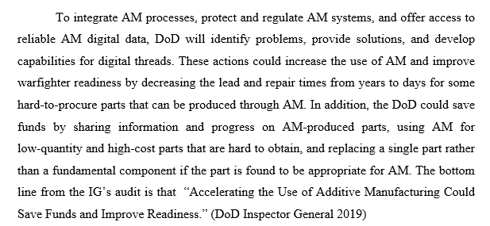
CAN YOU SPY
MISSING ATTRIBUTION?
MINE
MINE
Essential Rules
MINE
SOURCE

Slide 12
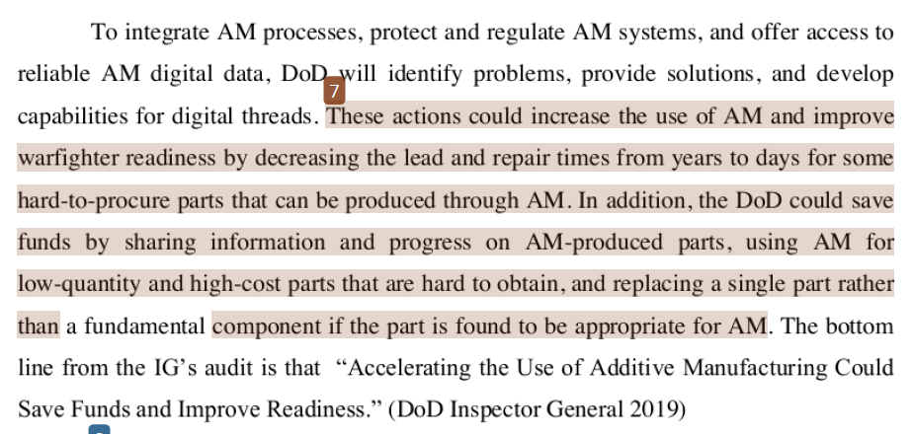
CAN YOU SPY
MISSING ATTRIBUTION?
MINE
MINE
SOURCE
MINE
SOURCE
SOURCE

Slide 13
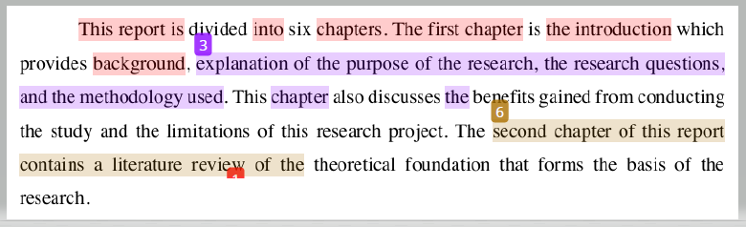
CAN YOU SPY
MISSING ATTRIBUTION?

Slide 14
CONVENTIONS
Plagiarism Prevention: Using Sources in Your Researched Writing

Slide 15
Plagiarism Prevention | Conventions
CITATIONS &
SIGNAL PHRASES
Signal that information has been borrowed from a source
Citations
Signal phrases
Differ by style
Match source in reference list
Signal source without citation
Show continued use of source
Use variety
In [13] and [14]…
Lim’s 1999 study revealed...
(Li & Sanchez, 2019)
Recent reports disagree.⁸⁹
Their research illustrates...
Lim also examined...
As the article suggests...
According to the website...
Citations
+
Signal phrases
+
Sentence flow

Slide 16
CAN YOU SPY
MISSING ATTRIBUTION?
MINE?
SOURCE
SOURCE
SOURCE

Slide 17
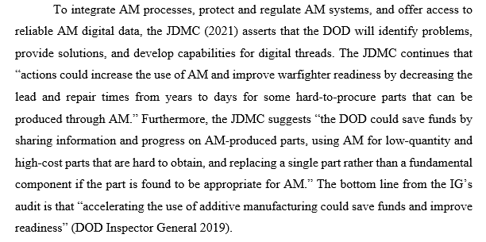
REVISED
X

Slide 18
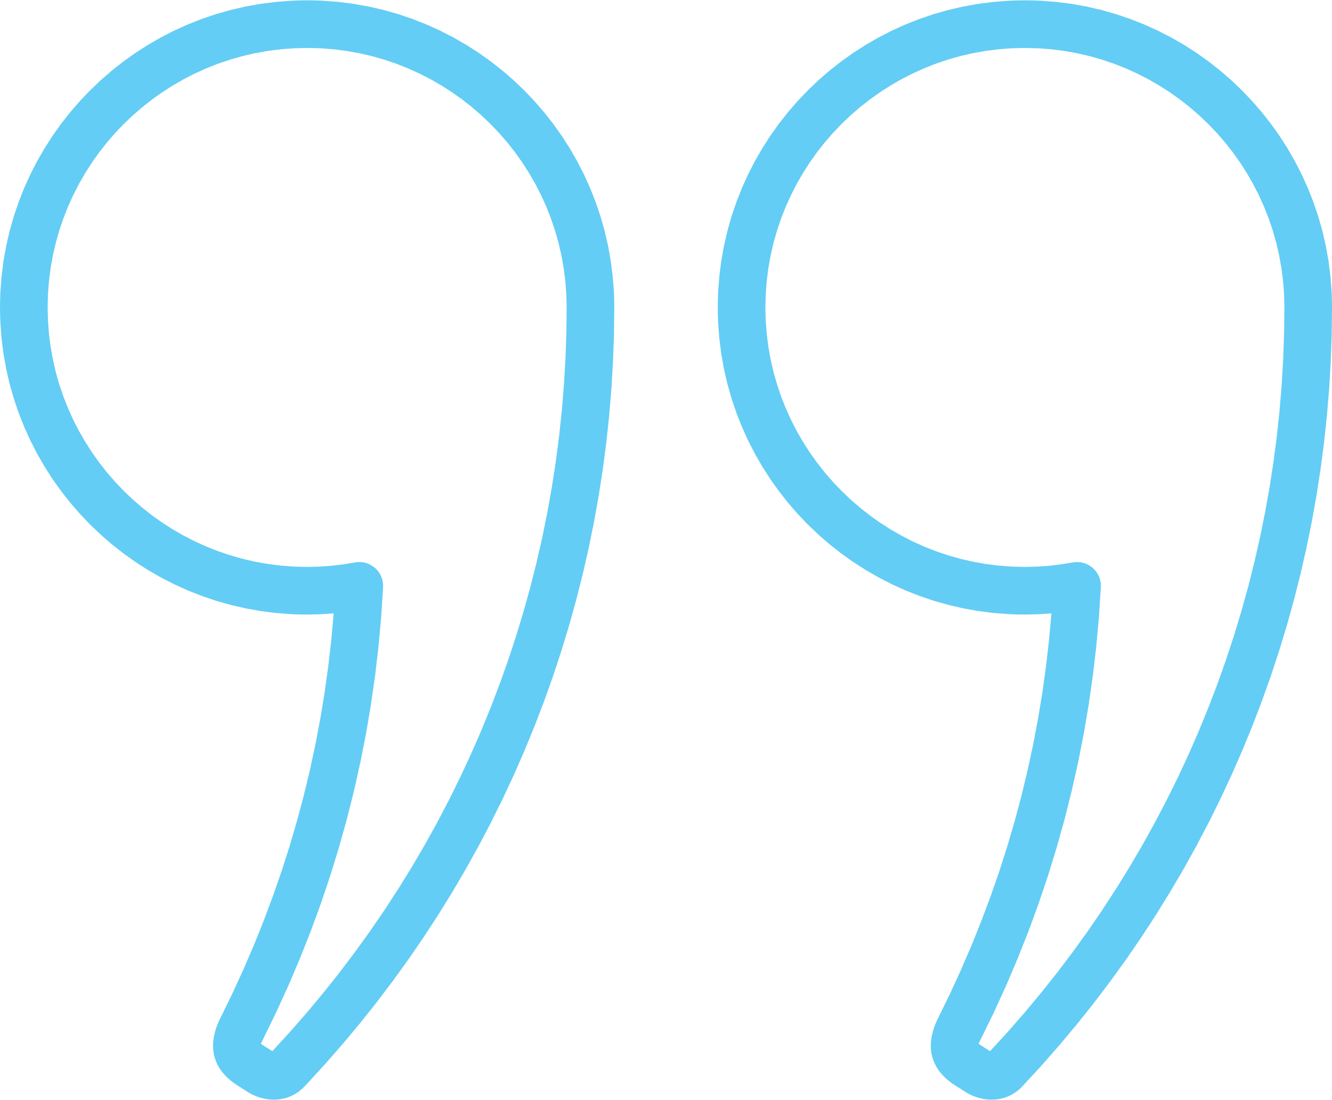

Plagiarism Prevention | Conventions
DIRECT QUOTATIONS
Borrowed language
Noteworthy
“Quotes” for ~5+ words
Can be said differently
Citation = credit for idea
Quotes = credit for words
  Don't quote: proper nouns, key terms, common phrasing, highly technical (equations)
Use sparingly
Precise or historical wording (definitions, legal)
Know your field’s norms
  Quote: passage is clear and brief; passage is powerful; passage is important

Slide 19



Plagiarism Prevention | Conventions
PARAPHRASING
Summarizing
Paraphrasing
Patchwriting
Source / idea as a whole
Shows you understand the bigger picture
Requires a citation
Summarize to: generalize detailed or lengthy information.
Source concept, your words
Context of your argument
Proper nouns / key terms
Requires a citation
  Paraphrase when: the source is complex or you can explain your own way.
Small changes
Same sentence structure
  Do not patchwrite
  in a final paper.

Slide 20
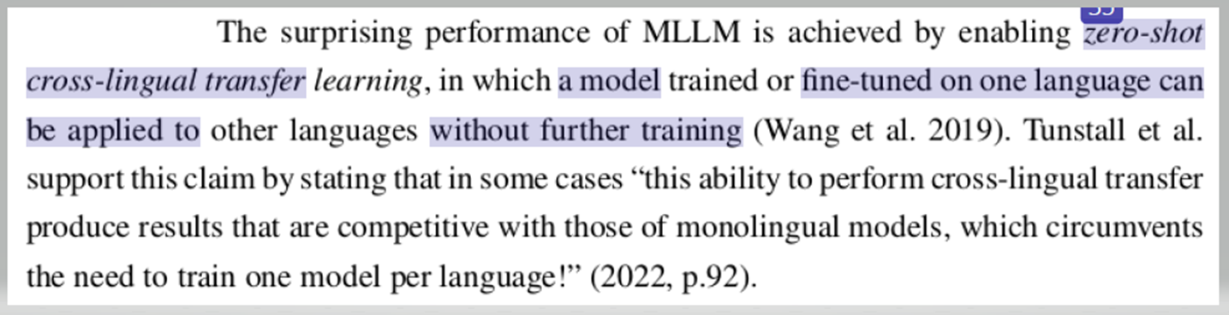
CAN YOU SPY
MISSING ATTRIBUTION?

Slide 21
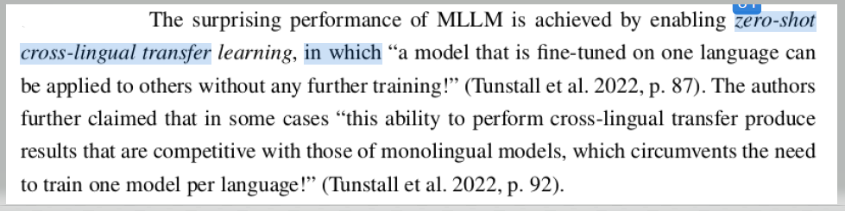
REVISED

Slide 22


Plagiarism Prevention | Understanding Sources
TAKE NOTE
In your notes:
From the source
Your response or idea
“Borrowed phrases, sentences”
Reference information

Slide 23
writingcenter@nps.edu
More info online
nps.edu/web/gwc/quick-clips-and-tips#plagprevention
Step 1: Resources
Step 2: Games
Step 3: Profit?

