Slide 1
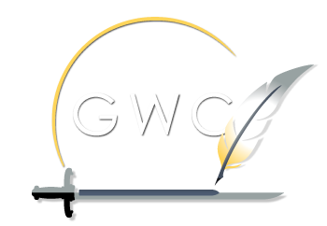

The Writing Process
Kate Egerton, PhD
(contractor)
April 12, 2024
Graduate Writing Center
Naval Postgraduate School
Notes:
Hi.

Slide 2
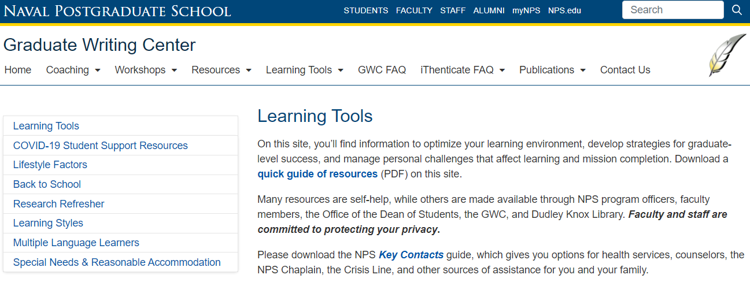
Learning Tools
Each learner is different
You are probably not the same student
you were before
Notes:
First, let me point to a handout in your packet. Learning Tools is an initiative of the GWC and others on campus to help you optimize your learning environment. Think about who are you now, versus the last time you were a student:
New discipline?
New experiences?
New life, responsibilities?
New medical issues that might affect your learning?
We want you to succeed, and we want you to be aware of the resources, including the possibility of accommodations.
This handout guides you through the Learning Tools section of the GWC website, and gives you an overview of the tools available there.

Slide 3
Expert writers:
Embrace the writing process
Practice writing early and often
Write to learn before writing to explain
Notes:
Here’s what I’m going to cover today on the writing process:
The writing process, and how it will help you succeed,
The virtues of practicing this process, especially when you’ve not been a full-time graduate student writer recently,
How writing to learn is different from writing to explain.

Slide 4
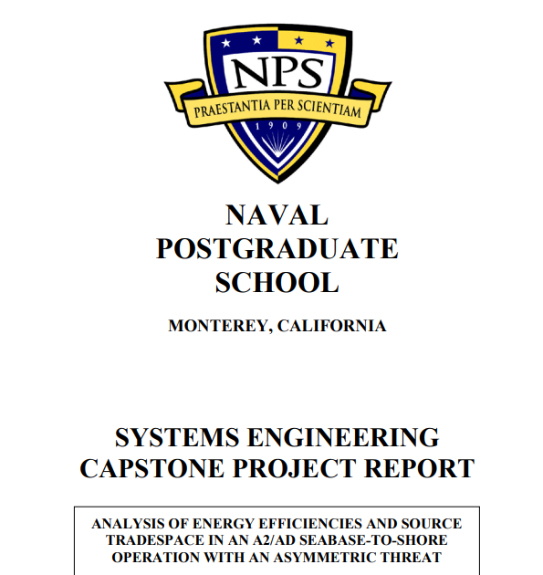
Notes:
Here at NPS, the most significant writing most students produce is the thesis, or capstone, and the time to start building skills for that project is . . . right now.

Slide 5
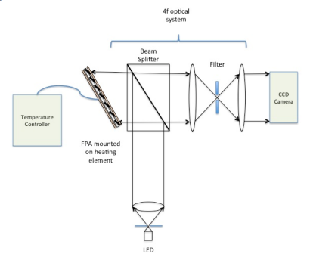
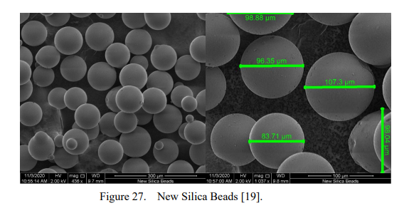
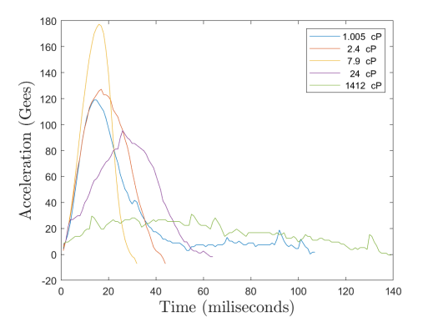
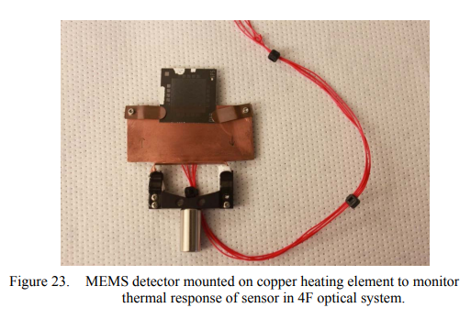
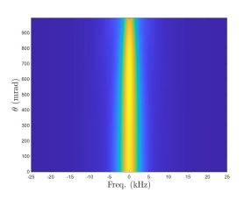
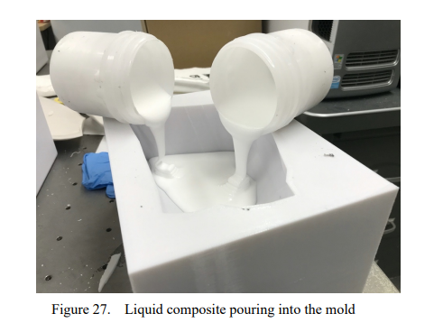
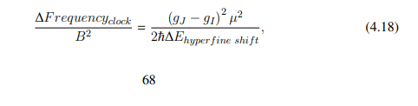
Notes:
Here at NPS, the most significant writing most students produce is the thesis, or capstone, and the time to start building skills for that project is . . . right now.

Slide 6
I would use numbers on this first slide. Then you can go without. But it helps ground them. Heck, they’re used to numbering paragraphs. It’s in their comfort zone.
1. Invent
Writing to learn
2. Draft
3. Revise
Writing to explain
4. Edit
5. Finalize
Ready to deliver
Notes:
So let’s dig into the Writing Process.
If you aren’t accustomed to thinking of yourself as a writer, it’s easy to buy into the popular illusion that expert writers don’t use any steps at all. How lovely to think that the words of whatever you’re reading just spilled out in that exact order, overflowing from someone’s brain with no effort whatsoever.
On the contrary, expert writers understand the import of each step.
That comes with practice.

Slide 7
Start before you are really ready
Stop before you are really done
Repeat
—Robert Boice
Notes:
That’s what makes this one piece of advice from Robert Boice (psychologist, procrastination researcher, and mentor to new academics like yourselves) so useful.
Write before you are ready, and at any given work session, stop before you think you are done. Then repeat. Build writing time into your daily schedule. 10 minutes is a LOT better than nothing. 5 minutes is, too.
The “stop before you think you are done” part is like not exercising to exhaustion every time you go out for a morning jog. Set yourself an appointment (and a reasonable goal), work for that time, and then stop while you still have some momentum (or just because your clock has run out).
Consider spending the last minute of a writing session making yourself some notes about what you would do next, IF you were going to keep working. These should be small, concrete steps, so that when you return to work, you’ve given yourself discrete tasks to do first.

Slide 8
Invent
Writing to learn
Draft
Revise
Writing to explain
Edit
Finalize
Ready to deliver
Notes:
Invention, also known as pre-writing, is almost anything that allows you to think on paper, and usually in a form that’s distinct from how the finished product will look. Journaling is good. Scribbling on the backs of envelopes works. If you like early outlines, do those, too.
The key is that pre-writing must be low-stakes and done early enough that you’re not staggering under an imminent deadline.
It can also be done in short increments, often 5-10 minutes at a time.

Slide 9
Generative AI at NPS
Build your AI Literacy – Generative AI Resources Hub on Teams
Consult Generative AI Guidance for all citation styles at Dudley Knox Library
Follow the Official Guidance from the Provost’s Office
Notes:
Invention, also known as pre-writing, is almost anything that allows you to think on paper, and usually in a form that’s distinct from how the finished product will look. Journaling is good. Scribbling on the backs of envelopes works. If you like early outlines, do those, too.
The key is that pre-writing must be low-stakes and done early enough that you’re not staggering under an imminent deadline.
It can also be done in short increments, often 5-10 minutes at a time.

Slide 10
Invent
Draft
Writing to learn
Revise
Writing to explain
Edit
Finalize
Ready to deliver
Notes:
Drafting flows from pre-writing once you’ve figured out the question that needs answering today. Your THESIS STATEMENT is, in a compact form, the ANSWER to that question. Faculty will sometimes provide you with a question, but often they won’t—you have to come up with it yourself.
The main point of drafting, like pre-writing, is to generate text and to get the words from the inside of your head onto a page. Any page. If that means speech-to-text software, or legal pads, or a close, personal relationship with your laptop, that’s all great.
Here’s a cardinal rule, though—keep moving forward. Minimize deleting, resist the temptation to review right now, and for the love of god don’t edit so long as the task at hand is drafting.

Slide 11
Perfectionism is the voice of the oppressor, the enemy of the people. It will keep you cramped and insane your whole life, and it is the main obstacle between you and a shitty first draft.
−Anne Lamott
Notes:
Early drafts are, and should be, kinda ugly.
Shitty, even.
Do not—DO NOT—let the perfect be the enemy of the good.

Slide 12
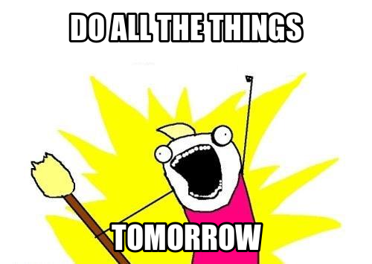
Adapted from: Allie Brosh, http://hyperboleandahalf.blogspot.com/2010/06/this-is-why-ill-never-be-adult.html
Notes:
Most of us, me included, are pretty great at waiting to draft, at deciding that I can’t possibly start writing right now because of any number of excellent reasons, headlined by
“I’m just not in the mood.”

Slide 13
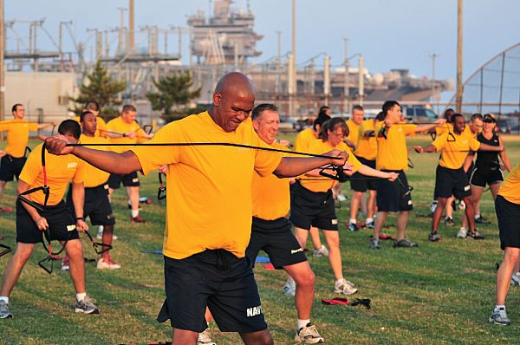
100623-N-1688B-064 NORFOLK (June 23, 2010) Command Master Chief Keith Mahaffey, assigned to the guided-missile cruiser USS Monterey (CG 61), participates in the commissioning of the Navy Operational Fitness and Fueling System (NOFFS). NOFFS is the Navy's new physical fitness program that is designed to give an all around workout while reducing physical training injuries. (U.S. Navy photo by Mass Communication Specialist 2nd Class Matthew Bookwalter/Released)
Notes:
That that excuse doesn’t work any better in the library than it does in the gym.
You don’t put off training for a marathon, or even for your next physical fitness test, and you shouldn’t put writing off, either.
Build your writing habits like you plan your physical training—I’m not in the mood to go to hot yoga class. I went yesterday. I’ll go tomorrow. Tough cookies, self—go anyway. Now.

Slide 14
Invent
Draft
Writing to learn
Revise
Writing to explain
Edit
Finalize
Ready to deliver
Notes:
Where are we? Woah—still drafting. That’s ok!
Here’s a cardinal rule, though—keep moving forward. Minimize deleting, resist the temptation to review right now, and for the love of god don’t edit so long as the task at hand is drafting.
When you edit early, you fix sentences that aren’t going to serve your final product, and having fixed them, you get attached, like bonding with a stray puppy when your kid is horribly allergic to dogs. Then you cling to the pup even when you know you shouldn’t, and you can see where this is going.
Microsoft Word, aggravatingly, seems to encourage editing early, and by early, I mean every damn second.
Attending immediately to each squiggly line is also a terrific way to never get to the next sentence at all. If, back when you were a kid, you were traumatized by red-pen wielding maniacs, this can really be a problem.

Slide 15
When you draft, try starting somewhere in
the middle
Choose something you already understand that your reader needs to know
Cite as you go, keeping track of which words, ideas, and data belong to whom
If you get stuck, skip to another subtopic within your project and start another paragraph
Notes:
So what SHOULD you do while drafting (if not edit)?
This stuff (on list)

Slide 16
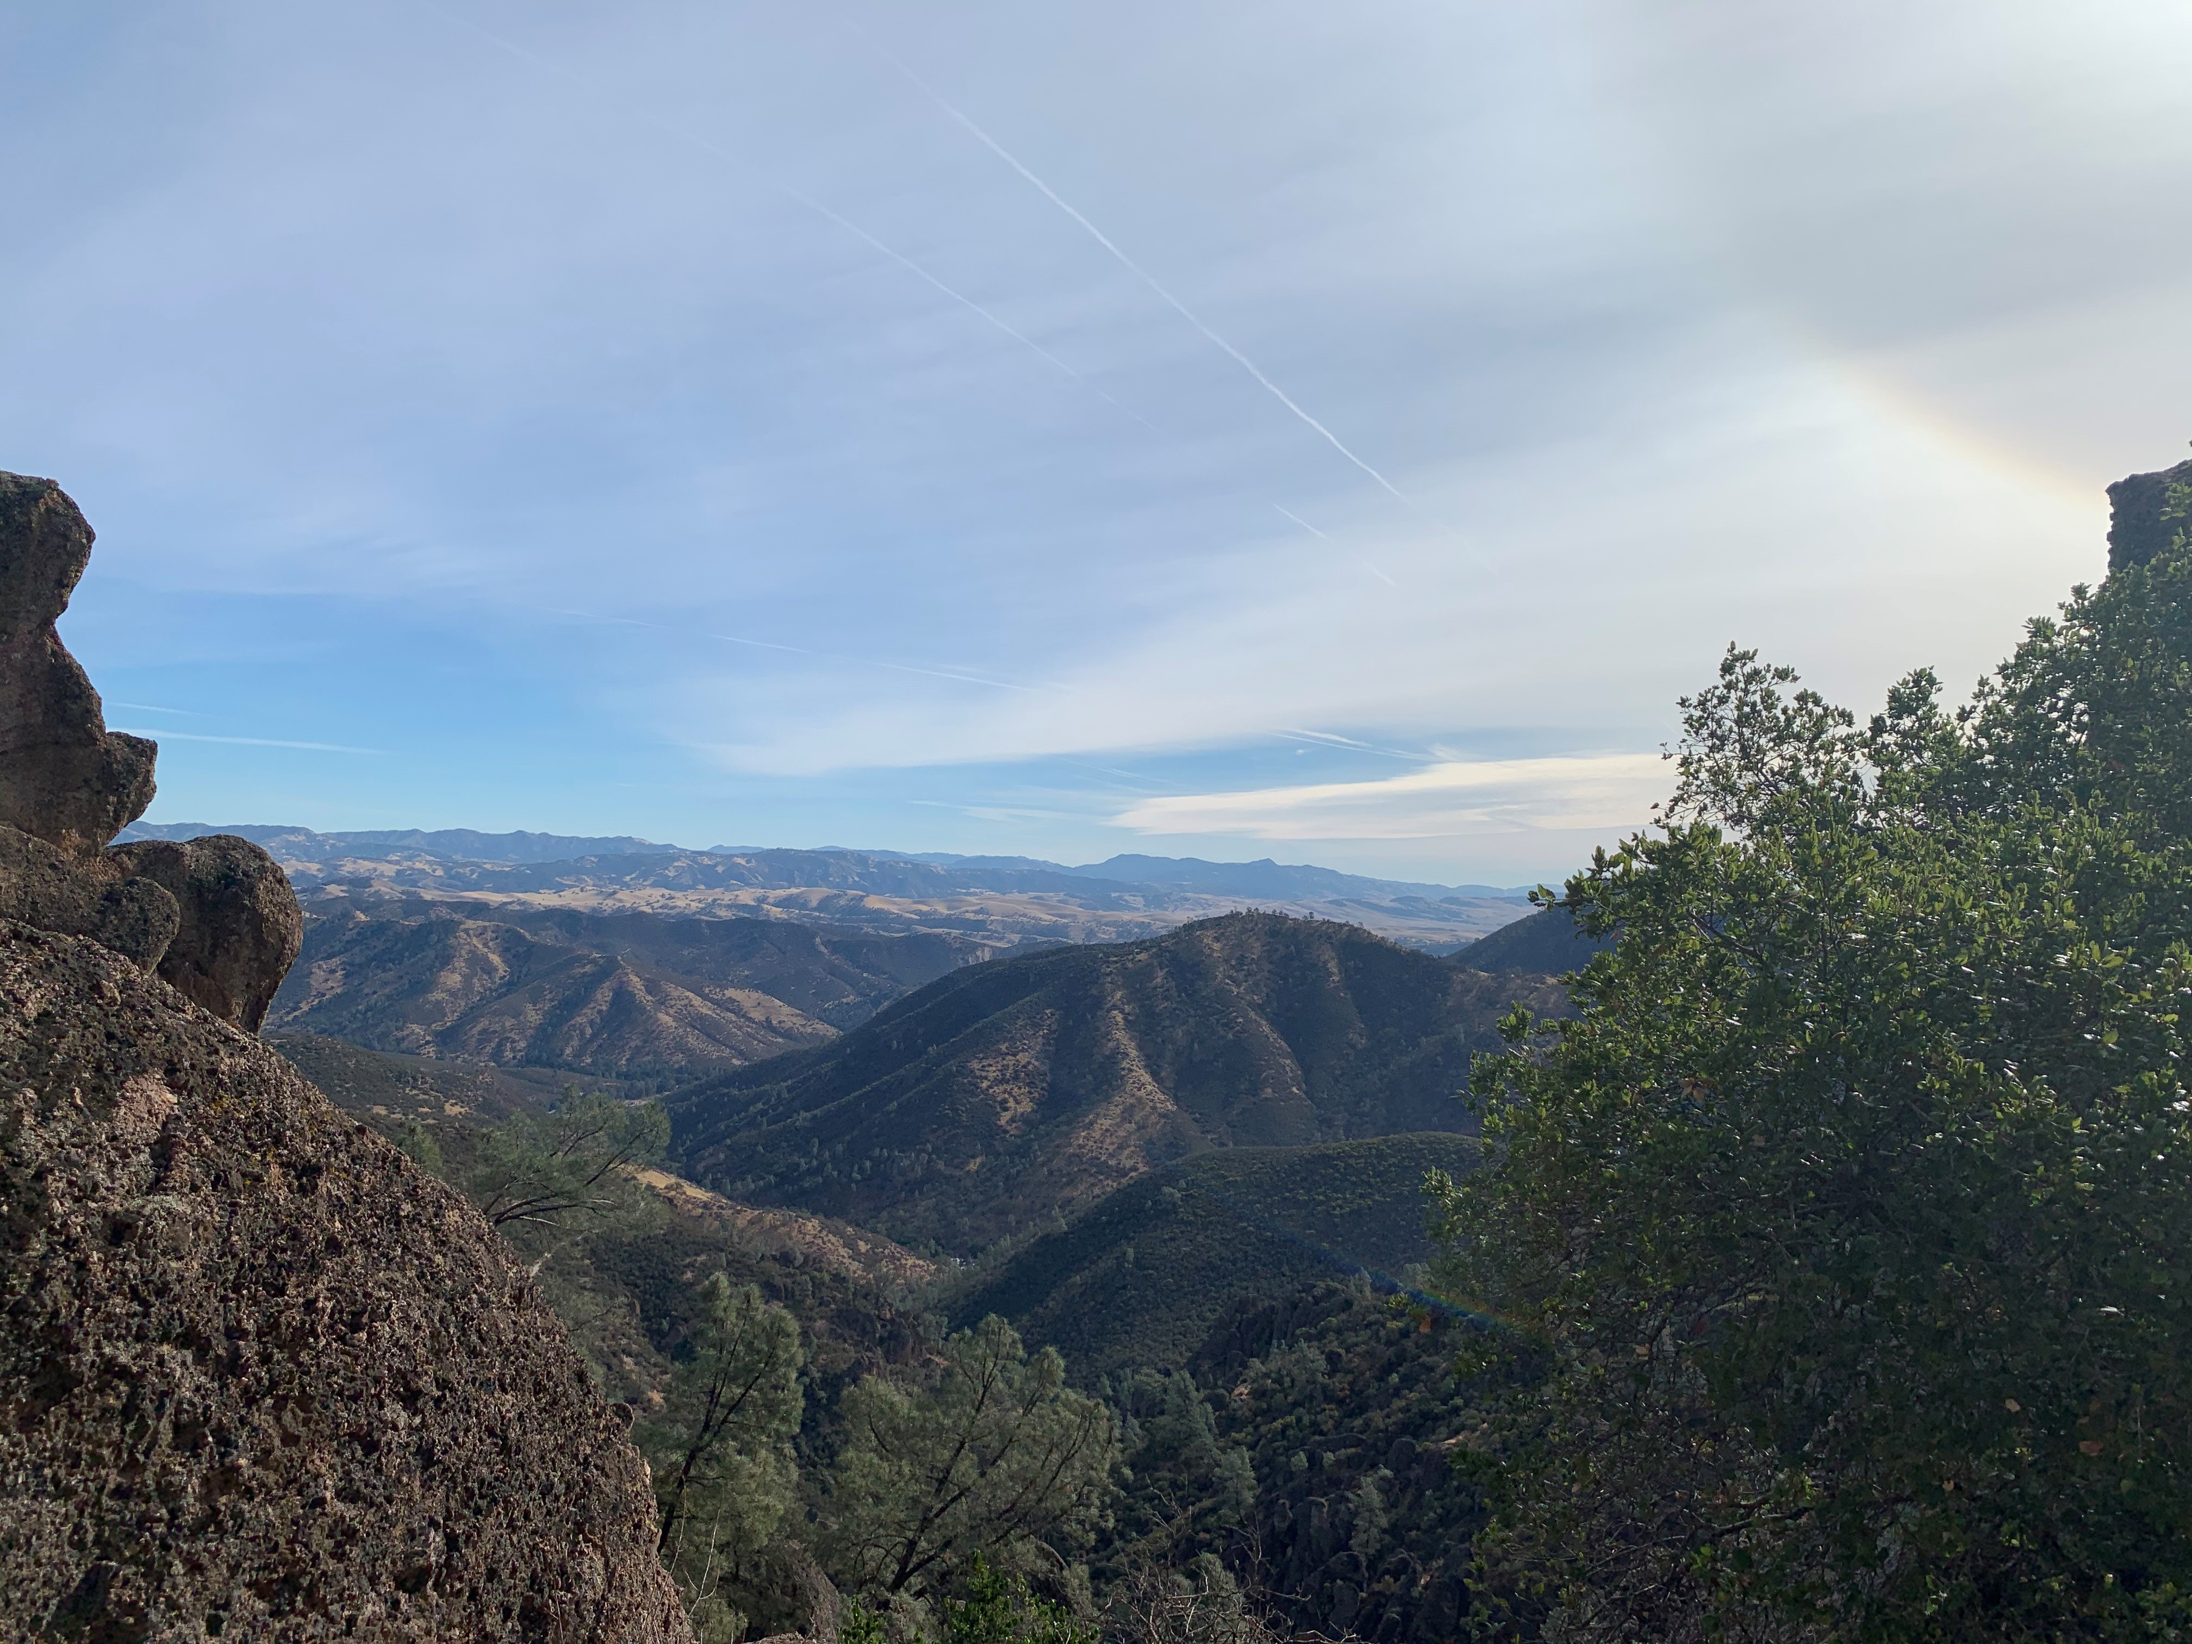

Notes:
Go hiking at Pinnacles National Park, just across the Salinas Valley.
Failing that, hang out with your family, change the oil in your car, go for a run, do a problem set, or get some sleep. When you come back, your draft will still be there.
I promise.

Slide 17
Invent
Writing to learn
Draft
Revise
Writing to explain
Edit
Finalize
Ready to deliver
Notes:
OK, NOW it’s time to revise.
Revise as a word, implies “re-seeing,” and more specifically, “re-examining,” which is why you need fresh eyes to do it well. This is the time to ask questions like “so my point here really is?” and to reassess both the evidence you’ve gathered and the analysis you’ve created in the service of your specific argument.
Here are some useful steps: (next)

Slide 18
Highlight (or write, if it’s missing) each paragraph’s topic sentence
Quickly outline your draft and audition changes
Fill gaps and kill repetition
Revise your thesis and place it front and center—what have you proven?
Now write (or revise) the introduction that sets up that thesis and a “so what, here’s why” conclusion
Notes:
In NPS course papers, as in many professional writing situations, you will be implored—over and over again—to put your Bottom Line Up Front (BLUF). That means the thesis goes on page one.
Remember, writing in graduate school is the big tool you use to solve a problem when lesser tools won’t work, and if you already knew the answer to your question before you struck the first key, you might be shooting squirrels with a grenade launcher.
I promise that the thesis statement you write during revision will be better than the one you took a shot at earlier. And before you take a crack at revising the thesis currently sitting in your introduction, read the last page of the paper and look to see if, just perhaps, there’s a GREAT thesis statement hanging out on the last page. Quite often, there is, ripe for the plucking.

Slide 19
Invent
Writing to learn
Draft
Revise
Edit
Writing to explain
Finalize
Ready to deliver
Notes:
Ok, so now you have revised. You have a strong thesis, stated clearly up front where your BLUF-seeking reader wants it to be, and a well-organized set of paragraphs that lay out your evidence and analysis.
When you’re confident in your content—your argument, your evidence, your analysis—and ONLY then, should you start fiddling with sentences and editing your prose. If you edit too early, remember, terrible things happen.

Slide 20
Take time away from your text
Create distance between your text and your brain by reading sentences out loud and, perhaps,
out of order
Can you find the subject and verb of every sentence? And do they agree?
Are you punctuating consistently?
Did you spell everyone’s name correctly each time?
NOW use spell & grammar check
Notes:
Go through list.

Slide 21
Invent
Writing to learn
Draft
Revise
Writing to explain
Edit
Finalize
Ready to deliver
Notes:
So here we are. You have invented. Drafted. Revised. Edited.
What’s left? Just a few things.

Slide 22
Find and follow your format
Check name spellings ONE MORE TIME
Perfect citations and references according to your chosen style
(don’t mix and match)
Deliver through the proper channels
Keep archive copies of all work
Notes:
Go through list.
The Graduate Writing Center, Dudley Knox Library and the Thesis Processing Office have great tools to help you cite correctly, no matter which style you are using, and there’s a handout on that topic in your packet, too. We are all here to help you succeed at NPS; come and see us!

Slide 23
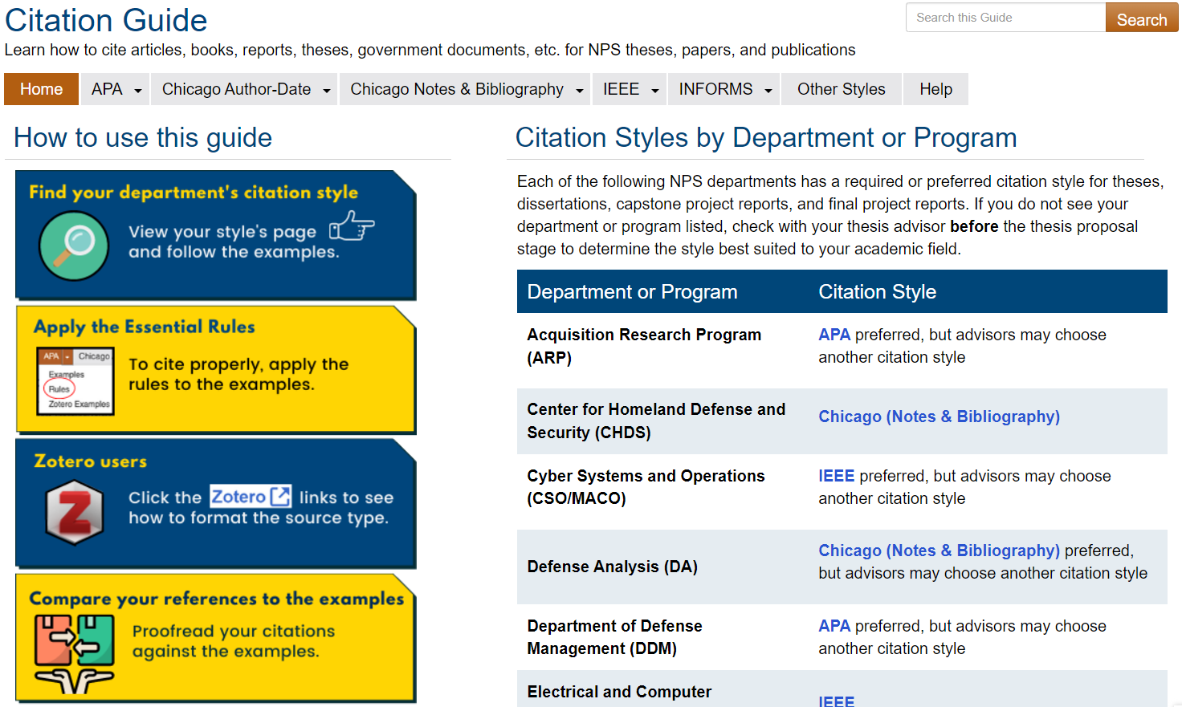
Dudley Knox Library’s Citation Guide

Slide 24
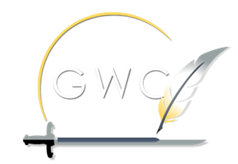
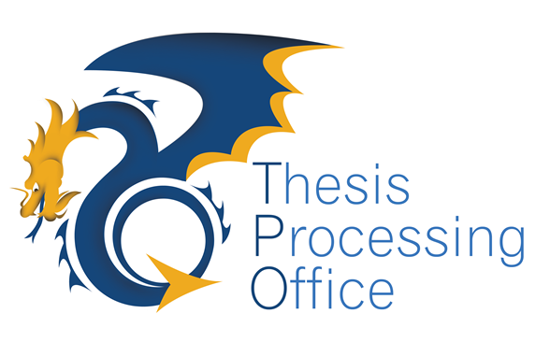
The GWC is here for you
Use our workshops, coaching sessions, and online resources
Build writing habits now that will support you through your thesis and beyond
Notes:
Go through list.
Bye!

