Slide 1


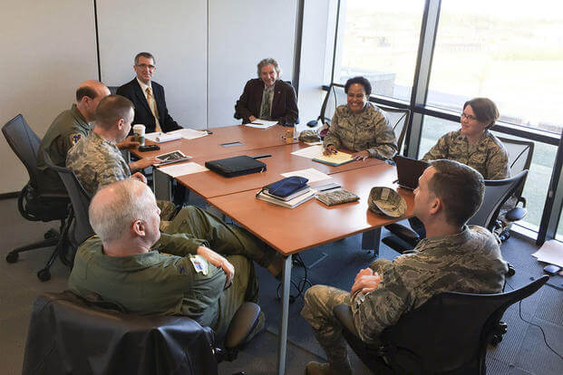
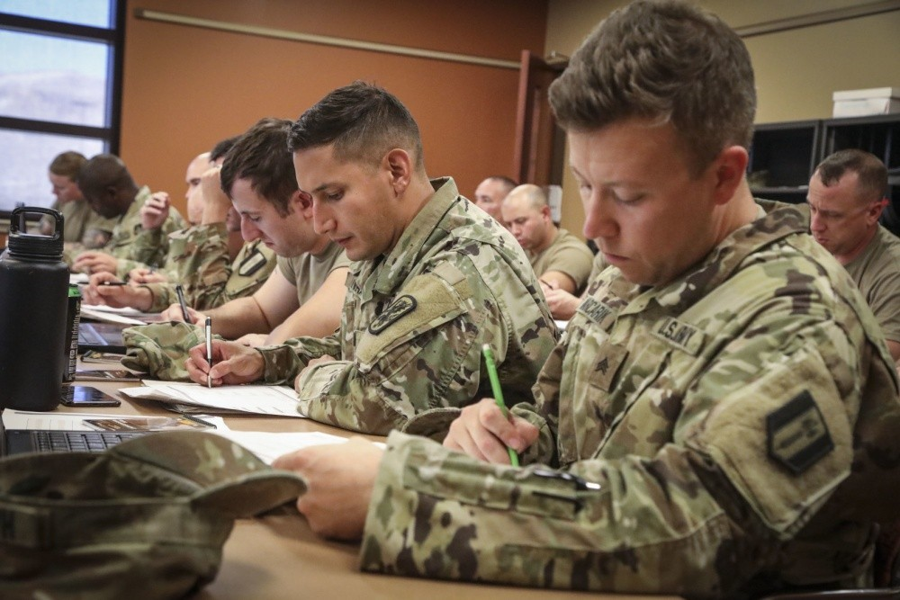
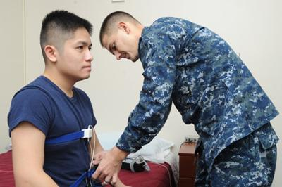
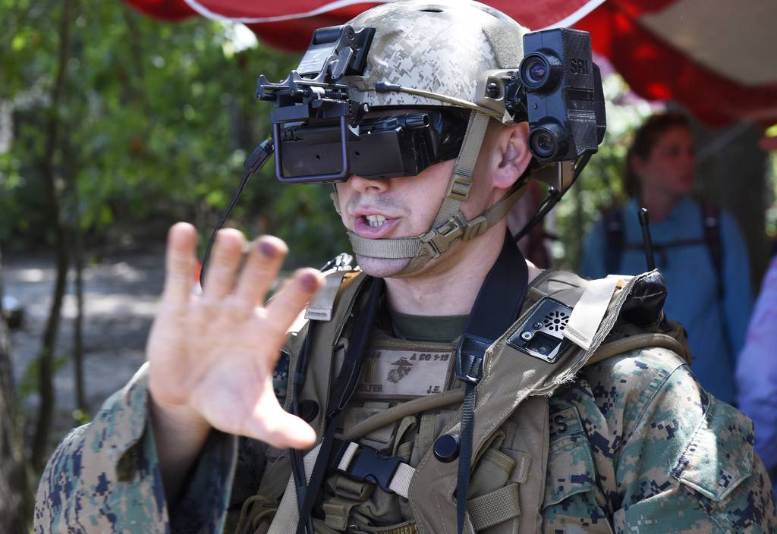
Going Straight to the Source:
Using Human Subjects Data in Your Thesis, Capstone Report, or Dissertation
Bryan Hudgens
Chair, Institutional Review Board
12 Apr 2024

Slide 2
Disclaimers
You won’t remember all of this.
That’s OK!
Keep these slides.
We’ll help you!
Your new friends in Human Research Protection (irb@nps.edu)

Slide 3
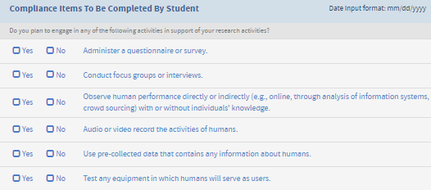

The Most Important Slide in This Presentation
ATTENTION NPS Students:
Only the NPS IRB can determine if your thesis, dissertation, report, or capstone includes an activity that is considered human subjects research (HSR).
Not you, your advisor, or your department chair
The Python Checklist:
Does what you checked match what you did or plan to do in your thesis?
If you checked “Yes” to any of these activities and haven’t contacted the IRB/HRPP, do so ASAP!
If you checked “No” and engaged in any of these six activities, contact the IRB/HRPP ASAP!
IRB/HRPP contacts:
  IRB Chair: Bryan Hudgens, Lt. Col. (Ret.), bryan.hudgens@nps.edu ext. 2039
  HRPP Lead Specialist: Ms. Ali Smith, alicia.smith@nps.edu ext. 1037
  HRPP Specialist: Mr. Scott Ramos, sramos@nps.edu ext. 2043
  HRPP Specialist: Ms. Cindy Burns, Cynthia.burns@nps.edu ext. 1927
Resources:
  NPS Human Research Protection Program (HRPP): https://nps.edu/web/research/irb-home, irb@nps.edu

Slide 4

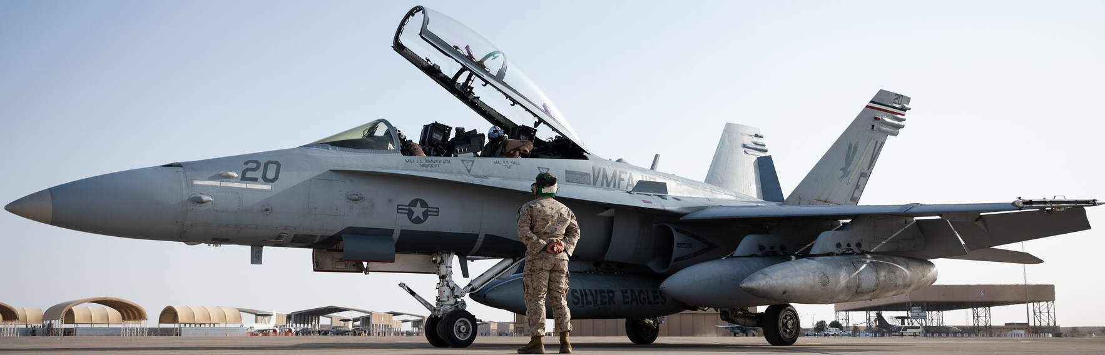
Can VR Be Used to Assist F-18 Maintainers?

Slide 5
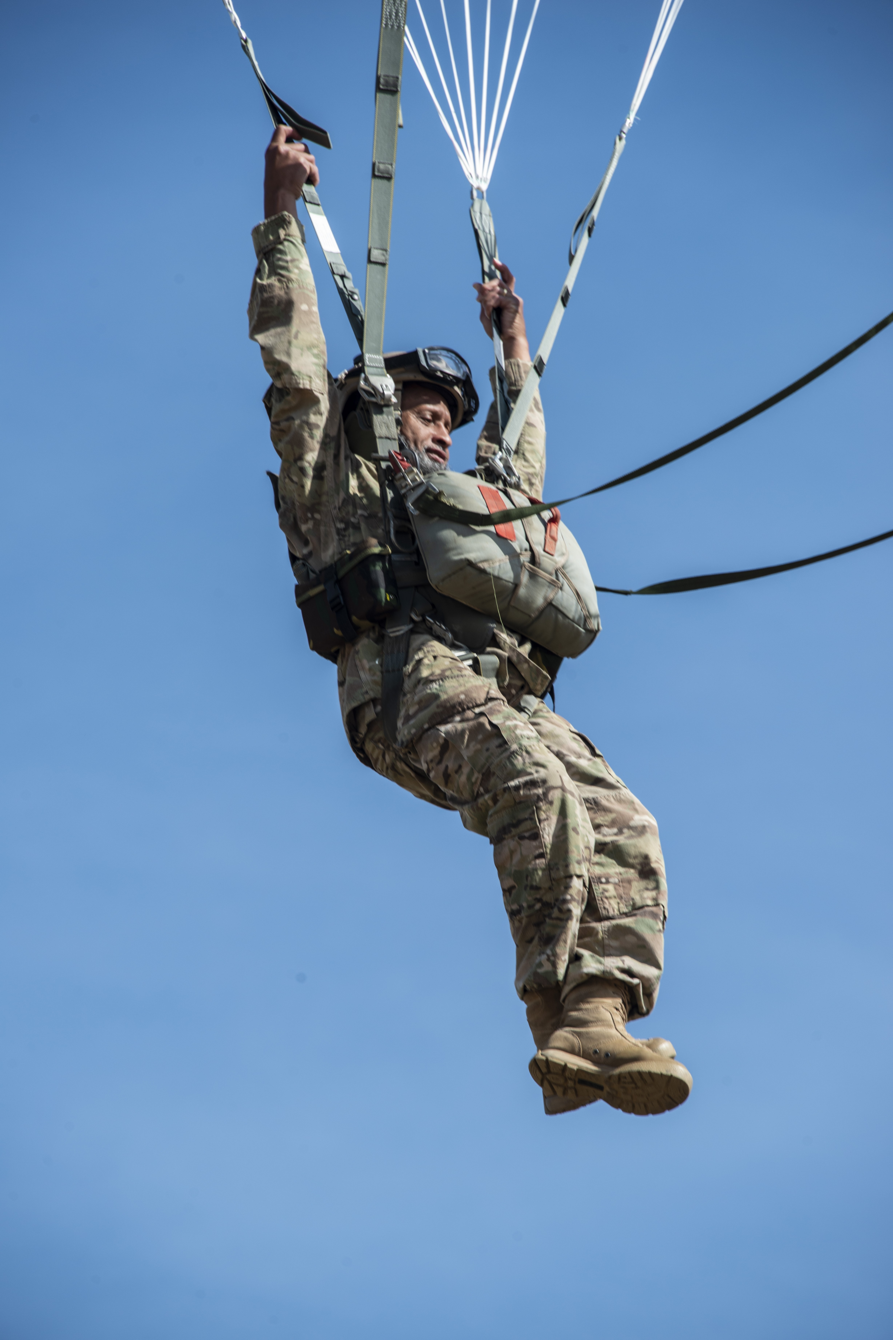
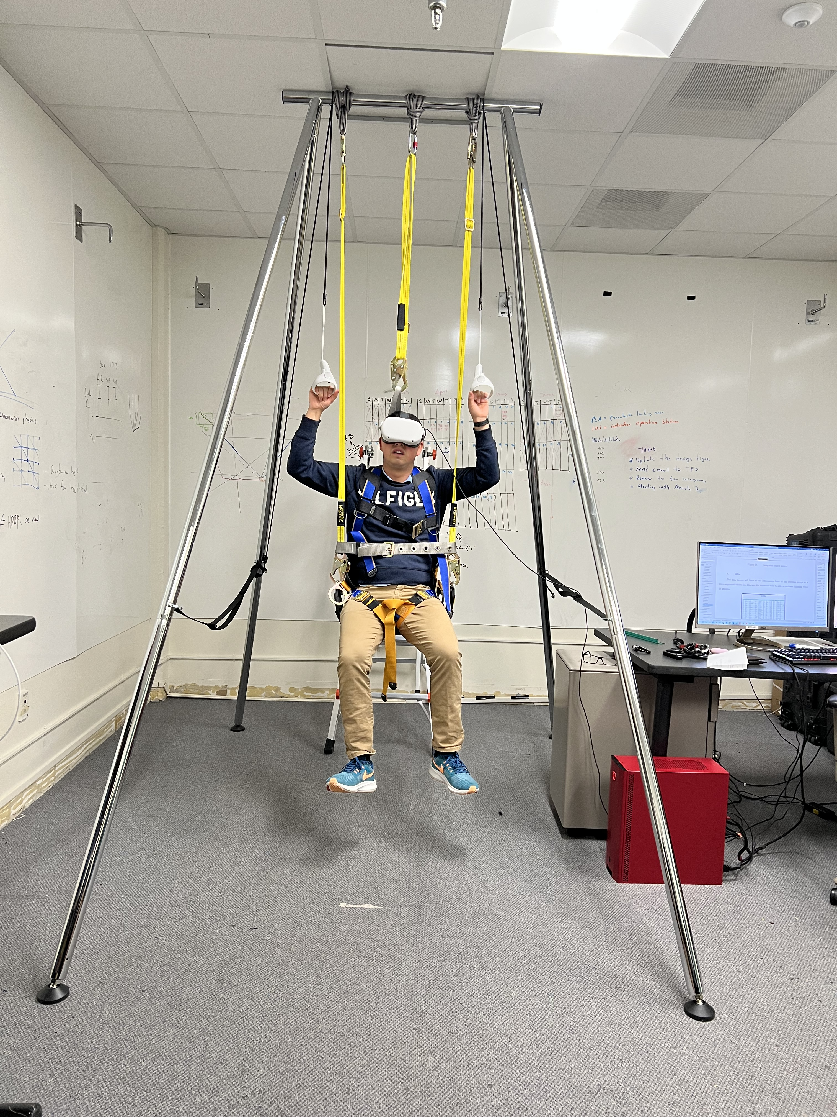
Laboratory Simulation
Can VR be used to train airborne soldiers to flair their parachutes for a safe and soft landing?
https://www.army.mil/article/246658/army_airborne_school_replaces_j_1_training_parachute_after_testing_new_j_3_chute_system
Photo Credit: Dr. Amela Sadagic

Slide 6
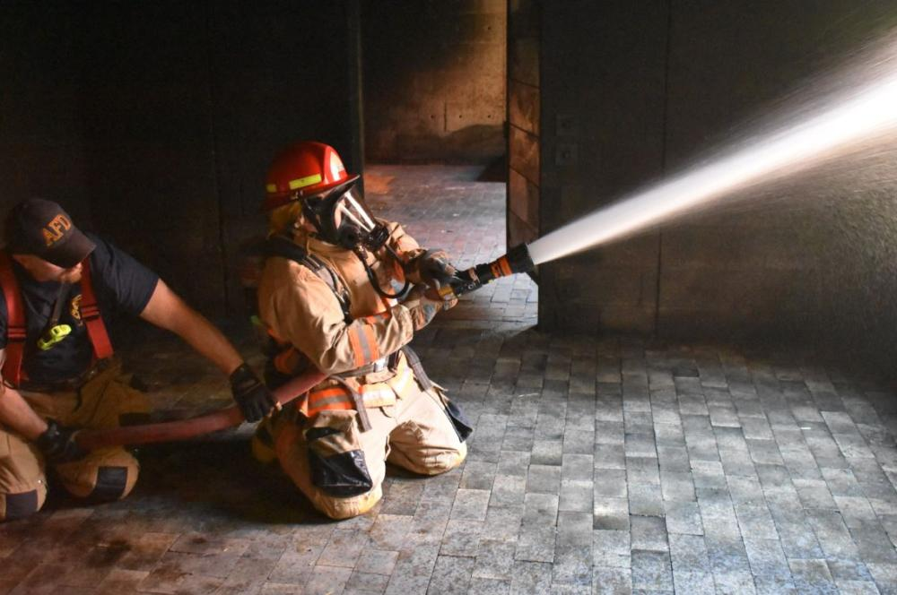
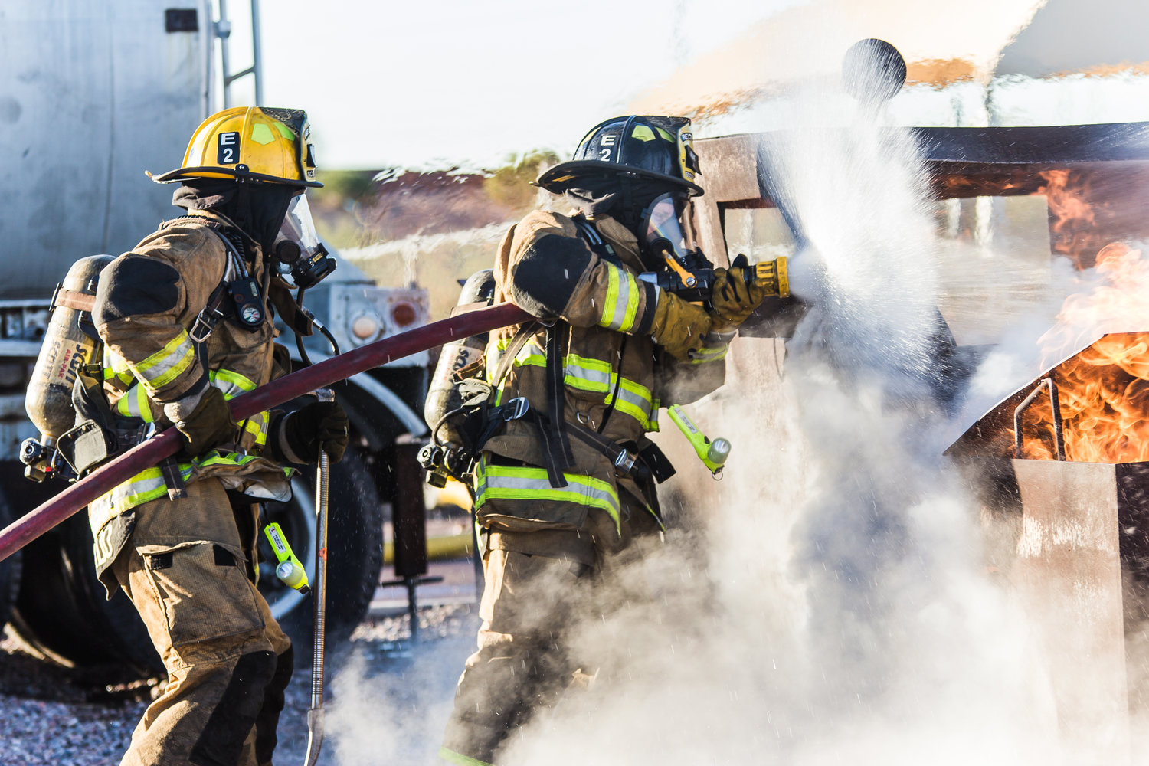
Field Study
Does training under stressful conditions result in better performance?
https://www.alexandriava.gov/academies/alexandria-community-fire-academy
https://www.citylabhamilton.com/new-blog-1/2020/1/15/digitally-upgrading-the-fire-departments-equipment

Slide 7
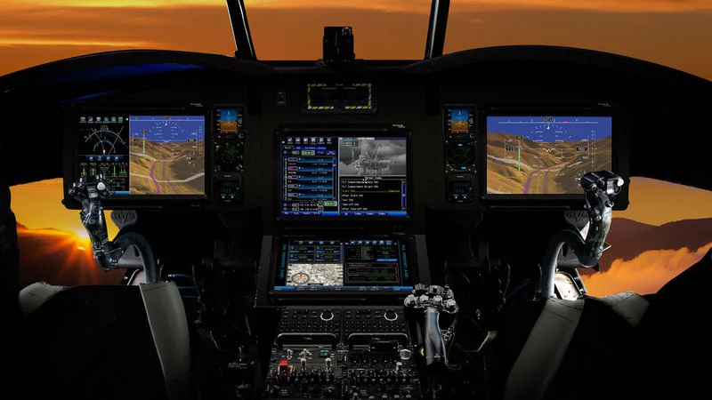
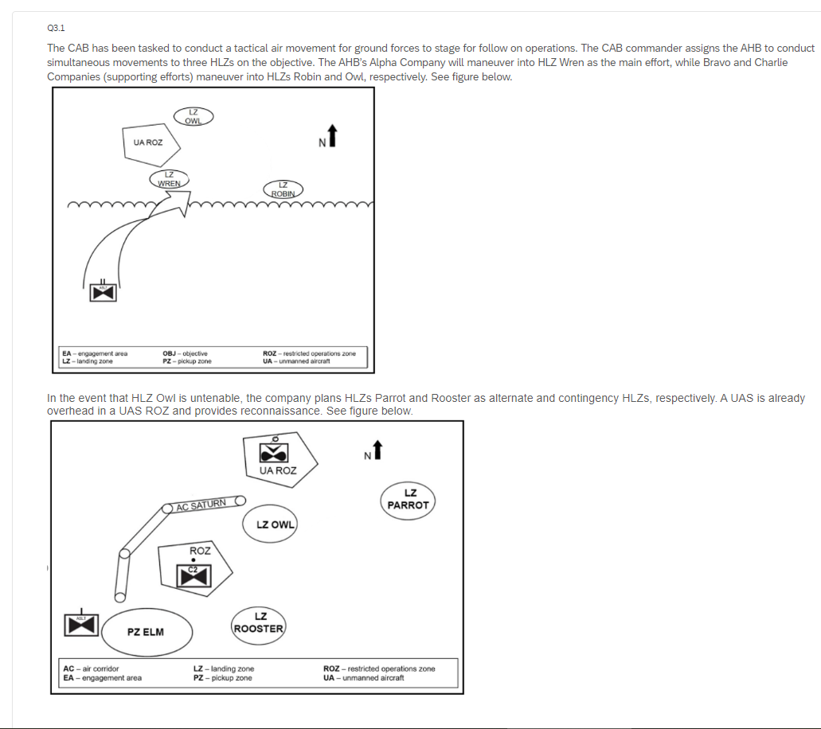
What Info Do Pilots Want to See in Each Phase of Flight?
Surveys
Questionnaires
Focus Groups
Interviews

Slide 8
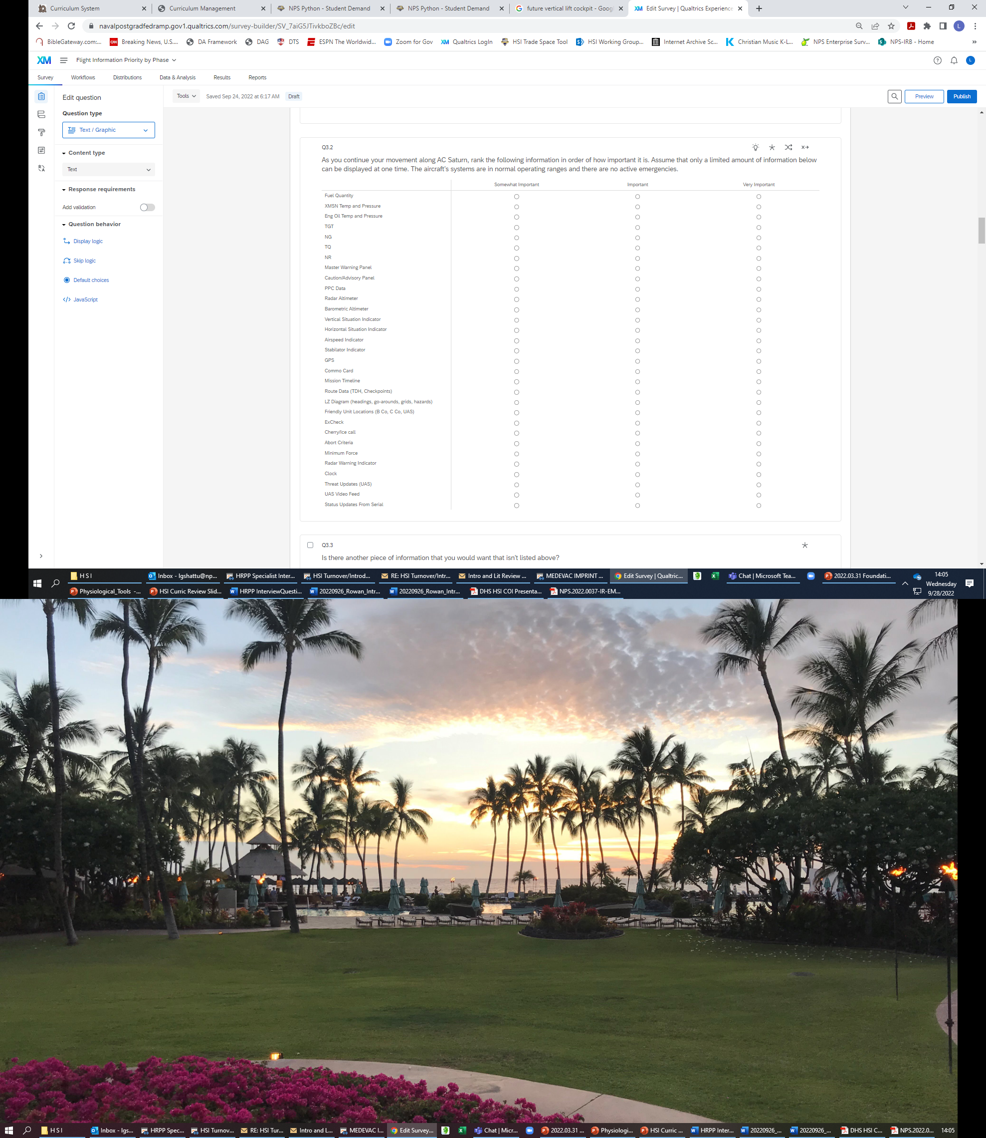

What Info Do Pilots Want to See in Each Phase of Flight?
Surveys
Questionnaires
Focus Groups
Interviews

Slide 9
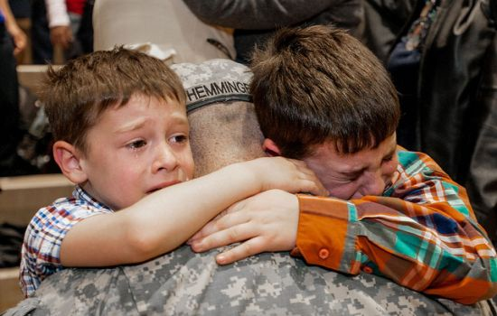
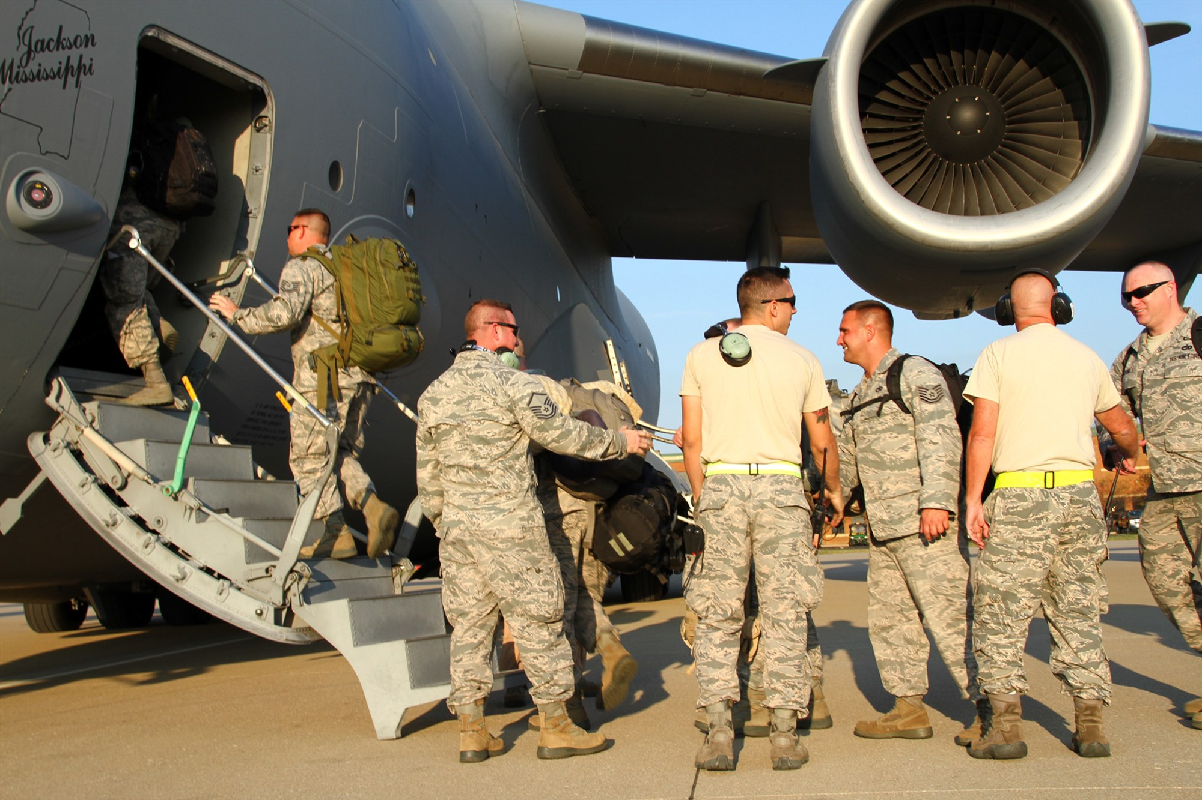
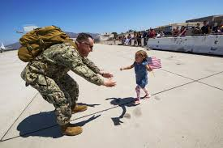
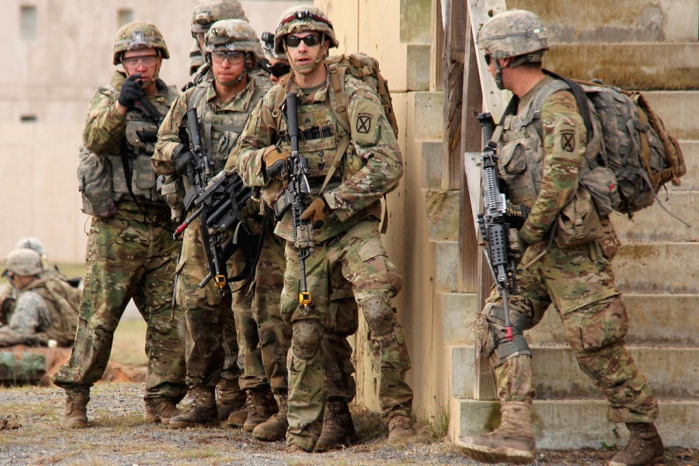
How Do Deployments Affect Children’s Performance in School?
Secondary Information
Compare performance of school children whose military parents are deployed to those children whose parents are not deployed.
          School grades
          Special classes (advanced or challenged)
          Disciplinary issues
          Number of deployments
          Length of deployments
          Age of children

Slide 10
What is Human Subjects Research (HSR)?
First, it’s research
    “A systematic investigation,
    designed to develop or contribute to generalizable knowledge”
Second, it’s research about human subjects
    “A living individual about whom
    an investigator…conducting research obtains
    (1) data through intervention or interaction with the individual, OR
    (2) identifiable private information about an individual.”
    Good news: Two categories of common NPS studies typically aren’t HSR
    (1) Evaluating DOD “programs” and giving results to the “boss”
    (2) Testing things in operational settings
    IRB must make this determination, but we do these quickly – trust the process!
(These are Federal Regulation definitions: see 45 CFR 46 & 32 CFR 219)

Slide 11
What Should You Do? Trust the (IRB) Process
Process for when a student plans to engage in an activity that may be considered human subjects research.
Student identifies a topic for a thesis or capstone
Student selects an advisor, and the advisor agrees to the topic
Student conducts a brief literature review and develops a method
The advisor agrees to the method
The student drafts a thesis or capstone proposal
Does
proposal include
activity that may involve interaction with humans or information about
humans?
Complete a determination request form, have advisor sign it, and submit it to IRB. Wait for a response before undertaking any activity that may involve human subject research
Did the
IRB determine that
the activity was human subjects research?
Subjects need protection. Take CITI training, then work with advisor to submit research protocol to IRB. Wait for approval before any human subject research activity
Yes
Yes
No
No
Survey, focus group, interview, questionnaire, audio/video recording, or secondary information about people
Activity does not constitute human subjects research and student can begin research activity

Slide 12
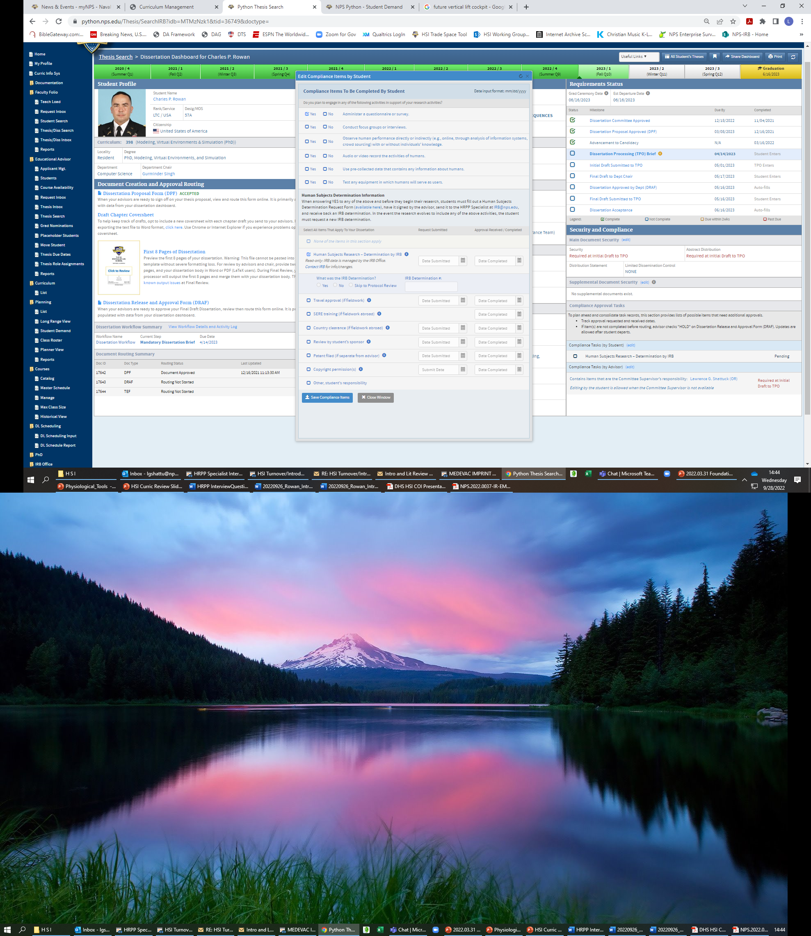
Trust the IRB Process: Step 1 – The Python Thesis Dashboard
This is a pre-screen.
“Yes” to any = need IRB determination. “No” to all = no IRB involvement.
If you have questions, please ask us!

Slide 13
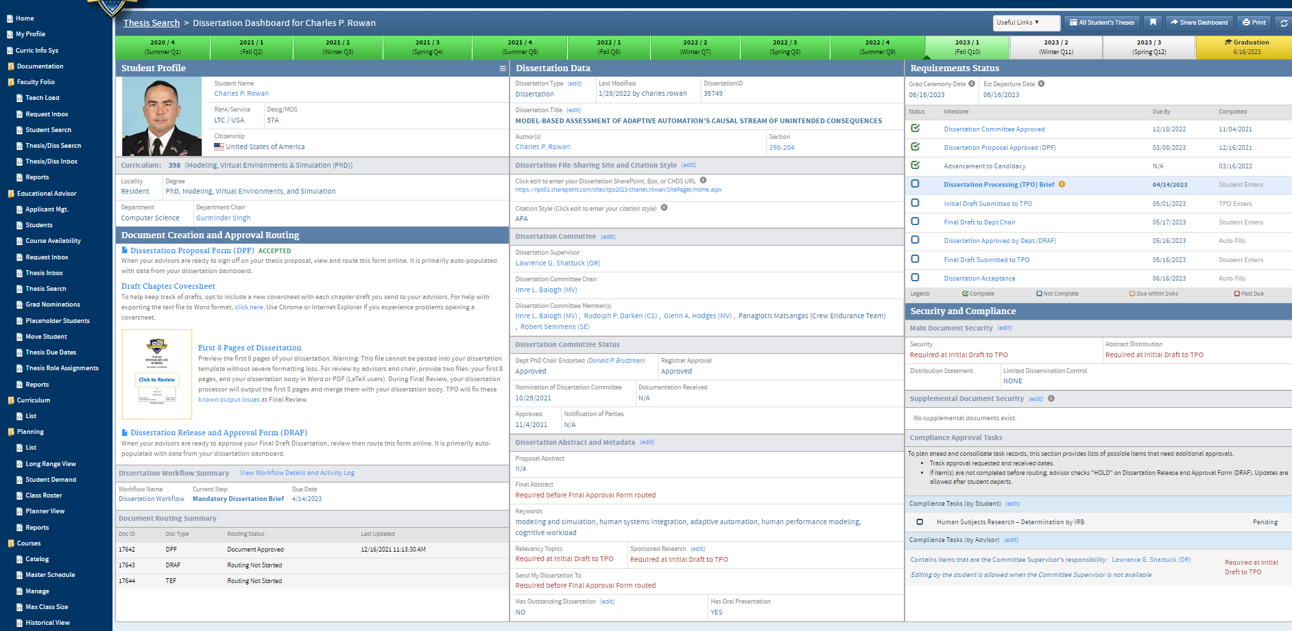
Trust the IRB Process: Step 1 – The Python Thesis Dashboard

Slide 14
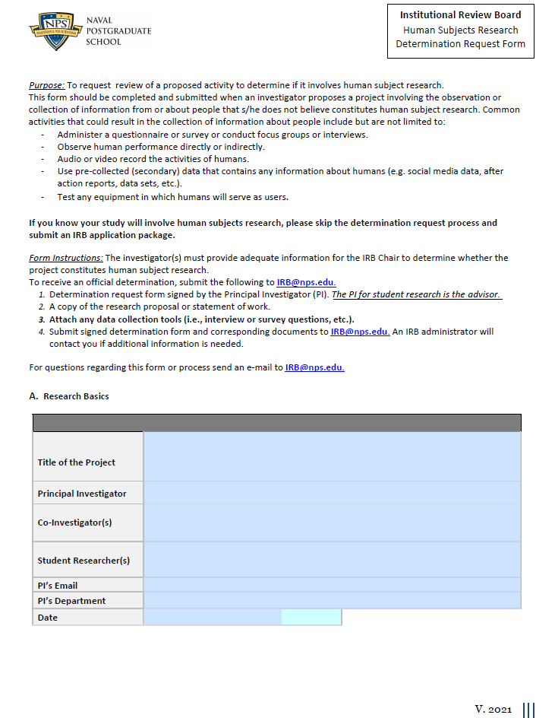
Trust the IRB Process: Step 2 – IRB Determination Request Form
Request if you answer “Yes” to any Python thesis dashboard question (link on our IRB page)
Student completes (~15 minutes), faculty advisor signs
Will you use secondary data or biospecimens? If yes (Python Checklist), describe the data - what variables?
Will you interact with people? If yes (Python Checklist), describe the interaction - interviews, survey, experiment, attend exercise and observe…?
Attach a copy of any data collection instruments (e.g., surveys) and/or interview questions
Include a copy of thesis proposal
NOTE: If your advisor is confident a project is research involving human subjects, you can skip this step and go right to Third Step - Prepare a Protocol (rare, contact us)

Slide 15
The (Other) Most Important Slide in This Presentation
ATTENTION NPS Students:
Only the NPS IRB can determine if your thesis, dissertation, report, or capstone includes an activity that is considered human subjects research (HSR).
Not you, your advisor, or your department chair
The Python Checklist:
Does what you checked match what you did or plan to do in your thesis?
If you checked “Yes” to any of these activities and haven’t contacted the IRB/HRPP, do so ASAP!
If you checked “No” and engaged in any of these six activities, contact the IRB/HRPP ASAP!
IRB/HRPP contacts:
  IRB Chair: Bryan Hudgens, Lt. Col. (Ret.), bryan.hudgens@nps.edu ext. 2039
  HRPP Lead Specialist: Ms. Ali Smith, alicia.smith@nps.edu ext. 1037
  HRPP Specialist: Mr. Scott Ramos, sramos@nps.edu ext. 2043
  HRPP Specialist: Ms. Cindy Burns, Cynthia.burns@nps.edu ext. 1927
Resources:
  NPS Human Research Protection Program (HRPP): https://nps.edu/web/research/irb-home, irb@nps.edu

Slide 16


HRPP and IRB Contact Information
NPS IRB website and email:
https://my.nps.edu/web/research/irb
IRB@nps.edu
IRB Contact Information:
IRB Chair: Mr. Bryan Hudgens
bryan.hudgens@nps.edu
HRPP Support: Ms. Ali Smith (Lead Specialist)
alicia.smith@nps.edu
Mr. Scott Ramos (Specialist) Ms. Cynthia Burns (Specialist)
sramos@nps.edu cynthia.burns@nps.edu
“Help [us] help you!” (McGuire, 1996)

