Slide 1
Unleashing the Fuel Tether
A perspective on DoN energy policy

Slide 2
Department of the Navy Energy
  Navy Energy – pop quiz
  It’s all about the mission.
  What’s next?
  A view from the beltway.
Notes:
1. How many were aware of the Navy energy program before you took the class? How’s you hear about it?
Word association.
DASN success or failure?
How many of you read the Mattis report? For those who read it, did it surprise you at all? What about the timing (2006)?
Mattis confirmation testimony

Slide 3
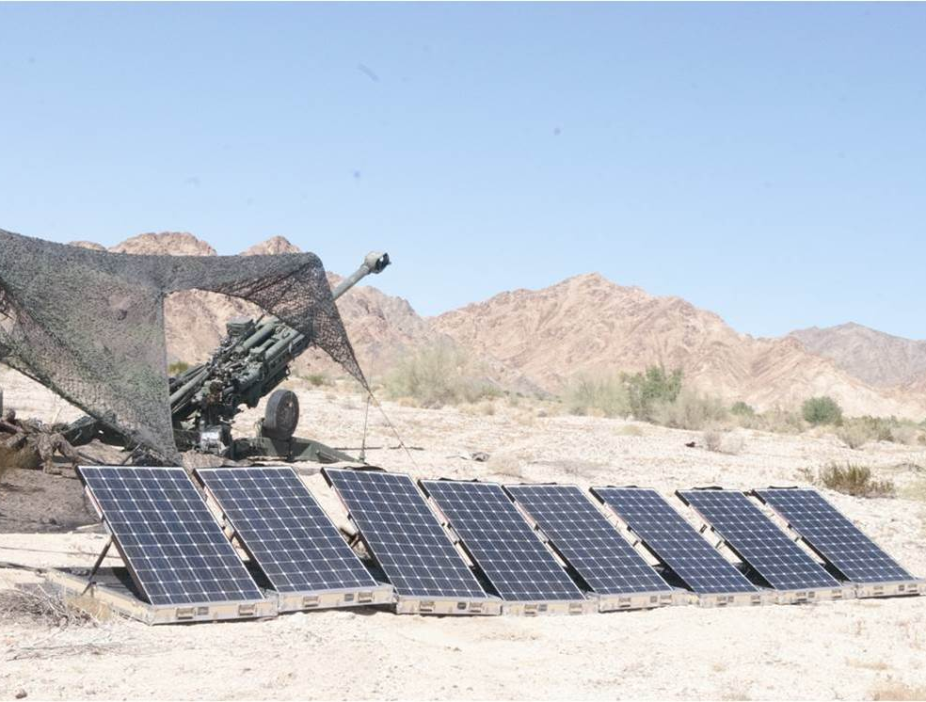
Notes:
Energy program:
Enhance combat capability
Strengthen Operational Flexibility
Protect sailors and Marines
Ensure mission resiliency
M777 Howitzer with GREENS powering targeting system. 100 lb rounds contain about 24 lbs of TNT. Firing range @ 20 miles. Ground Renewable Expeditionary ENergy System.

Slide 4
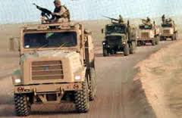
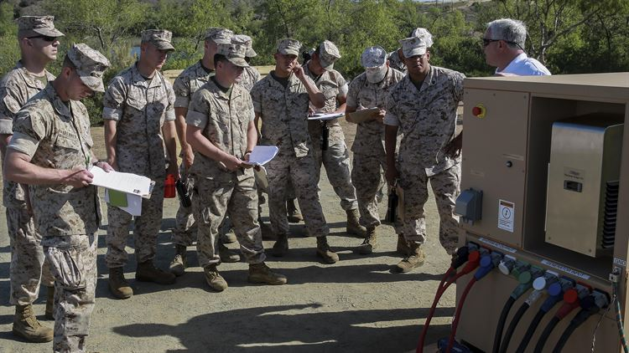
Capability – Operational Reach
Notes:
Fuel efficient MTVR & Hybrid Generators
1. MTVR = 3.8 mpg / Cruising range of 300 miles - 15% improvement extends reach by 45 miles - reduce idle speed, add auxiliary power unit and modify driver behavior
Hybrid generators - Diesels operate better when fully loaded, and are sized to meet peak load so they operate inefficiently. Hybrids allow them to charge batteries and then shut down. Silent watch.
Behavior – 29 Palms example

Slide 5
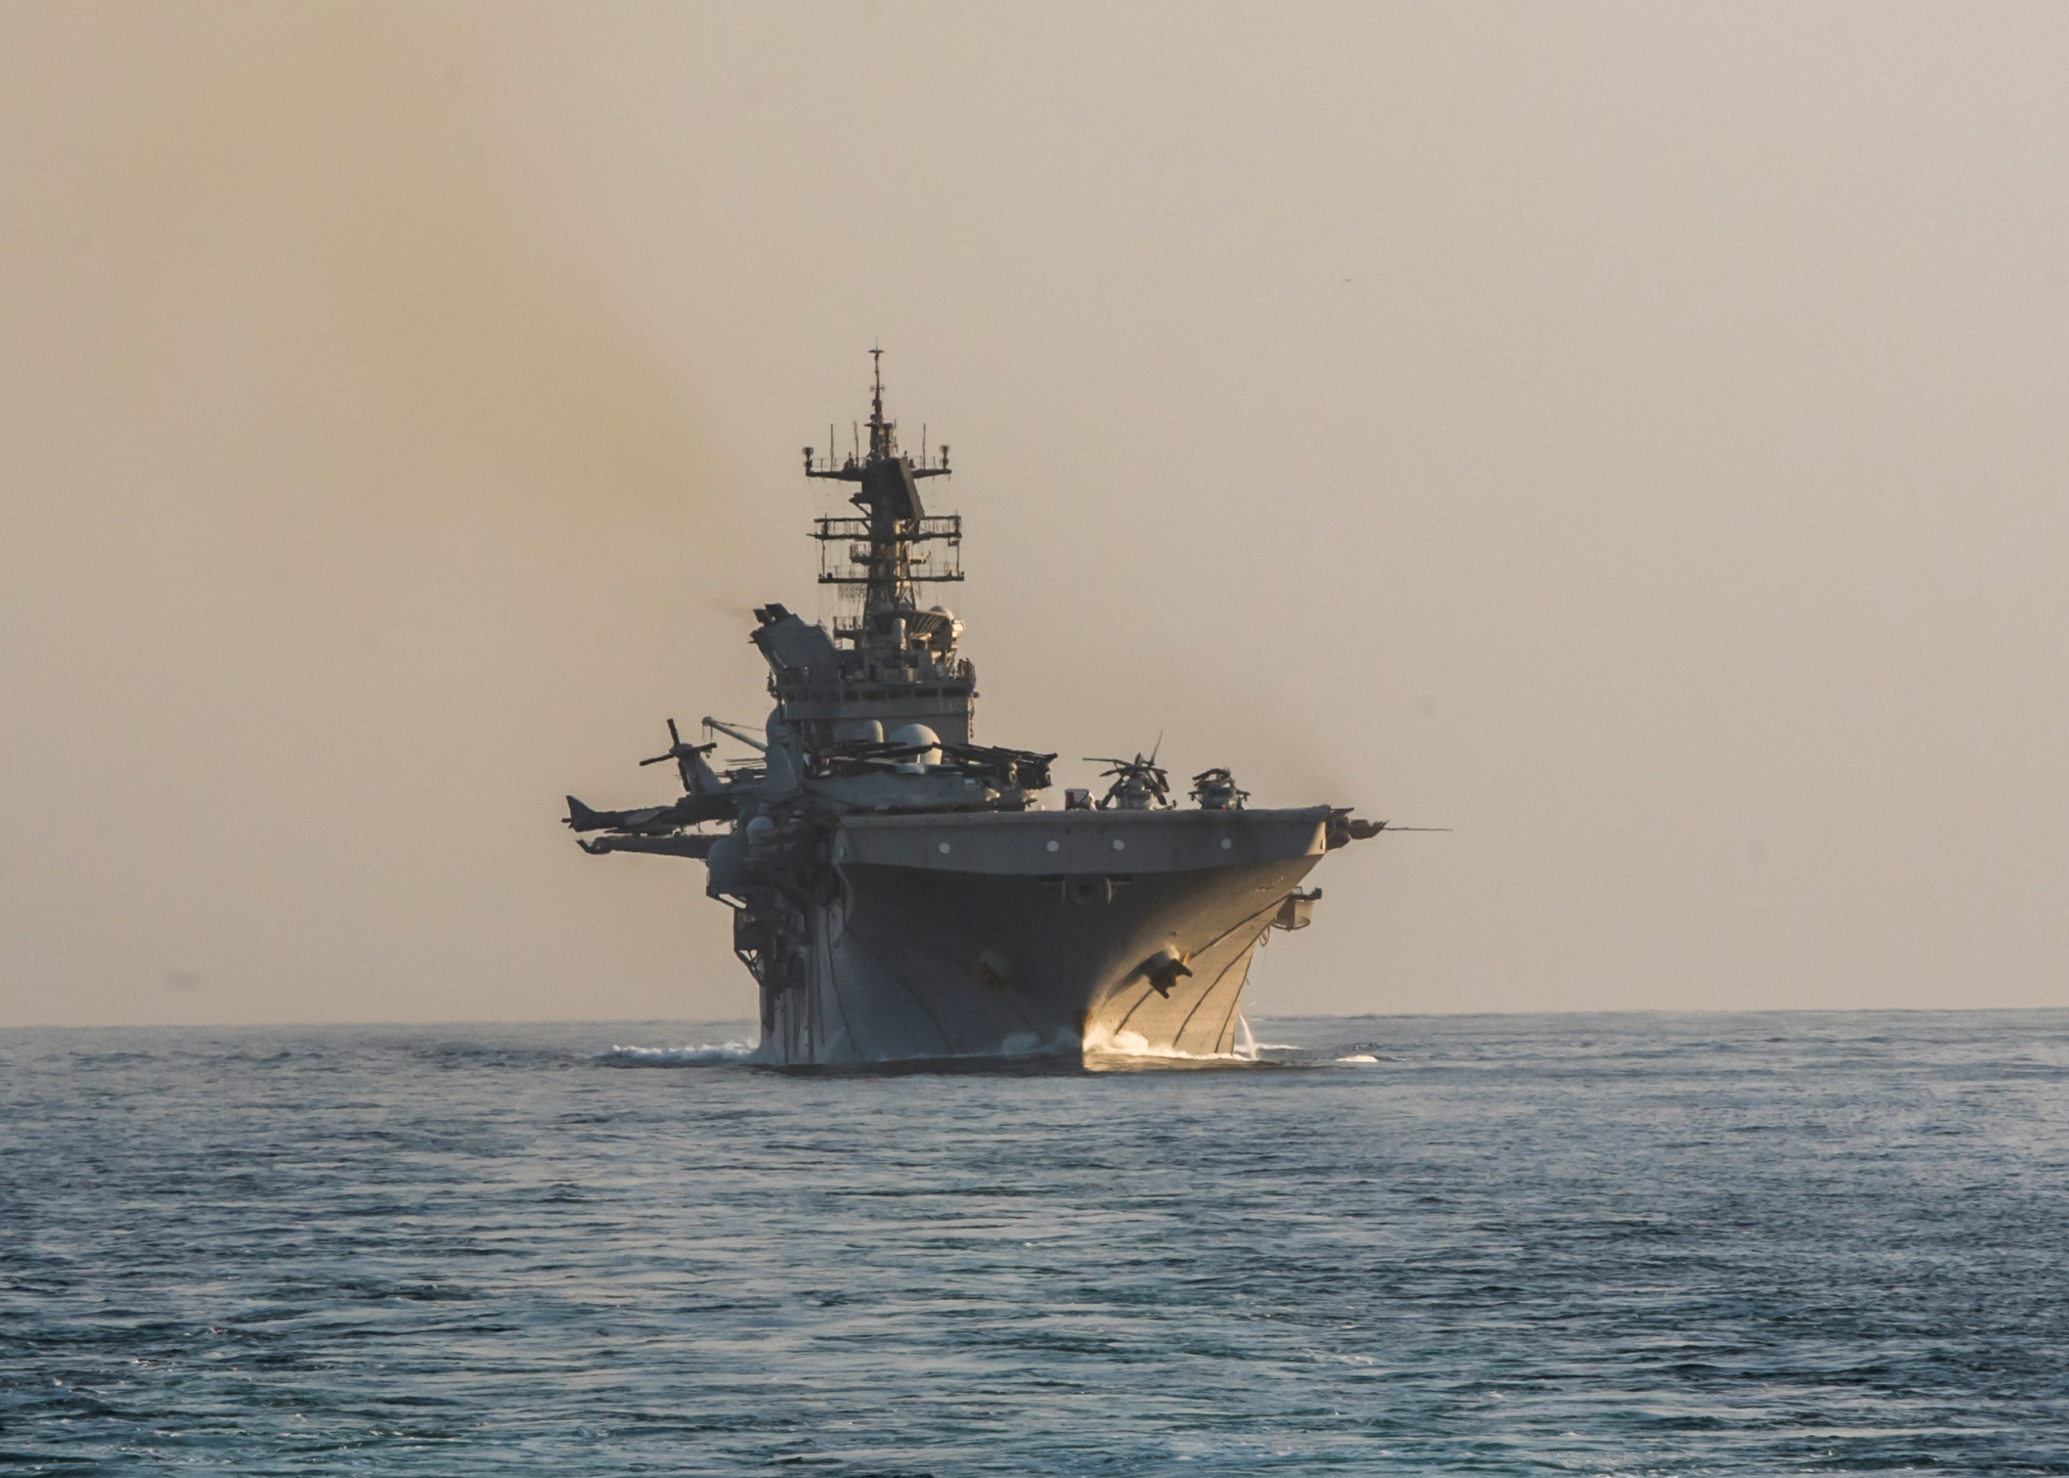
Capability - Time on Station
Notes:
Makin Island amphibious assault ship has two gas turbines each connected to a main reduction gear. The turbines are used to power the ship above 12 knots. Below 12 knots, propulsion is provided by two electric motors connected to a second input shaft on the main reduction gears.
HED allowed the ship to remain on station between refueling three times longer during her maiden voyage and resulted in fuel savings equating to 50 additional underway days a year.

Slide 6
Hybrid Electric Drive
https://www.youtube.com/watch?v=VqeRn3I7uYI
Notes:
SUCCESS? Plan to install HEDs in destroyers in 2017. Lots of debate about DDG HEDs in budget.
LESSON: Go forward by going backward. War games.

Slide 7
LEDs– Every Little Bit Helps
https://www.youtube.com/watch?v=-ZN6B--ldYA
Notes:
1. How many of you have changed a lightbulb on a ship or supervised lightbulb changing? How many of you have been on a ship that has switched to LED lighting?
a. LEDs save about 2 percent of a ship’s electrical load.
b. Last up to 5 times longer – cutting maintenance time by up to 80 percent
c. Better quality light – safety and better task lighting
d. Cuts storage requirements
e. Keeps people off of ladders changing bulbs.
f. No hazardous materials
SUCCESS: In 2015, Vice Admiral Paul Grosklags (deputy at RD&A) directed PMs for new construction ships to install LEDs and authorized up to $2 million per ship.

Slide 8

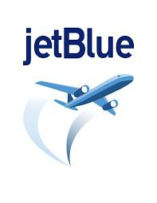






Operational Flexibility
Notes:
WHY FUELS?
Operational flexibility
Keep pace with the private sector – joint use of civil airstrips
Singapore Petroleum Company - wholly owned by PetroChina – owns half of Singapore Refining Company refinery on Jurong Island (ExxonMobil & Shell)
SUCCESS: Certified ships and opened DLA acquisition for suppliers of qualified fuel.

Slide 9
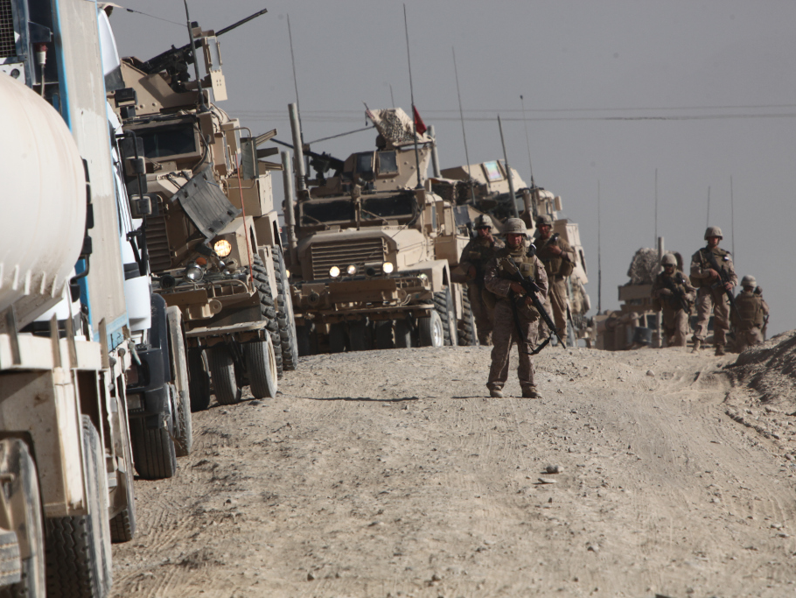
Force Protection
Notes:
Marines escorting fuel convoy in Helmand.
2013 Marine Corps study found 1 Marine casualty for every 50 fuel and water convoys in Afghanistan.
2009 Army study found one Army soldier or civilian killed or wounded casualty for every 24 fuel resupply convoys in Afghanistan. (Sustain the Mission Project: Casualty Factors for Fuel and Water Resupply Convoys)
Energy command and control

Slide 10
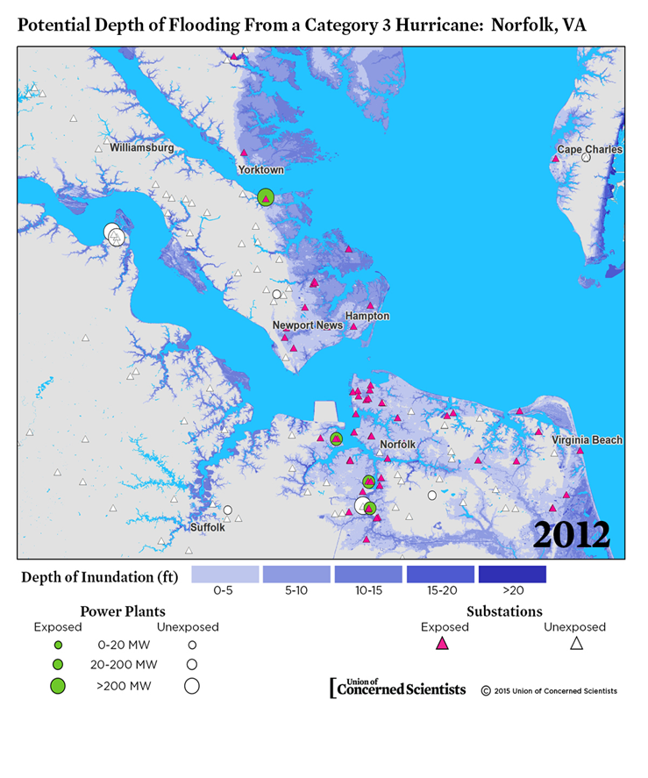
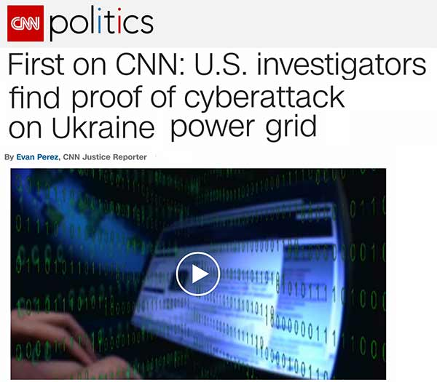
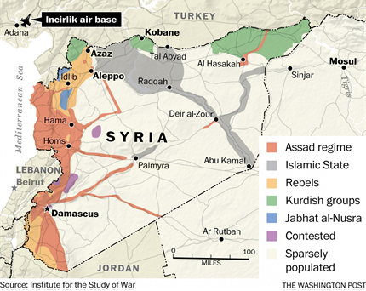
Mission Resilience
Notes:
THREAT
1. Ukraine attack in December 2015. Another similar attack in December 2016 took out 200MW.
2. Union of Concerned Scientists analysis - 15 of the 18 major substations in Norfolk and nine of the 11 major substations in Hampton at risk in Category 3 hurricane.
July 15, 2016 Incirlik lost power. Power restored on July 22, 2016.
April 16, 2013, a team of gunmen opened fire on the Metcalf Transmission Substation just south of San Jose, severely damaging 17 transformers.

Slide 11
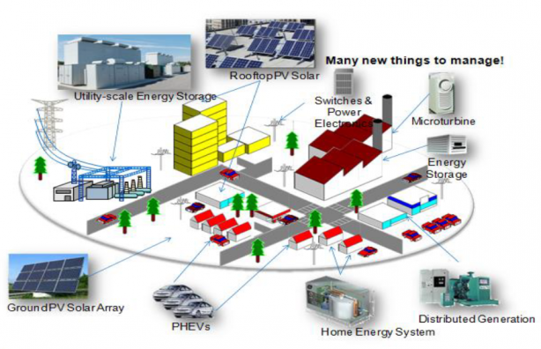
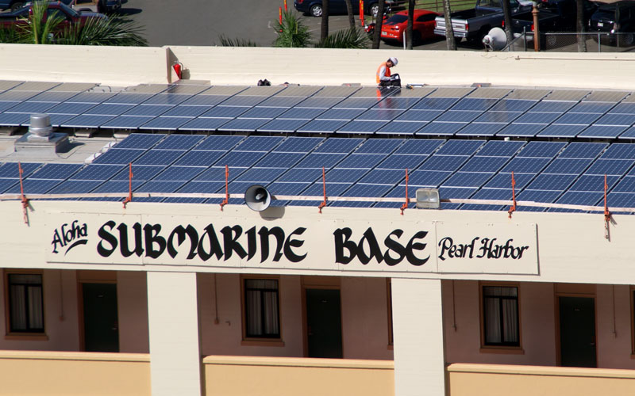
Mission Resilience
Notes:
MITIGATION: Improve energy efficiency and bring generation inside the fenceliine.
SUCCESS:
Energy efficiency. $630M awarded in energy efficiency.
Several hundred megawatts of distributed solar.
UNDONE: Valuing energy security/resiliency, e.g. MICROGRIDS: Miramar will the use the microgrid to run the base in the event of an outage. The microgrid uses solar energy, diesel gens, and fuel cells, extension cord.

Slide 12

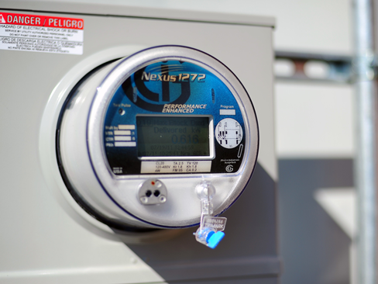
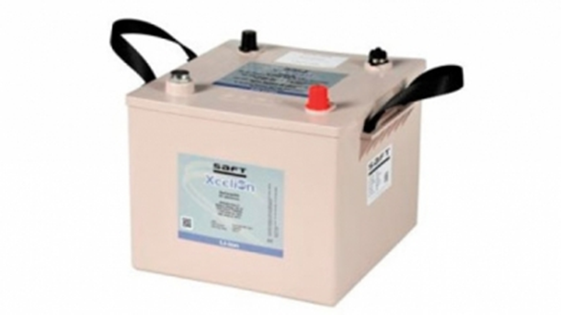
W
What’s Next?
Notes:
DATA:
a. Shipboard energy dashboard - real-time situational awareness of energy demand - increase efficiency while meeting performance and reliability requirements.
b. Navy – Genesys program. E-logbooks
c. USMC - Energy Command and Control
2. STORAGE: Standardization – don’t replace fuel trucks with battery trucks.

Slide 13
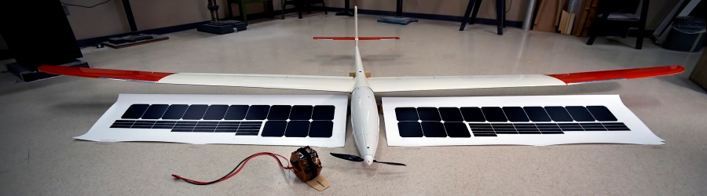
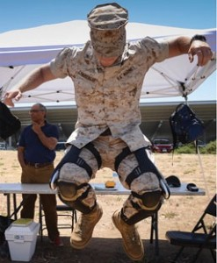
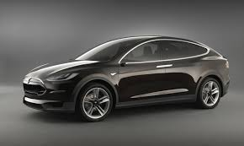
What’s Next – New ideas
Notes:
Thinking outside the box
1. Hand-launched group one UAV that can provide persistent ISR capability on zero fuel. Uses thermal updrafts, communicates with other drones. Harvest and store solar power through high efficiency photovoltaic cells. Demonstrated an endurance of 19 to 20 hours.
2. JIC-P
3. Blue light suppresses melatonin, affecting sleep. LEDs that can adjust for blue light.

Slide 14
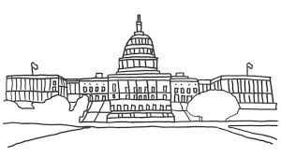
What’s Next?

