Slide 1
Cyber Security for Operations Technology (OT)
& Why We’re Failing
This Briefing is Proprietary and Competition Sensitive

Slide 2
Introduction
Mr. Aaron Fansler
  Soon to be Dr. Aaron Fansler (Fingers Crossed)
  Applied Mathematics, Computer Science w/emphasis on Machine Learning
7 Years in the Air Force, 3 Years in Army
Since 2002 working on Control Systems
  SCADA, ICS, O.T. IIOT (acronym of day)
DCO & OCO Operations
Chief Technologist at Ampex

Slide 3
What Are Control Systems
Control Systems (ICS, OT, SCADA) are used to run facilities
  Nuclear power stations
  Non nuclear power plants
  Oil refineries
  Chemical plants
  Manufacturing plants
  Building automation
  Mass transit (rail, subways)
  Water (potable, non-potable)
  Ships
  Even airplanes

Slide 4
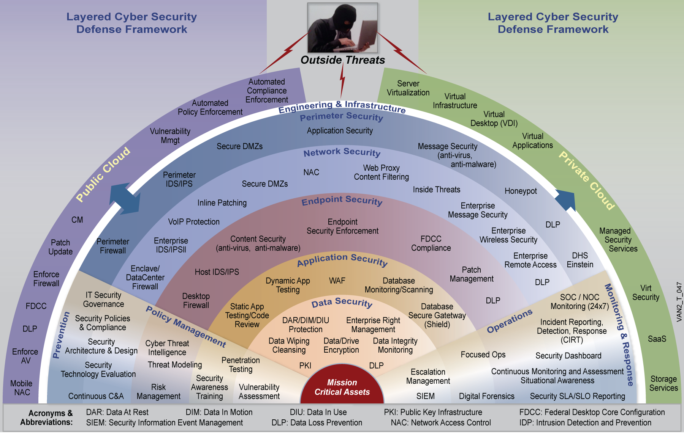

Slide 5
Why are we failing
Stuxnet
DuQu
Flame
Attacks Targeting Industrial Control Systems (ICS) Up 110 Percent
Saudi Aramco Attacked
Russia Attacks Ukraine
Control System Attacks only going to get worse

Slide 6
Why we are failing
According to a Waterfall published paper the top two theats to control systems:
  #1 ICS Insider – A disgruntled insider with access to ICS equipment uses social engineering to steal passwords able to trigger a partial plant shutdown
  #2 IT Insider – A disgruntled insider with access to an IT network uses social engineering to steal passwords able to give them remote control of a copy of the HMI system on an engineering workstation.
They list 18 others but even they are drinking the same I.T. problems cool-aid

Slide 7
Aaron’s Reasons we are failing
We are a society of openness
Very greedy companies
Low expectations such as with security compliance
Insider Treats but not what you are thinking…. Incompetence
American workers and kids are becoming very lazy

Slide 8
Openness
First I’m not a communist, I’m all for making money.
We give our adversaries our defensive “playbook”
  DiD
  NERC
  NRC
  Industry best practices…NIST
Open competitive bids
  RFPs, RFIs, Awards

Slide 9
Openness & Greed
Power plant is a power plant etc
Sell of security products
  Same internals nothing new
  Signature based solutions
  Snake oil solutions
Training
  SANS, NERC, NIST
Certifications
  CEH, CISSP, CHFI
Universities
  Software coding…poor

Slide 10
Compliance vs Security
Does meeting security compliance standards make you secure?
NRC & NERC
Remember the Target breach?
  How did it happen..attack vector?
  Called an “epic” security breach
  Upwards of 70 million credit and debit card numbers were stolen in late 2013 from the retail giant
  Was validated as PCI-compliant just two months before the breach.

Slide 11
Compliance vs Security
Compliance does not equal security…Period
It’s merely a snapshot of how your security program meets a specific set of security requirements at a given moment in time
The most common misconception?
  Thinking compliance and security are one and same.
  In fact, they play different roles, both in your internal environment.
  Proper cyber security protects your information from threats by controlling how that information is used, consumed and provided.
  Compliance is a demonstration, a reporting function of how your security program meets specific security standards as laid out by regulatory organizations.

Slide 12
Another misperception is:
  Meeting compliance regulations will cover all security needs. This “checkbox” mentality is a surefire path to inadequate protection. Why?
  Because compliance corresponds to a set of specific requirements that change slowly, not the daily changes in the security landscape.
NERC/CIP
  North America Energy Reliability Corporation
  V7

Slide 13
Insider Threat
The old threat as defined, “An insider threat is a malicious threat to an organization that comes from people within the organization, such as employees, former employees, contractors or business associates, who have inside information concerning the organization's security practices, data and computer systems

Slide 14
Incompetence
The new “insider threat” problem is still a part of the old insider threat that has been around for years but no one is calling it out for what it is.
The new one that I’m going to single out is specifically incompetence
I’ll go one step further and call it gross incompetence
Case Study

Slide 15
Laziness
Lazy isn’t just limited to the now and current generation and there are actually many layers
Previous case study
Casino Example
Oil Refinery Example
Our Wonderful Millennials
  Not going to group them all under one umbrella
  Each generation has that percentage but this generation seems to have been blessed with that gene

Slide 16
Laziness
New Hires
The next generation of operators
  Nuclear
  Power
  Water
I actually hear on CNN where one lady was talking about A.I. for our next soldiers.
  She made a comment, “Technology doesn’t make mistakes”

Slide 17
Recap
We give our adversaries our playbook
We sell them our security products
We train them to be certified in how we defend and let’s not forget penetration testers.
All the while we only secure for compliance for some of our most critical infrastructures.
We have incompetent people trying to secure these systems but are too lazy to make simple passwords or hit the keystrokes on the keyboard to logout and log back in.
And to top it all off we allow foreign nationals in to work on our critical infrastructures in essence giving them 100% intelligence to not only the networks but exactly how we defend them incase our adversaries are thinking it can’t be that easy if they give away their defensive playbook.
Have is missed anything?

Slide 18








Generic Control System Pyramid
HMI
Databases
Front End Processor
Subordinate Devices (PLC, RTU, Embedded)
Data concentrators
Supervisory Devices (PLCs / RTUs / Embedded)
Sensors
Protection is focused at the top…proven threats also exist at the bottom

Slide 19
Current Control System Solutions
Retread of IT capabilities for OT/ICS → doesn’t work
OT/ICS are closed networks → not any more
Very limited situational awareness of the OT/ICS networks
  SCADA data on an HMI is not validated
  How can you protect what you don’t know about?
A clear and present danger
  Over 90%of OT/ICS devices exposed to Internet are vulnerable
  Attack on Ukrainian power a wake-up call
  Attack on Saudi Aramco…..not once but twice
  Heartbleed & Shellshock find a new way to wreak havoc on critical infrastructures
  Stuxnet, DUQU, FLAME and hundreds more
The old way of protecting IT devices does not protect ICS devices!
Our Solution: BLUE Lightning

Slide 20
BLUE Lightning (BL)
Entirely new approach to control system security
Two proprietary and patented algorithms
  One works inside upper and lower limits for a device…creates tighter limits for earlier detection of anomalies using wavelet analysis
  One compares commands sent to the components being controlled with control command status data being sent to monitoring displays (prevents spoofing attacks)
Not signature-based…not chasing the ever-changing malware
Multiple protocols: DNP3, Modbus, C37.118, IEC-61850 & BACnet…provides protection no matter the process (water, power, HVAC)
Zero day detection, would have detected STUXNET, DUQU, FLAME
Informs conditions-based maintenance and enhances ability to detect normal component wear and tear
  Increase longevity of components, reduce maintenance costs

Slide 21
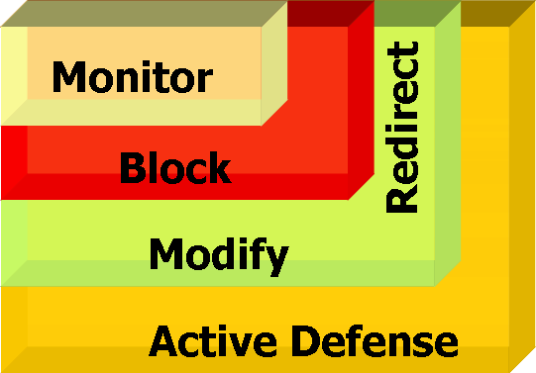



Blue Lightning In the Network
Defensive Techniques
Sensor
Can monitor
multiple endpoints
Monitoring
Protocols
Secondary Validation
1001101011
0110010100
0110010100
1001101011
1001101011
1001101011
0110010100
0110010100
0110010100

Slide 22
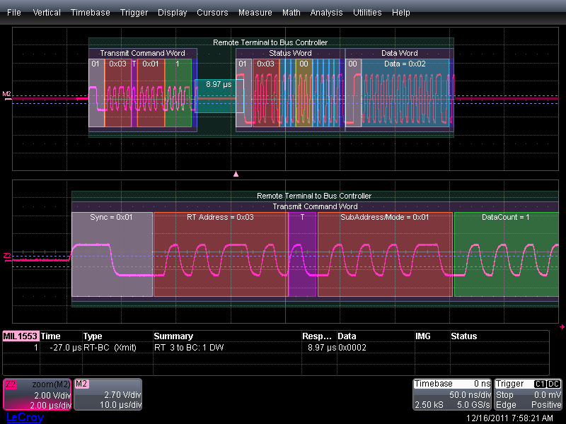
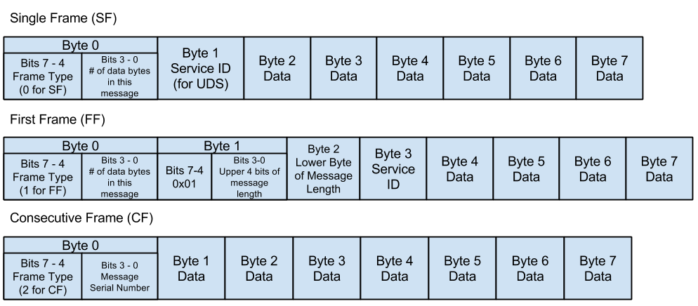
What else?
MIL-STD-1553
Is a military standard for the Digital time division command/response multiplex data bus
Other MIL-STDs
We know the format
We can instrument and protect the subsystems

Slide 23
AMPEX Blue Line of Products
Blue IQ
  Neural Model with Machine Learning (ML) Algorithms
  Two neural nodes
    FMV, IR, Thermal
    Cyber, Signals, Intelligence
  Architected to work with existing Mission Data Recorder (MDR) lines and BL Box
  Focus is for distributed GPUs to process data during a flight what is normally post-mission processing
  Integrated with Lightning and we’ll have Sentry
Many applications
  Power Lines / Pipe Lines
  Shipborne, Airborne
  Remote site security (substations, oil rigs…etc)

Slide 24
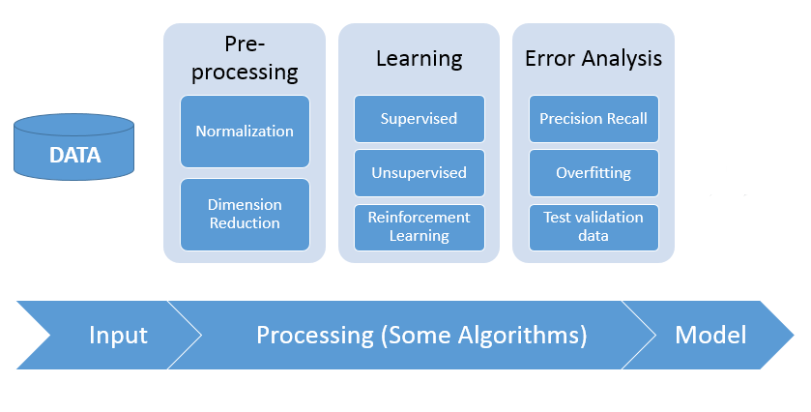
Functionality
Ability to process raw data at the endpoints or the points of collection
We are processing the following data types
  FMV
  Thermal / IR
  Packetized Data
  Radar
  Lidar
  SIGINT
  Analog

Slide 25
Are migrating the process
M&S
Agent
Tradition
Automated
Training
Disseminate /
Distinguish
Classify
Annotate
Automated Ingest
Learn
Train
Disseminate /
Distinguish
Classify
Annotate
Feed
Learn
Mission
Behavioral
Standard

Slide 26
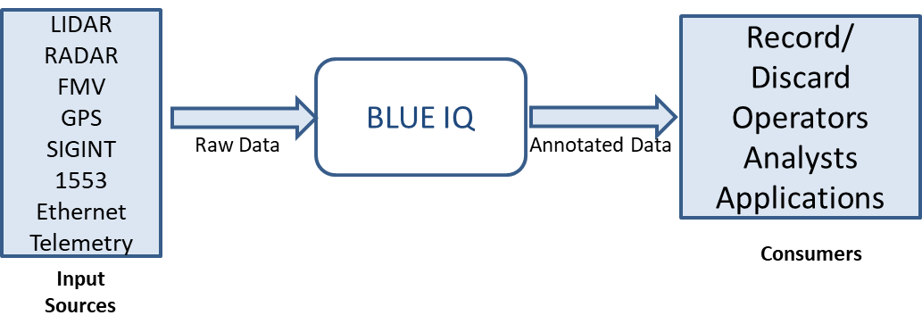
BLUE IQ
BLUE IQ: Analyze and categorize Data with SWaP limitations
  Extract, Categorize, and Structure Raw Data
    Raw Platform Data is analyzed by the BLUE IQ engine and KLV Metadata is generated
    KLV Metadata Annotation is muxed into the data stream
  Support each mission phase by reducing time to discovery and necessary manpower
  Easily create and update mission models with the BLUE IQ training platform
  Hot Swap mission models as ISR mission evolves and insights have been gained

Slide 27
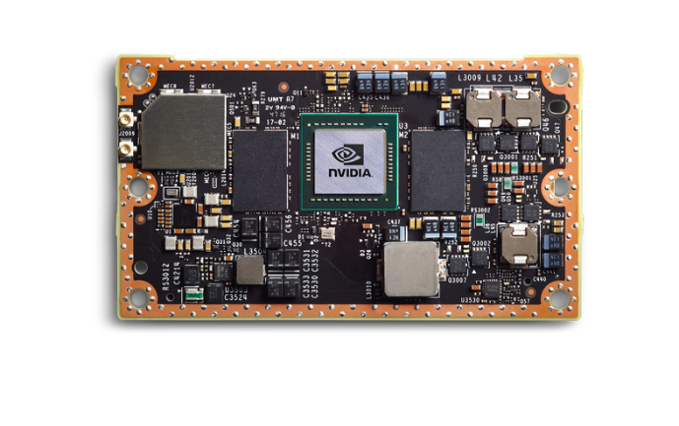
BLUE IQ FMV - Example
HD/SD Video Encoder
Model 4480E
NVIDIA
Jetson TX2
TuffCORD
KLV
Meta Data
Command/
Control
Command/
Control
h.264
Ethernet
Transport
Stream
Ethernet
Transport
Stream
Ethernet
Transport
Stream
MISB compliant encoder producing a transport stream from an h.264 input
  The software is set-and-forget
  Once configured, the encoder will continuously stream
  The encoder supports KLV meta-data insertion through the network interface
Jetson TX2 is a system provided by nVidia
  Tools and run-time examples are based on Ubuntu Linux OS (Core neural network
  Functionality is provided by Tensor Flow which is open source software sponsored by Google (version 1.7)
  Specific functionality for driving the data flow from the encoder to the TuffCORD is implemented in a set of Python scripts (ML libraries)
TuffServ software build includes ACCE software running on a RedHat 7.X system
  MPEG4 record and reproduce
  Record error detection, data validation and software transcoding
  Playback provides search capabilities for time, event marks and fault conditions
  Capable of exploiting the meta-data provided by the up-stream data source

Slide 28
BLUE SENTRY
AMPEX Blue Sentry has
  ML/AI Engine
  SNIEPR
  Visual Analytics
  Micro Firewalls
  Enhanced Data recorder
Focus is complete platform resiliency
Optimized multivariable dynamic defensive decisions at machine speed
Enhanced platform situational awareness
Focused defensive baseline prior takeoff
Ability to detect, identify and make defensive decisions via machine-to-machine engagements

Slide 29
How Do We Protect
The bad guys know and are trained on current defensive tools and strategies
Must be better than they are
  Faster, Outside the Box thinking and solutions
Machine Learning defensive solutions for companies
Understand your “Digital Footprint” and do things to minimize it

Slide 30
Questions

