Slide 1



Megatrends in the
Electrical Power Industry
Tom Golden
Program Manager, Technology Innovation
2018 Naval Postgraduate School
July 27th, 2018
© 2018 Electric Power Research Institute, Inc. All rights reserved.

Slide 2

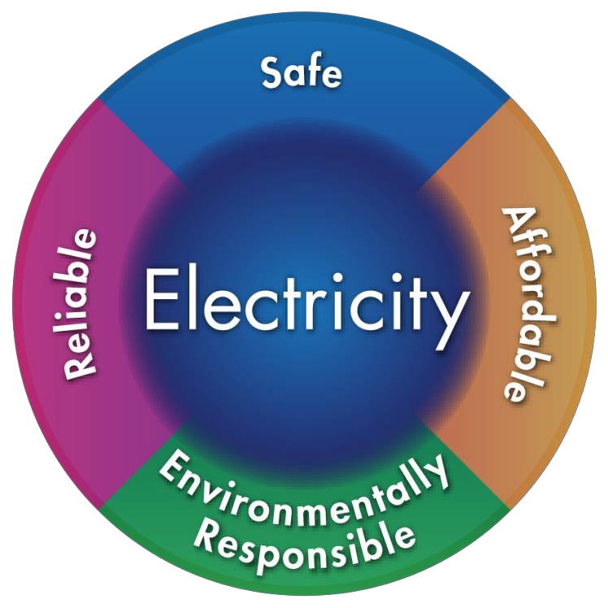
EPRI’s Mission
Advancing safe, reliable, affordable and environmentally responsible electricity for society through global collaboration, thought leadership and science & technology innovation

Slide 3
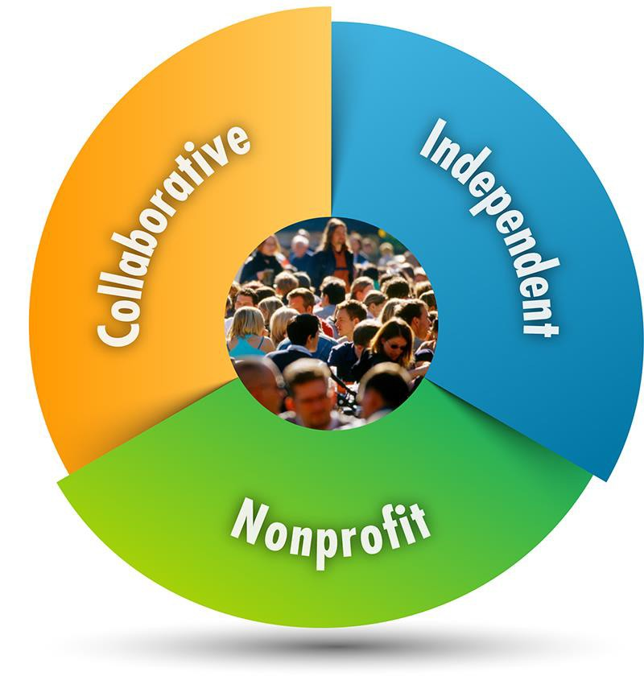
Three Key Aspects of EPRI
Independent
Objective, scientifically based results address reliability, efficiency, affordability, health, safety, and the environment
Nonprofit
Chartered to serve the public benefit
Collaborative
Bring together scientists, engineers, academic researchers, and industry experts

Slide 4

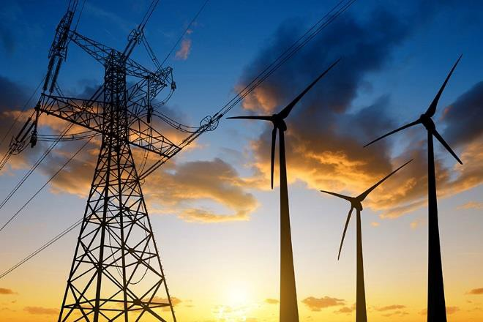


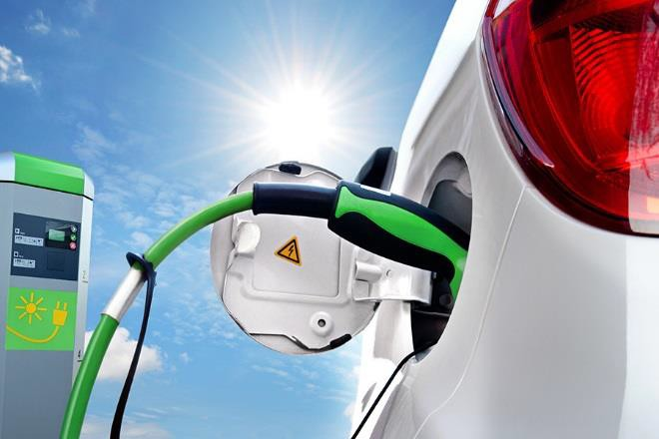

Our Members…
▪ 450+ participants in more than
30 countries
▪EPRI members generate approximately 90% of the electricity in the United States
▪ International funding – nearly 25% of EPRI’s research, development, and demonstrations

Slide 5

Born in a Blackout
Founded in 1972 as an independent, nonprofit center for public interest energy and environmental research
New York City, The Great Northeast Blackout, 1965

Slide 6






Utility Industry Megatrends
▪ Decentralization
▪ Digitization
▪Efficient Electrification

Slide 7
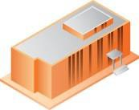

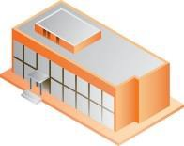
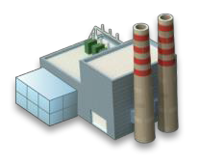

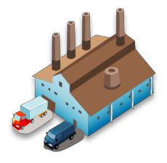


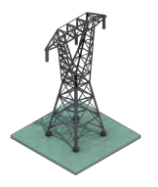

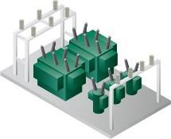
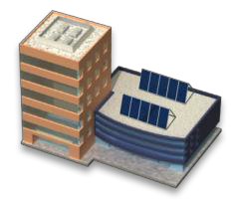



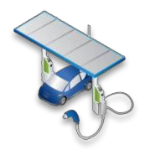


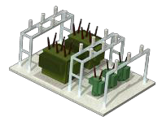

Decentralization - Energy Storage
Commercial& Industrial
Transmission
Operator
Load Serving
Distribution Operator
Entity
Industrial
Customer
Distributed
Resources
Commercial
Customer
Energy
Substation
Storage
Multi-
Dwelling Unit
Residential
Customer
Other Substations
Microgrid/Sustainable
Communities
Large-Scale Renewables
Substation
Microgrid
Residential

Slide 8
Future Costs Trends and Insights For Lithium Ion Systems
Lithium-Ion Battery Actual Costs and Cost Projections
800
700
600
500
400
300
200
100
0
Electric Vehicle Battery Costs ($/kWh)
2010
2015
EPRI Estimated Actual
2020 2025
2016 EPRI Projections
Source: EPRI Estimates, 2016

Slide 9

FERC Ruling 841 (February 2018)
Establishes energy storage as a major asset option
  Allowed to participate in energy, ancillary services, and capacity markets when technically able
Clarifies technical provisions for energy storage
  Participate as wholesale buyer and seller
  Minimum market participation size must be 100 kW or less
  Ability of storage to set price as both a buyer and seller
FERC ruling may significantly change how storage participates in organized markets

Slide 10
Forecasted Battery Energy Storage System Price Trends
Benchmark capital costs for a fully-installed energy storage system, of a 1MW/1MWh project
631
57
581
27
53
544
25
49
495
Developer margin
100
24
462
96
45
435
21
42
Grid connection
58
93
40
410
20
37
18
389
54
87
19
35
17
369
Developer overheads
68
51
83
34
16
65
46
81
EPC*
78
76
80
63
44
74
59
42
40
Energy Management System
74
57
38
71
55
53
36
64
52
Balance of System
60
57
50
54
52
PCS
241
50
214
193
172
156
142
Battery pack
129
118
109
2017
2018
2019
2020
2021
2022
2023
2024
2025
10
Source: BNEF, 2017 Global Energy Storage Forecast

Slide 11
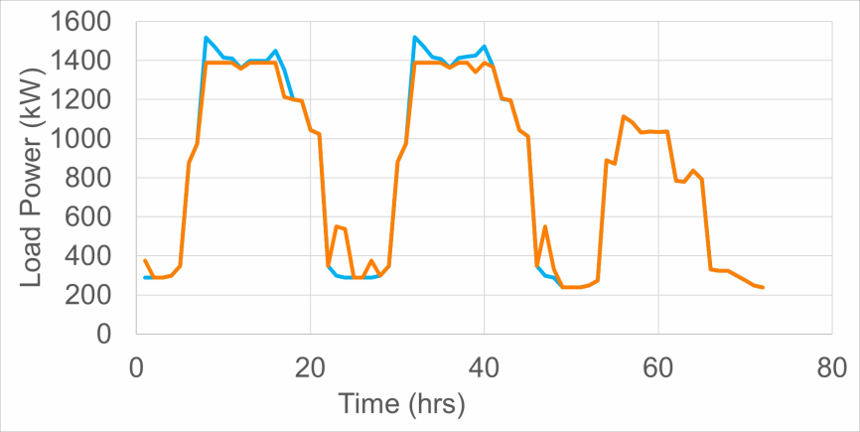
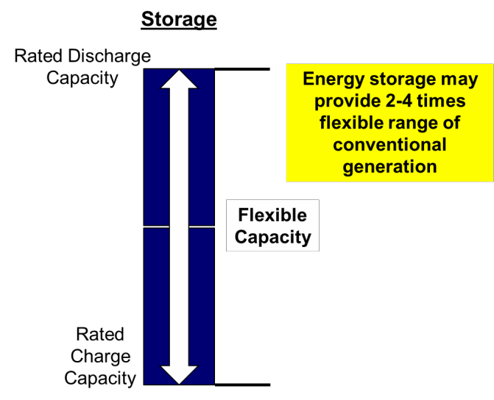

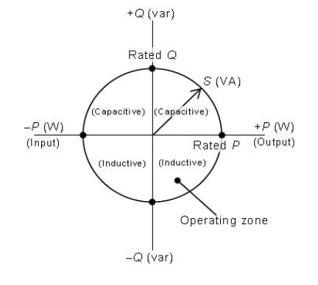
Energy and Utility Considerations
Capacity Resource: Peaker replacement or non-wires alternative
Flexibility Resource: System ramping,
renewable variability and uncertainty
Reliability / Resiliency Resource: Backup power, microgrid, black start
Voltage / Power Quality Resource: Dynamic, 4-quadrant inverter capabilities

Slide 12











Efficient Electrification of Agriculture
“We’re giving people food that tastes better and is better for them.”
– Matt Barnard
Leafy greens travel an average of
2,000
miles
“Grocers would love to get another four to five days of shelf life for leafy greens.”
– Mikey Vu
Farm to table in hours
rather than days
Vertical farming doesn’t use any soil
before reaching a store
“Because we work with physics, not against it, we save a lot of money.”
– Matt Barnard
Global supply of fruits & vegetables are
As much as
50X
greater yield than conventional farm
22%
short of nutritional needs
With up
to 95% less
of water use
Source: https://w ww.bloomberg.com/new s/features/2017- 09-06/this-high-tech-vertical-f arm-promises-w hole-foods- quality-at-w almart-prices

Slide 13
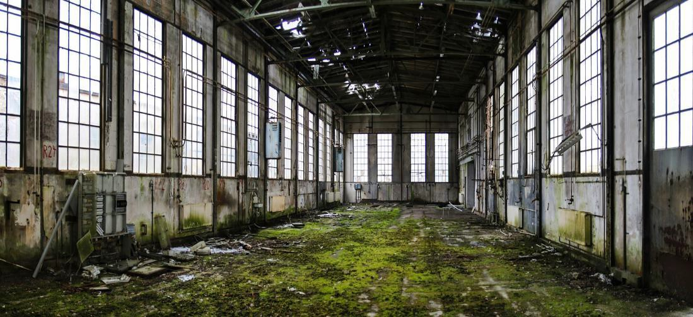








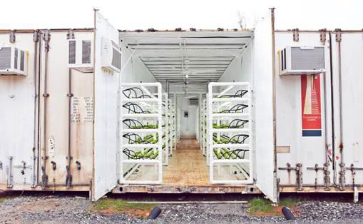
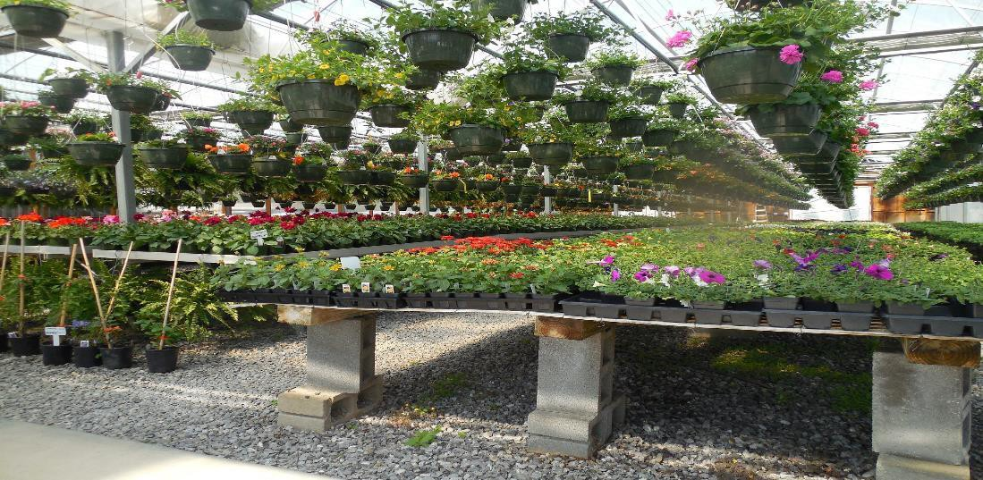







Custom Warehouse
Pods – Shipping containers
Controlled Greenhouse
Variants

Slide 14

Drivers for Indoor Food Production
Today 80% of the world’s arable land is in use.
– “If every city on earth were to grow 10% of its produce indoors, it would allow us to take 340,000 square miles of farmland back to forest” – Prof Dickson D. Despommier, Columbia University
▪ By 2050:
World population ~9.6 billion (currently ~7.5 billon)
80% of world population living in urban areas
Water conservation is a growing concern
Reduced “food miles”

Slide 15
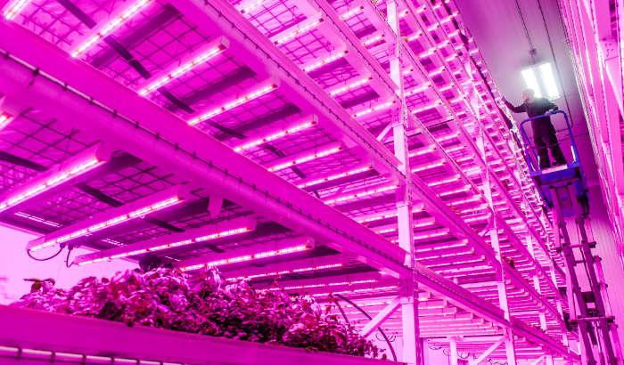
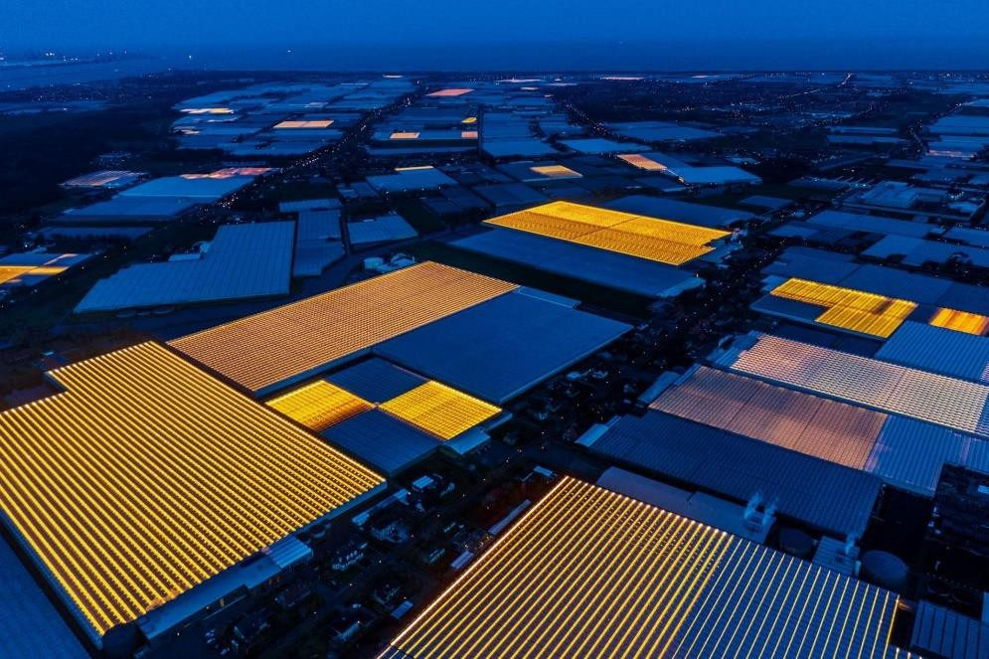
Energy and Utility Considerations
Potential Demand Response (DR)
Not supported in current codes/standards
Each installation potentially represents a large grid load
– Augmented greenhouses and vertical farms are often in the tens of MWs range
The impact of these operations on the grid must be fully understood
The operational characteristics of these installations are seasonal
Winter and summer have different load shapes
Photo from Philips Lighting / GreenSense Farms
Photo from National Geographic

Slide 16
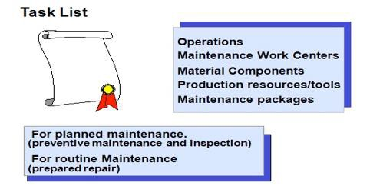






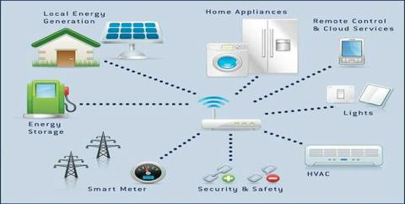






Digitalization – Artificial Intelligence
STRUCTURED |  | UNSTRUCTURED
Workflow/Process/Web |  | Image
APP
TYPE OF CLIENT
THING
Voice/Text
Sensor Network

Slide 17


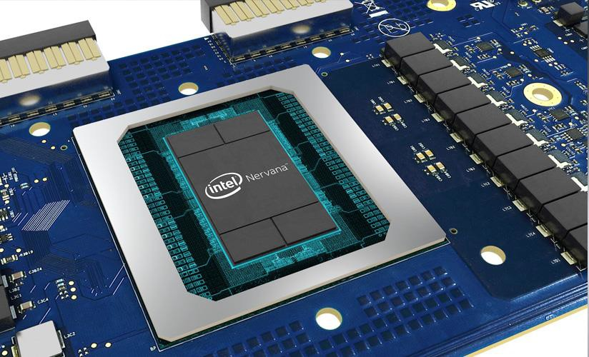

reserved.
© 2018 Electric Power Research Institute, Inc. All rights

Slide 18
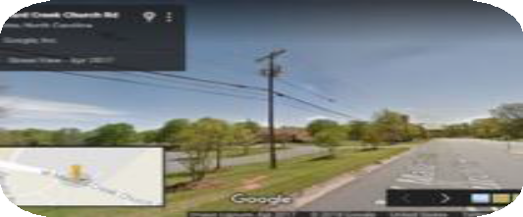













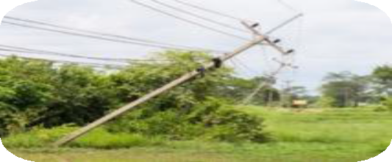

Energy and Utility Considerations
Acquire
“Street View” Style Images
UAS and Aerial
Crowd- sourced
Images as a Service
AI is the Link
Use
Asset Inspections
Vegetation Management
Storm Assessment
Others?

Slide 19



Continue the Discussion
EPRI website: www.epri.com EPRI Journal: eprijournal.com Twitter: @EPRINews
Visit our incubatenergy.org and follow the conversation on Twitter & LinkedIn
Subscribe to our Podcast on iTunes
Contact Tom Golden with any questions: tgolden@epri.com

Slide 20

Together…Shaping the Future of Electricity

