Slide 1
Informing the Fight:
Methods, Challenges, Strategies
A J-DEPLOI Case Study
Mr. Kawakahi K. Amina
HQ USINDOPACOM J46X
Mr. Joel Young
HQ USINDOPACOM J46X
Mr. Shawn Charchan
Group W
This brief is classified:
UNCLASSIFIED

Slide 2
Purpose and Desired Takeaways
Path that led to the J-DEPLOI solution
Current state of Operational Energy (OE) analysis
Brief J-DEPLOI demonstration
What we’ve learned about OE
Lessons learned about tool creation
Q&A
2

Slide 3
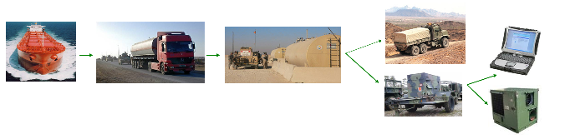
Initial OAD Study
Focused on Environmental Control Units (ECUs)
  Via USMC Operations Analysis Directorate (OAD)
  Goal: creation of a transparent, repeatable process
Research shed light on how to best conduct energy analysis
  High-fidelity data and more robust calculations
  Demand-side perspective
Led to development of Military Power and Energy Model (MPEM)
Most energy data and analysis was viewed from the perspective of the movement of bulk fuel
The fidelity of current energy analysis requires a focus on the energy demands of individual equipment
3

Slide 4
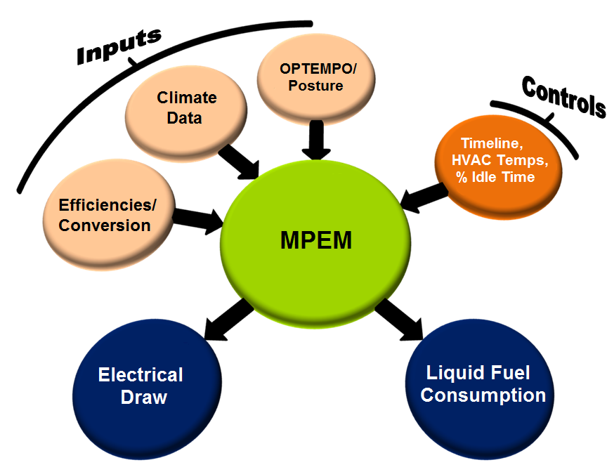
Military Power and Energy Model
MPEM is an enumerative simulation that calculates a task-organized force’s energy consumption from a Principal End Item perspective while accounting for operational and environmental factors.
Characteristics:
VBA model
Excel “wrapper”
Non-proprietary
USMC-owned
Graphical interface
Quantifies:
Fuel Use
Electricity Use
Electricity Generated
Battery Use
Generator Loading
Heating/Cooling BTU
4
Notes:
Alternate language: MPEM quantifies the complex interrelationships between liquid fuel, its conversion into electricity and the contributions of batteries and solar power on the battlefield

Slide 5
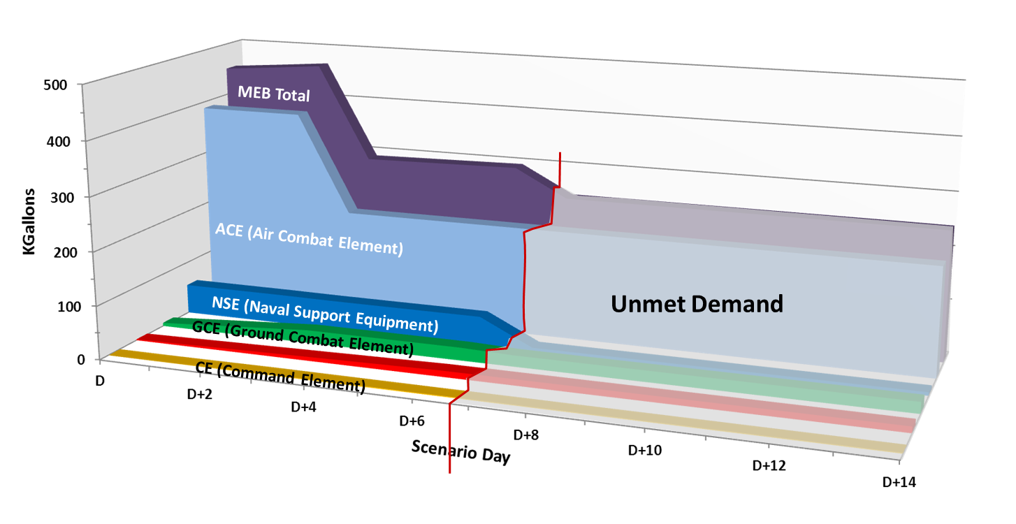
Subsequent MPEM-Supported Studies
MPEM-Supported Studies 2011-2012:
  How long can a MEB conduct full combat operations using only assault echelon shipping fuel?
  What are the impacts of the POM-14 Operational Energy (OE) investment on the future MEB?
  Due to the limits of amphibious shipping what actions could be taken to meet the doctrinal advertised capabilities of self-sustainment MEB?
5
Notes:
Shaping vs. Defining

Slide 6
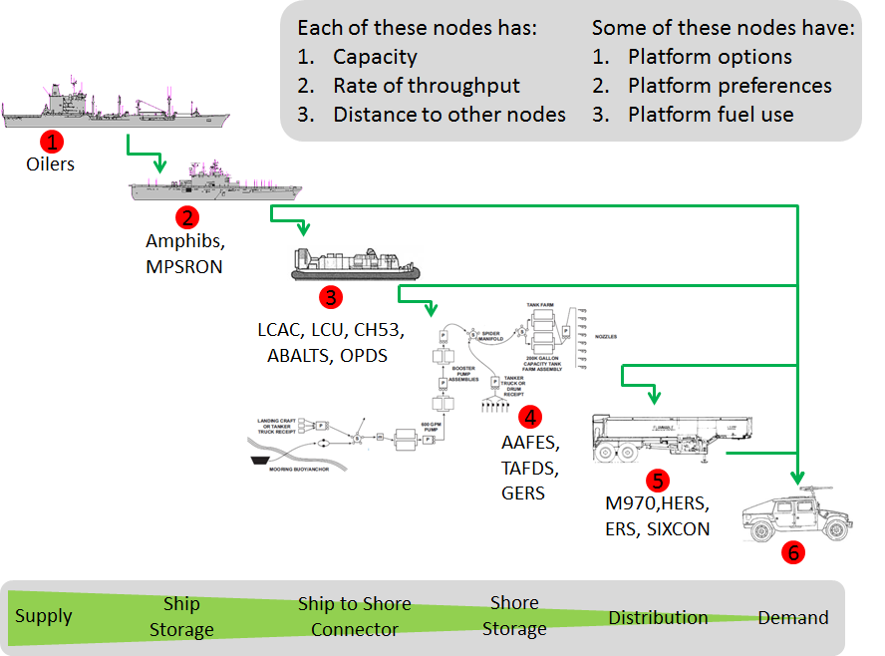
Meeting the Demand
6

Slide 7
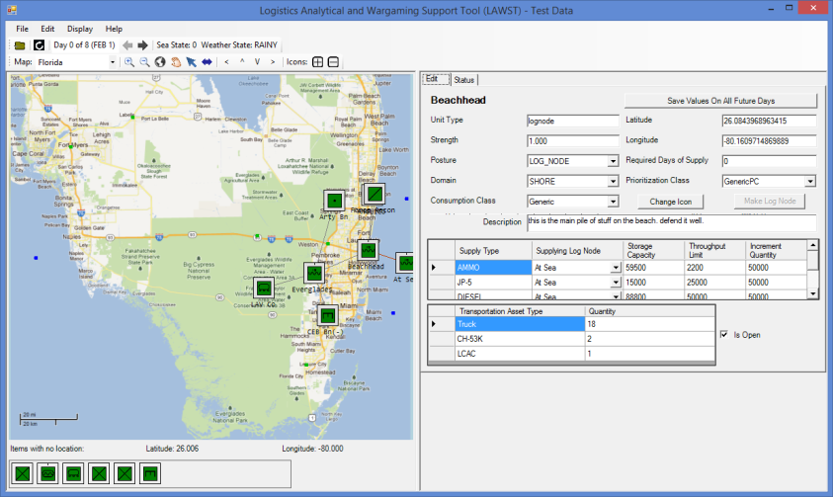
Logistical Analysis & Wargame Support Tool (LAWST)
A data-driven virtual network simulation that enables the quantification of supply-side logistical capacity and throughput, in the context of overall operations, from a temporal and spatial perspective.
Supplies:
-Unit supply status
-Supply shortfalls
-O/H supplies
-Lift utilization
-Storage utilization
-Log LIMFACs
Characteristics:
.Net based tool
Non-proprietary
USMC-owned
24-hr timestep
Map based
Drag & drop
LAWST aids understanding of the logistical feasibility of a scenario and quantifies the impacts that kinetic and non-kinetic actions on combat units, support assets, and infrastructure have on logistical network capabilities.
7

Slide 8
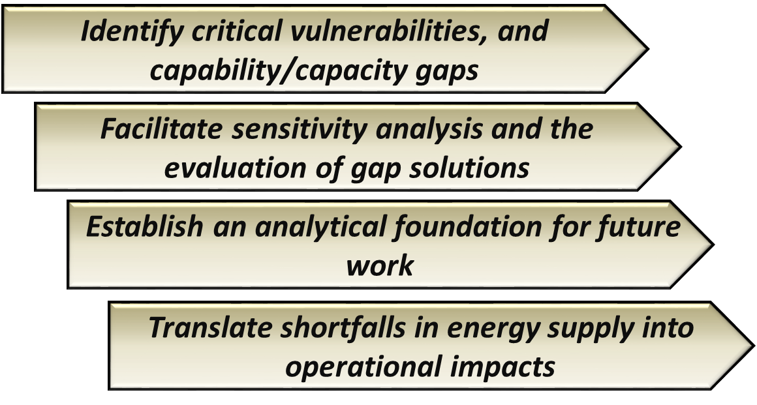
OR-15 Wargame and Study Goals
Estimate the amphibious force’s demand for OE and investigate the naval expeditionary logistics force’s ability to satisfy the demand for OE at critical points in the operation
8

Slide 9
OR-15 Findings
The 2025 naval energy distribution system is linear and brittle with multiple single points of failure and insufficient redundancy which presents a critical vulnerability to littoral operations
Programmed logistics and theater enabler force structures and equipment do not support EF-21 and limit the ESG/MEB’s ability to condition the joint operating environment during Phase II for follow-on operations.
Dated planning factors, information management systems, and support concepts could force commanders to unwittingly accept risk where they might otherwise mitigate it.
Rebalancing forces and transforming the logistics force are critical to enabling operational reach.
9
Notes:
Shaping vs. Defining

Slide 10
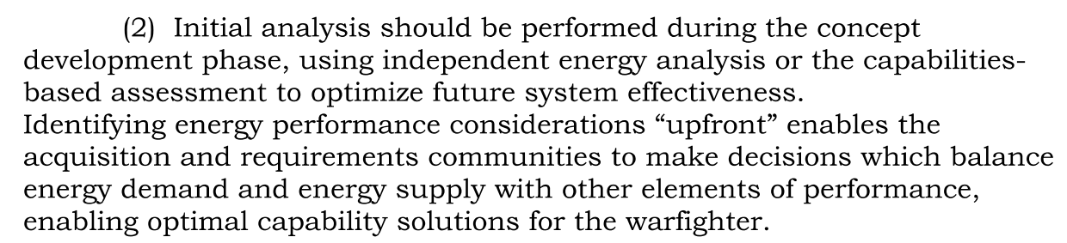
Energy Supportability Analyses
Used OR-15 as an “analytical baseline”
To be completed prior to Energy KPP generation:
Systems examined to date:
  JLTV, ACV 1.1, LHA-8, LXR, SSC, LCU 1700, CH-53K, F-35B
10
Notes:
Shaping vs. Defining

Slide 11
OPLAN Analysis Key Takeaways
The greatest OE risk is found during the initial creation of the lodgement
  We say, “no iron mountains,” but increasing storage capacity and lift ashore for fuel and other supplies may be required to mitigate resource shortfalls
Extending the buildup of combat power ashore might be required
  AE force and equipment composition will likely require rebalancing.
Units don’t have the fuel or water storage capacity to land with 3 DOS
  AAVs require fuel immediately upon landing (~120mi range) which may not be tactically feasible - possible mitigation: utilize ~70gal GERS-S to top off upon landing
BSA storage capacities and trafficability from the BSA are critical
  BSA fuel mobile storage capacity will need to be increased
Connectors OE capability and capacity isn’t sufficiently resilient.
  It’s a training and equipment issue: fuel blivets, slings, yokes, pumps, and appropriately trained personnel are limiting factors
11

Slide 12
Meta-Observations About OE-Based Risk
Translating OE-based risk into operational impacts is the means by which these issues garner attention
Planning factors typically supply a point estimate, which will nearly always be wrong (forces are task organized)
Our planned logistical networks often lack resiliency to account for disruptions due to weather, reliability issues, enemy actions, etc.
Concepts (Distributed Ops, MOC, Agile Basing, etc.) point the force in a direction that exacerbates the risk
The CCMDs and services are playing a sort of shell game in which they push their OE-based risk off on other services
Planners lack the tools required to examine the logistical risk associated with their plans
12

Slide 13
Energy ORM Integration
Goal: Get the fleet to own the problem
Method: PME/POI, MPEM/LAWST training, exercise/MCPP support
Engagements: Roadshow and MEF/MEB/MARFOR engagements via exercise planning, OPLAN revisions, schoolhouses, etc.
User feedback was critical to shaping our understanding of the difference between a planning tool and an analytical tool
Conclusion: There are 3 ways to field a software solution
13

Slide 14
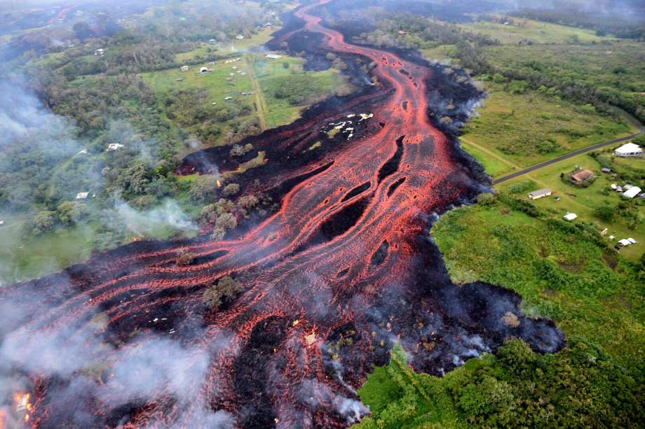
Wait… who?
“K”
“Kava”
14

Slide 15
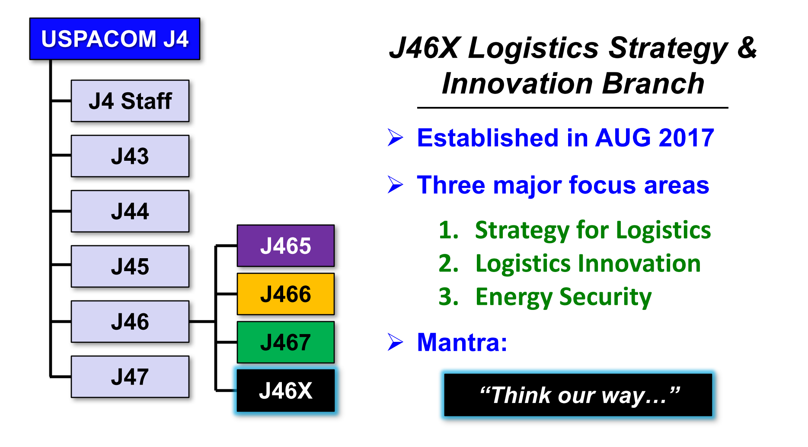
Who we are

Slide 16
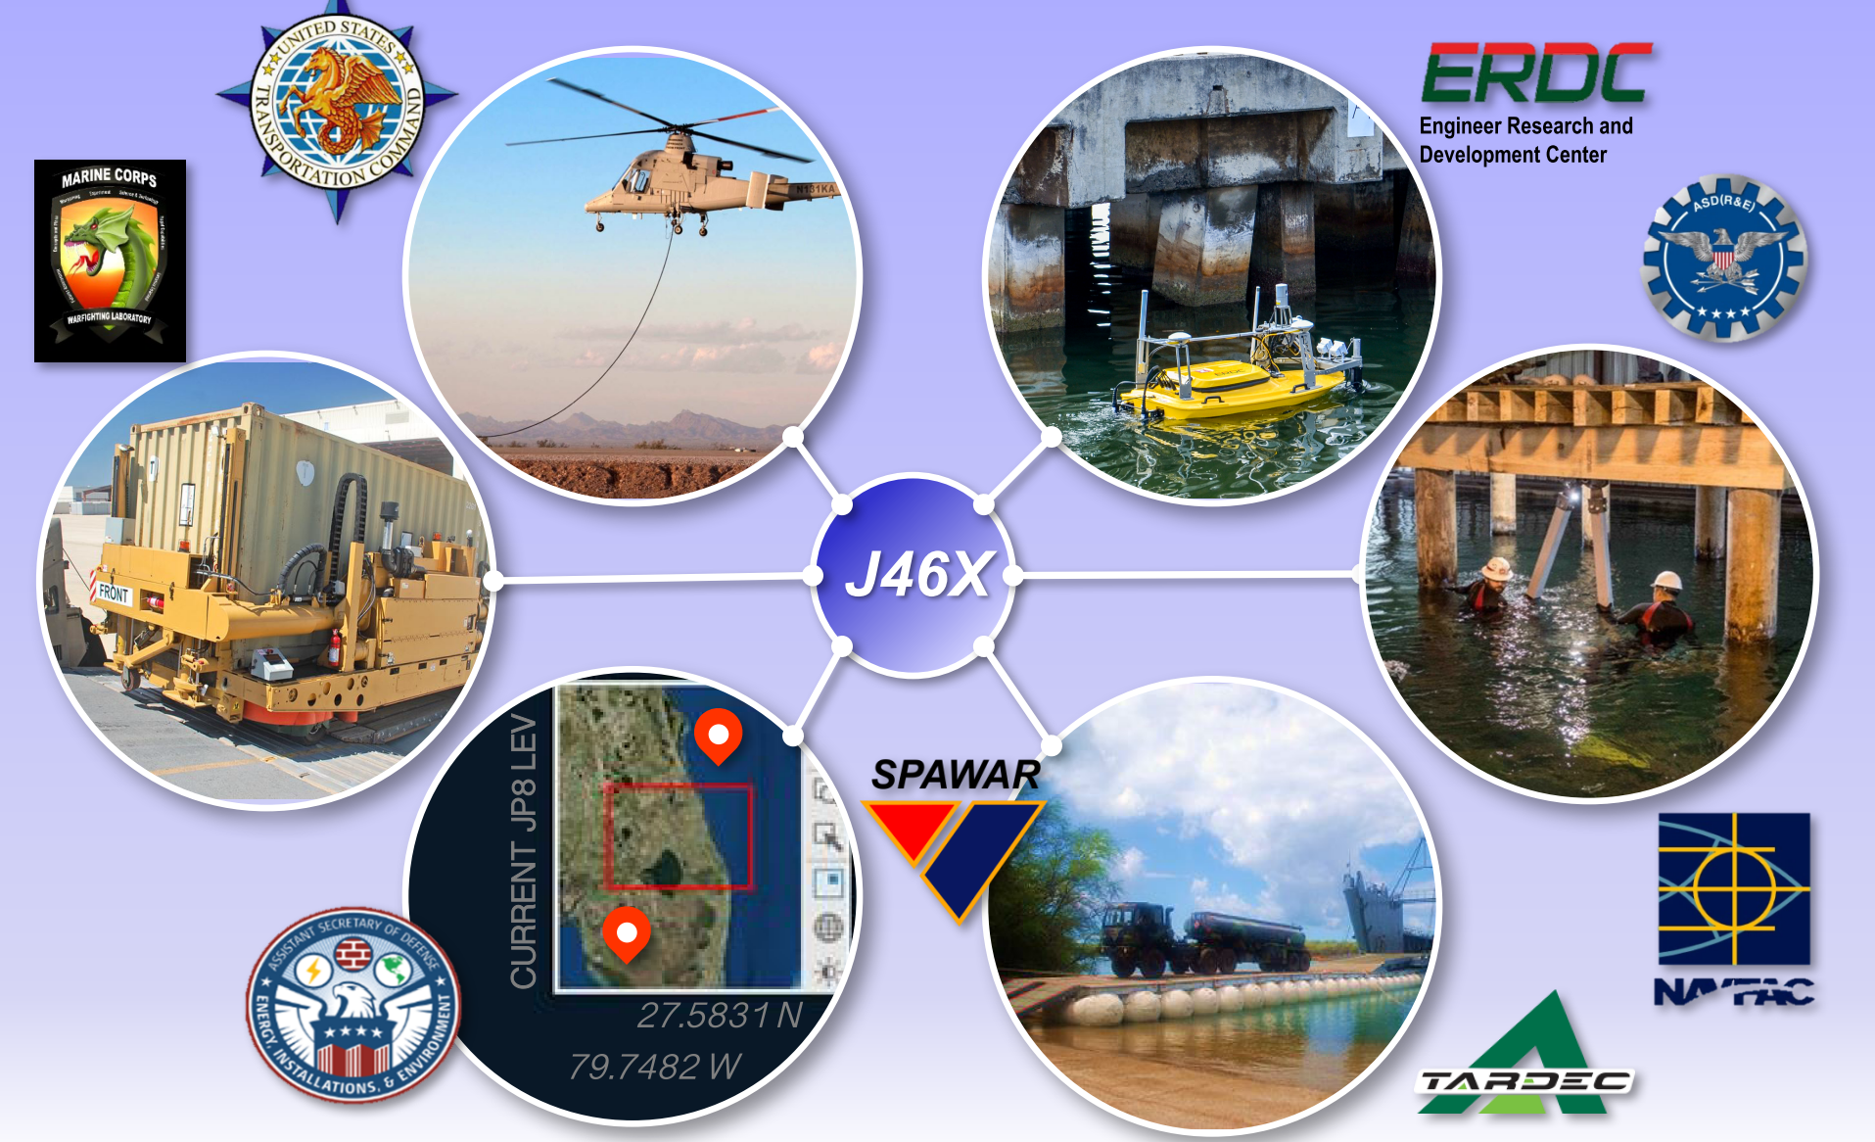
What we do

Slide 17
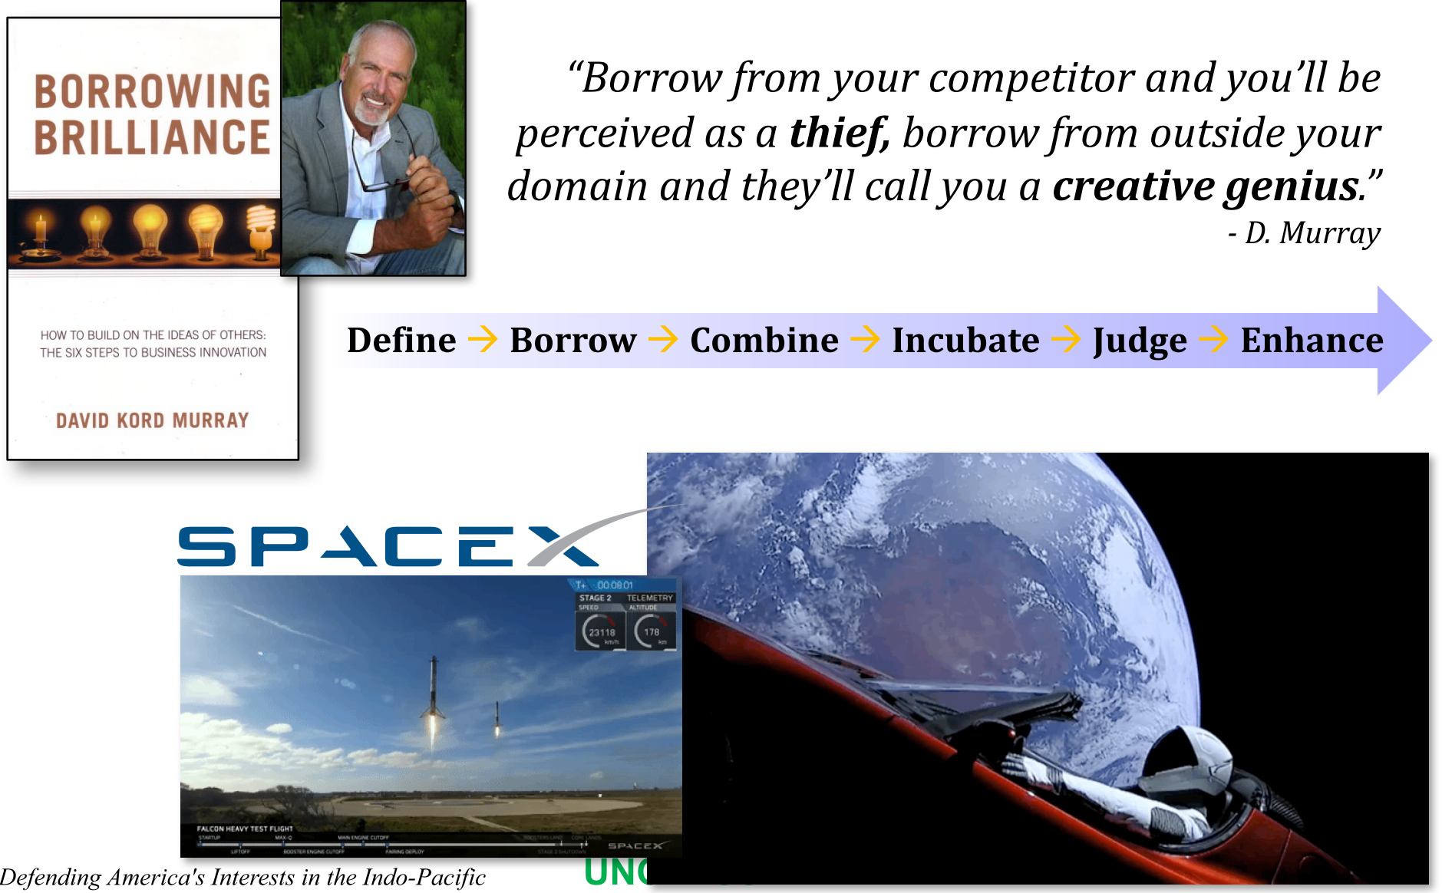
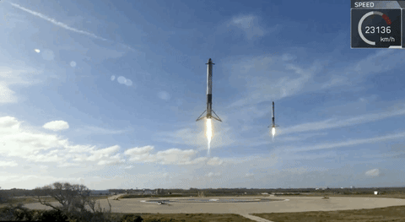
The “I” Word

Slide 18
TL;DR
6 51% 3,000 7 5
Geographic
Combatant
Commands
of Earth’s
Surface
languages
largest
militaries
allied countries w/
mutual defense
treaties
Munitions
Fuel
Airfields/Ports
18

Slide 19
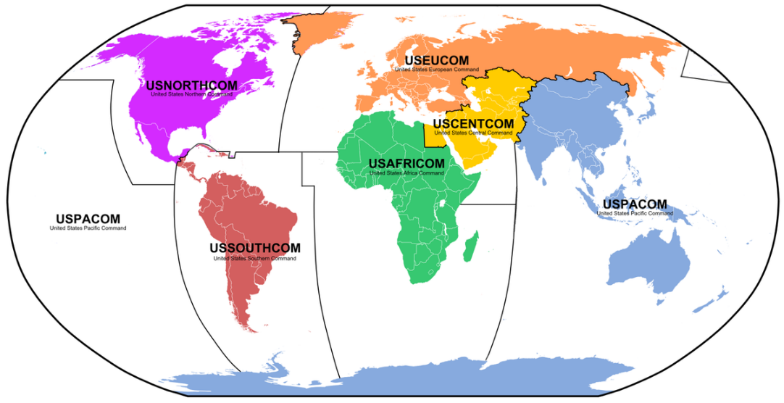
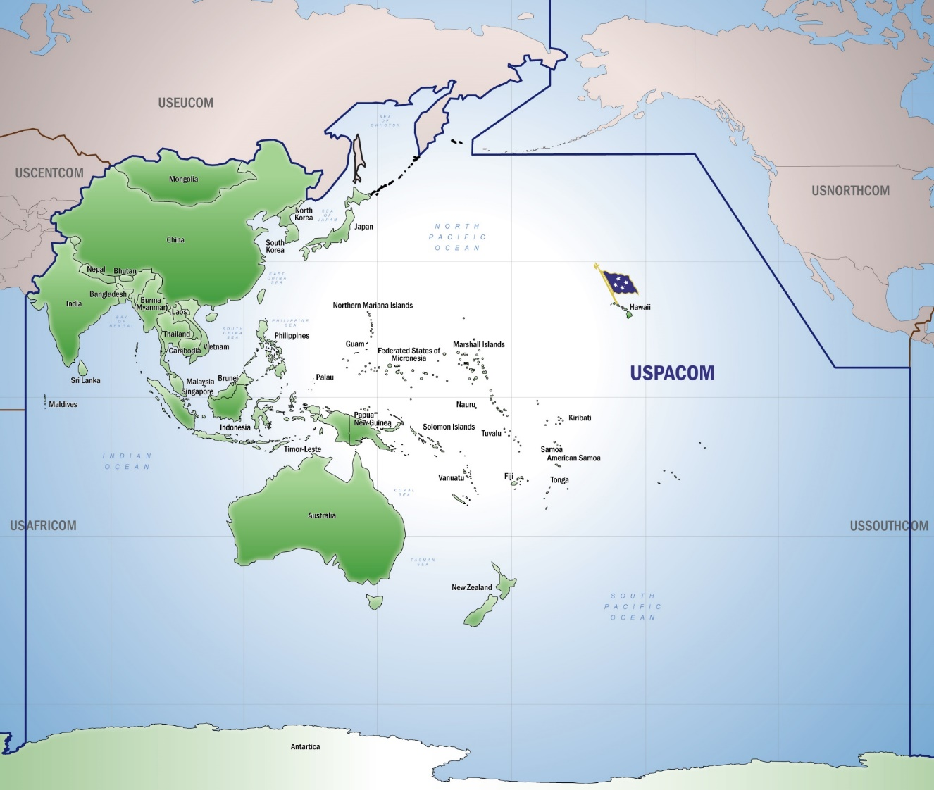

United States Indo-Pacific Command (USINDOPACOM)
19

Slide 20
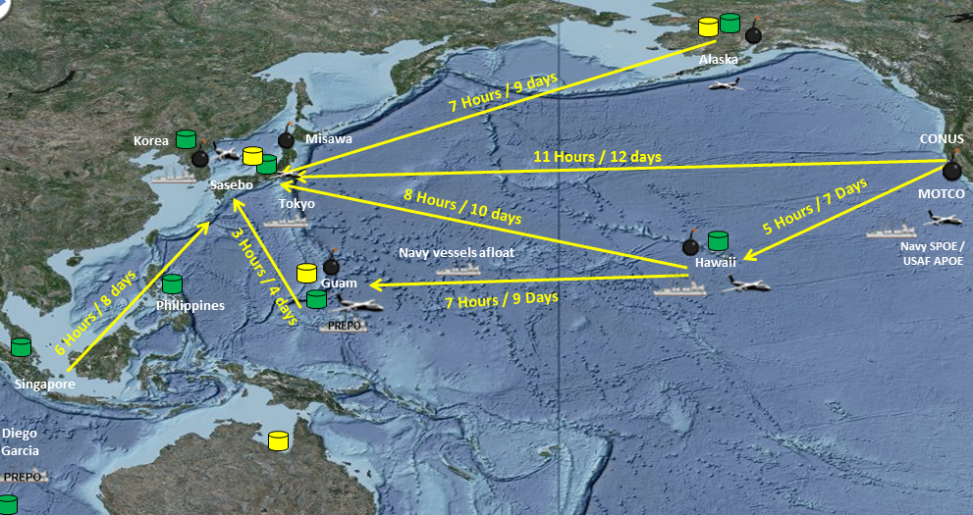
Challenges in the AOR
(Capable Enemy = Large US Req) X Tyranny of Distance X Reduced Capability/Capacity/Access =
Wicked Logistics Problem
Complexity, Scope and Volume of PACOM Logistic Challenges Combined with Extended LOCs, Increase Risk and Negatively Impact
Theater Responsiveness and Resiliency
20

Slide 21
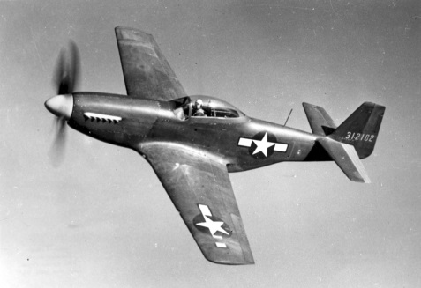

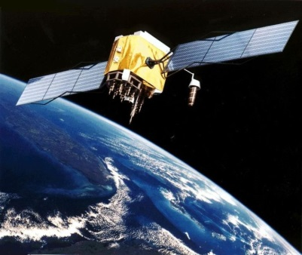
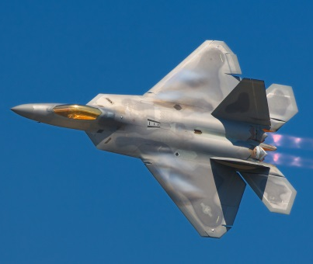
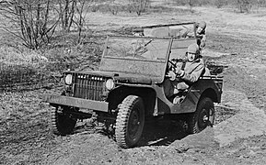
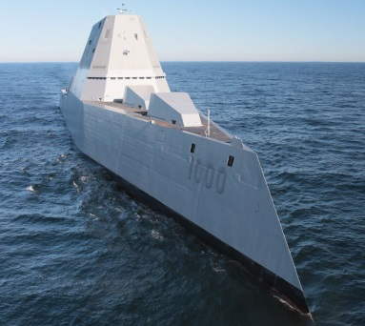
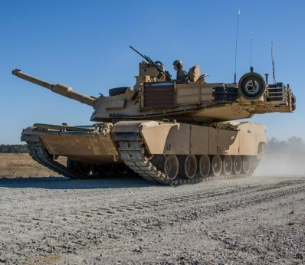
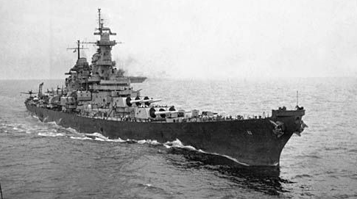
The Changing Landscape
From three domains…
…to five (or six)!
AIR
CYBERSPACE
SPACE
AIR
LAND
SEA
LAND
SEA
21
Notes:
Add voice-over here of endorsement from Service Energy Office

Slide 22
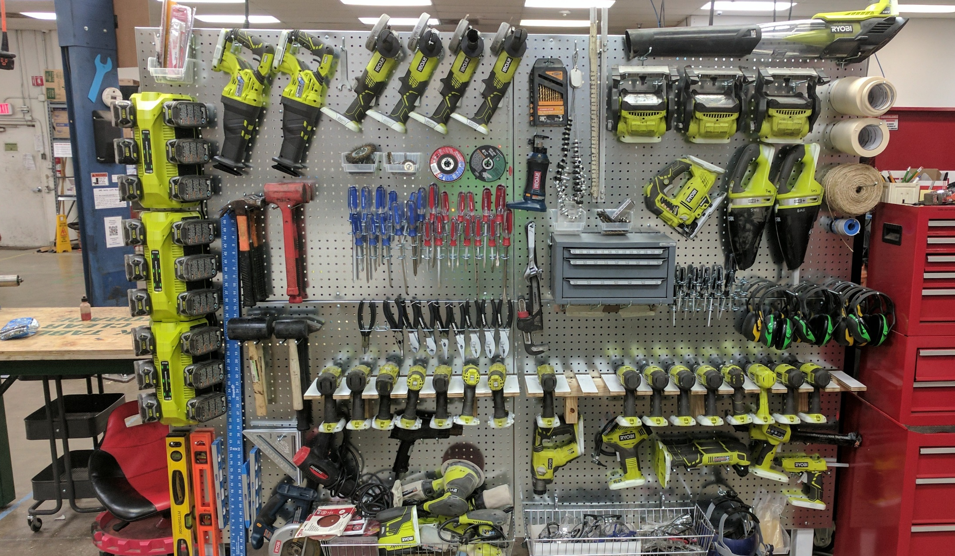
Disclaimer: A tool in the toolbox…
22

Slide 23

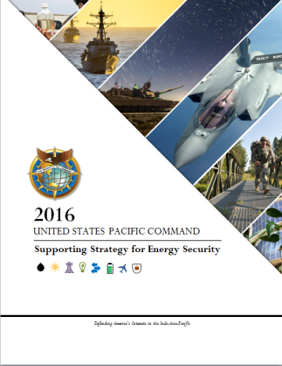
J-DEPLOI Program Summary
4yr OECIF-funded analytic tool and associated policy/process improvements to facilitate energy analyses earlier in the Joint Planning Process (JPP).
It would allow operational planner to visualize, quantify, and collaboratively evaluate fuel logistical vulnerability of various COAs during the COA Development, COA Analysis and Wargaming, and COA Comparison steps of the JPP.
GOAL: “Identify and Mitigate Energy Related Risks in Deliberate Planning” (DoD OES, 2016)
GOAL: “Reduce Energy System Risks through Analyzing and Adapting Plans” (2017, USPACOM SSES)
23

Slide 24
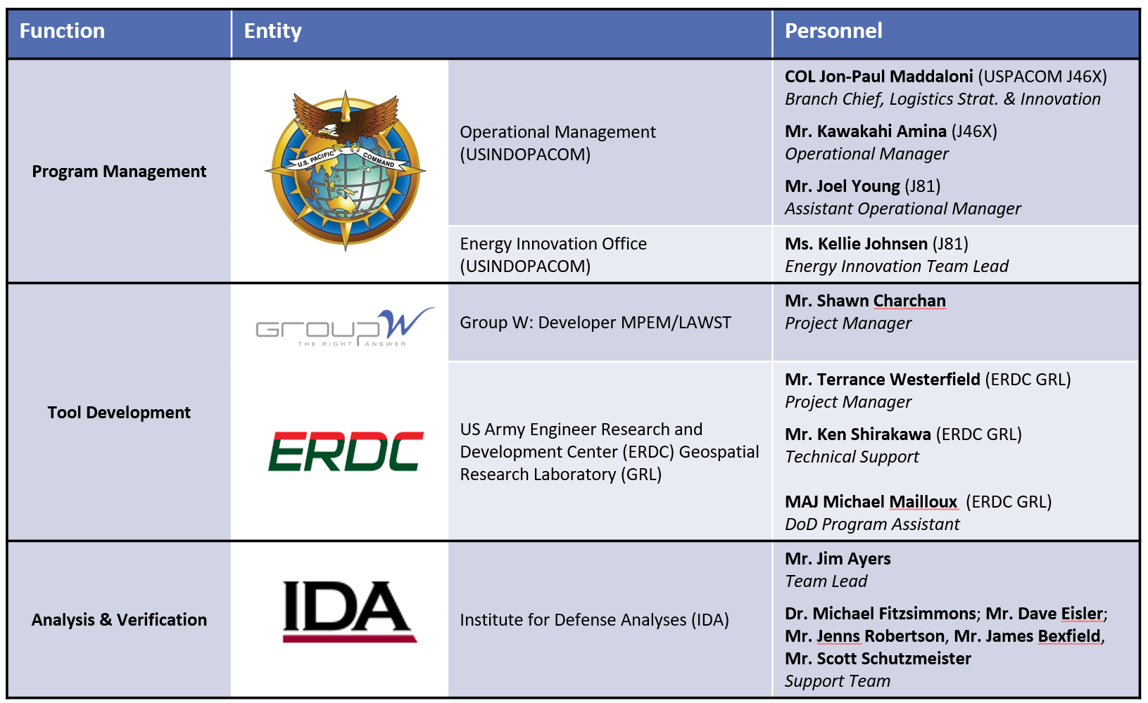
J-DEPLOI Team Structure
24

Slide 25

Key Takeaways from Phase I
It’s worse than we thought!
Most joint planning steps are performed in
basic Microsoft Office: PowerPoint, Word, & Excel
TPFDD development consumes >75% of planning capacity, leaving little for other phases of operational & logistics plans
TPFDD creation involves manual retrieval and “hand-jamming” of data from one system to another, consuming 20-70% of planning time, leaving little capacity for analysis
Positive difference may be within reach!
Map fuel supply chain across CCMD AOR
Machine-readable fuel status updates
Sketch force laydown in time and space with just enough data structure and collaboration to be an improvement over PowerPoint
25

Slide 26

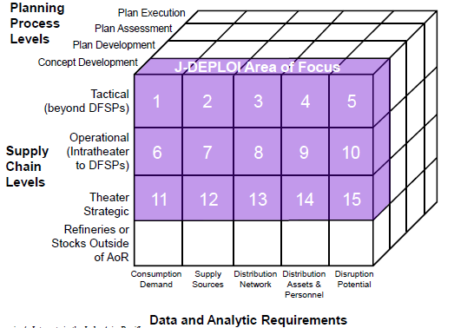
Defining the Scope of J-DEPLOI
Supply Chain Level (Tactical/Operational/Theater)
Planning Process Levels
Data & Analysis Requirements
26

Slide 27
Inventory of Available Solutions
27

Slide 28
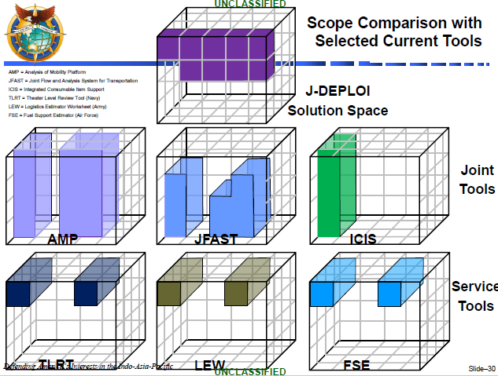
28

Slide 29
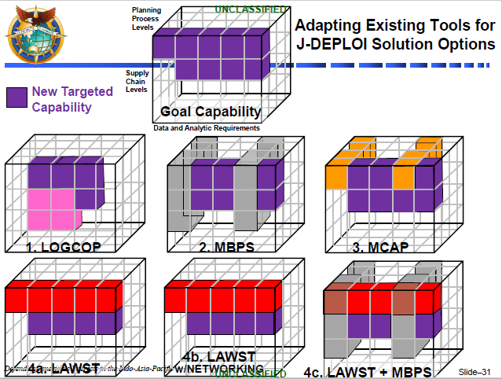
29

Slide 30
J-DEPLOI Demo
Joint Deployment Energy Planning and
Logistics Optimization Initiative
30

Slide 31
Lessons Learned
Accounting for every logistical capability on the battlefield requires a lot of time and data (model to the fidelity required to get at the questions)
Embracing design thinking principles will lead to a stronger user base and decrease training time
Integrate the tools and the insights they provide into the process you are trying to influence
Listen to the experts – some things brief really well but are wholly impractical and/or infeasible in practice
Having the greatest number of people using the same tools and data for wargames, planning, etc. might be the best way
A sound “business model” for the ongoing creation, rollout, and upkeep of a software solution is critical
31

Slide 32
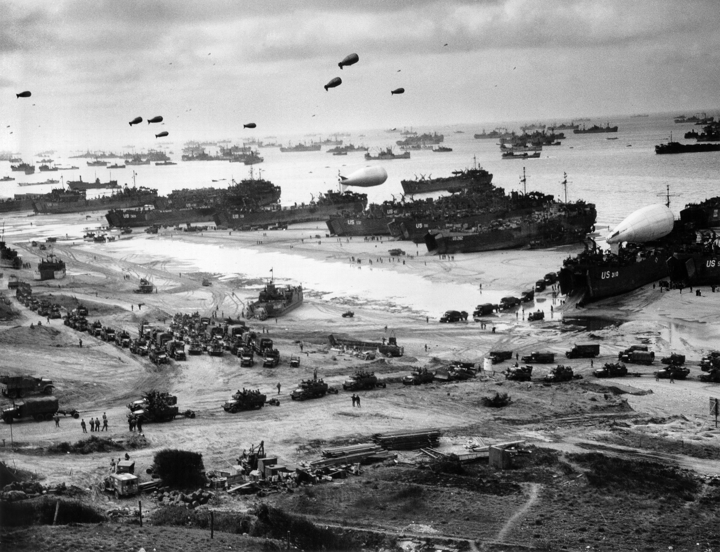
Discussion
32

