Slide 1
An introduction to
Digital Real-Time Simulation (DRTS) for advanced energy system testing
Thomas Kirk, M.A.Sc.
Solutions Engineer
OPAL-RT Technologies
thomas.kirk@opal-rt.com
July 13th, 2018

Slide 2
Presentation – OUTLINE
Introduction on OPAL-RT and Real-time simulation applications for electromagnetic and electromechanical systems
Challenges and approaches to Digital Real-Time Simulation (DRTS)
Examples/cases:
  User Example: Microgrid Controller Challenge
  User Example:
  Airplane Power Systems
  Cyber Vulnerabilities & Cyber-Physical Simulation

Slide 3
Introduction

Slide 4
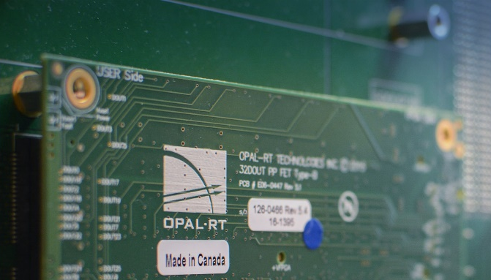



ABOUT OPAL-RT
  Founded in 1997 in Montreal, QC, Canada
  185 employees (20% growth in 2 years)
  US Offices: Michigan, Colorado
  Int’l: China, Germany, France, India, Australia, Chili, South Africa
  Giving back: over $50,000 raised in last 5 years towards local charities
  Winner of multiple SMB awards in 2016-2017
  In 2018 alone, OPAL-RT systems have been mentioned in 246 technical papers!
  Since company founding, that number is close to 3000!
Notes:
Please unhide the slide corresponding to the targeted market.
THIS SLIDE IS TARGETING THE AUTOMOTIVE INDUSTRY
OPAL-RT has a growing presence in US, European and Asia national research laboratories: Pacific Northwest, NREL, Fraunhofer, Agency for Science, Technology and Research, and Sandi National Laboratories
In the last 3 years, a growing presence in R&D utilities: Southern California EDISON, ENTERGY, New York Power Authority, Tenaga Nasional, Tubitak, and Hydro Quebec
Important system presence at power systems manufacturers: ABB, GE, and Siemens

Slide 5

OPAL-RT MISSION
Build better…
Faster, at lower-cost
OPAL-RT believes in empowering engineers and researchers with accessible, cutting-edge, real-time simulation technology in order to accelerate the availability of better technology.

Slide 6
Who we supply and work with
Federal and State Program involvement
Defense University Research Instrumentation Program (DURIP)
DOE's Advanced Research Projects Agency-Energy (ARPA-E) US Navy, Philadelphia, PA
DOE Solar Energy Technologies Office (SETO)
California Energy Commission (CEC)
DOE Enabling Extreme Real-Time Grid Integration of Solar Energy (ENERGISE)
DOD customers & related
US Naval Academy, Annapolis, MD
US Navy, NSWCCD, PA
US Navy, Philadelphia, PA
US Air Force, COS 90th, Lackland, TX
US Army Research Laboratory, Adelphi, MD
University of Dayton, OH (Air Force)
UT Austin Center for Electromechanics (Navy)
National Laboratories & FFRDC customers:
Sandia National Laboratory
Natural Renewable Energy Resources Laboratory (NREL)
Idaho National Laboratory (INL)
Pacific Northwest National Laboratory (PNNL)
Lawrence Berkeley National Laboratory (LBNL)
Oak Ridge National Laboratory (ORNL)
MIT Lincoln Laboratory
SLAC National Accelerator Center

Slide 7
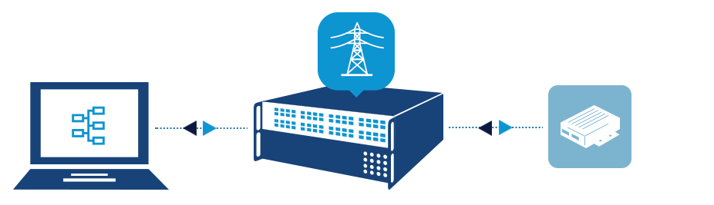
Hardware-in-the-Loop (HIL, HItL or cHIL)
Hardware-in-the-Loop (HIL) testing leverages Real-Time Simulation to connect real equipment and systems, through sensors and actuators, and “fool” them into thinking that they are connected to the real thing.
This allows users to perform realistic closed-loop tests without the need for testing on a real system’
While HIL typically refers to setups low-voltage level signal connections, Power Hardware-in-the-Loop (PHIL) can be employed for higher power testing (see later slide)
DUT examples
Controllers
  SCADA, EMS, DMS, Microgrid controllers
  “Low-level” controllers
  Vehicle ECU
Sensors
Intelligent Electronic Devices
  Protection devices
  “Smart” Sensors
Software systems
Workstation
Real-Time Simulator
Device Under Test (DUT)

Slide 8
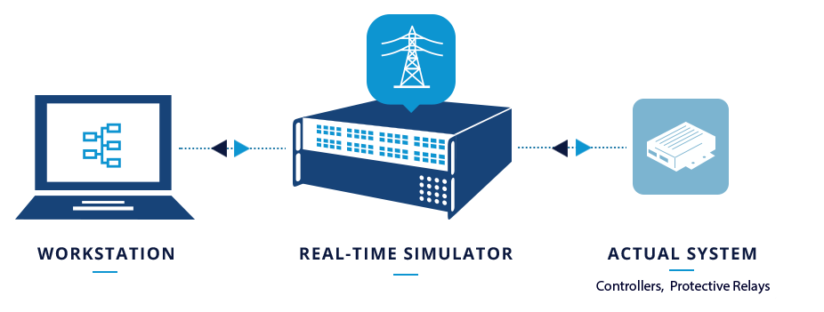
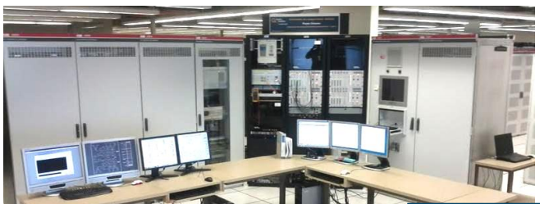

Hardware-in-the-Loop
ABB SVC Controller
Replica
ABB SVC Controller
Replica

Slide 9
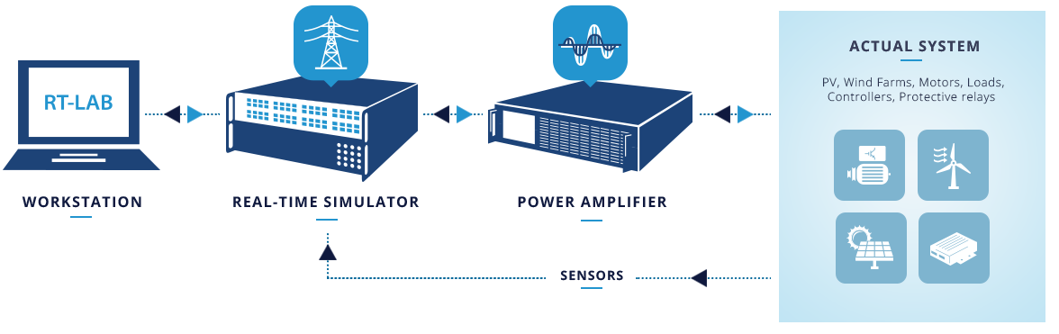
Power Hardware-in-the-Loop (PHIL)
An extension of Hardware-in-the-Loop (HIL), Power Hardware-in-the-Loop (PHIL) involves creating a virtual power interface between the digital simulation and devices under test
Typically, the power interface involves power amplifiers (Voltage and/or current), which must be selected carefully depending on the application to act as a source or sink
DUT examples
Controllers that sense at power
Power converters (Inverters, rectifiers, power supplies)
Protection devices
Electric machines
Batteries, Battery management systems (BMS)

Slide 10
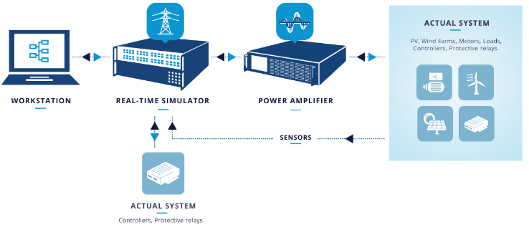
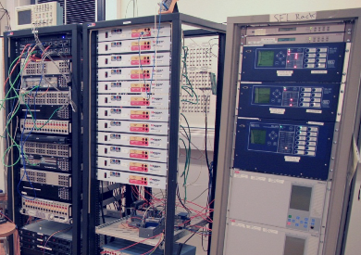

Power Hardware-in-the-Loop (PHIL)

Slide 11
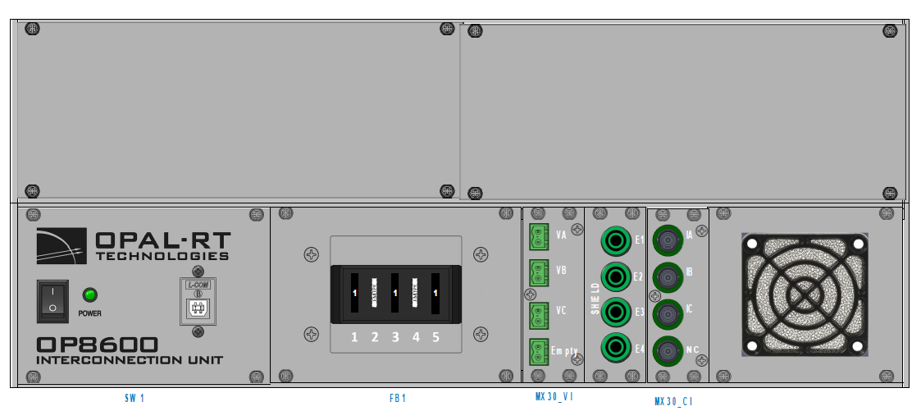
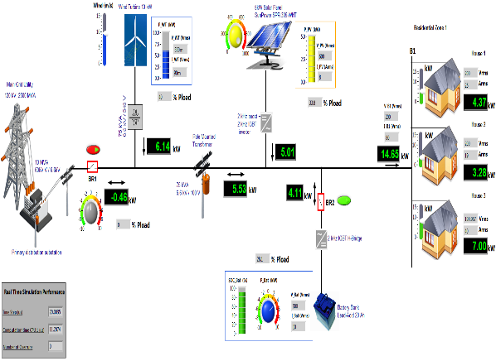
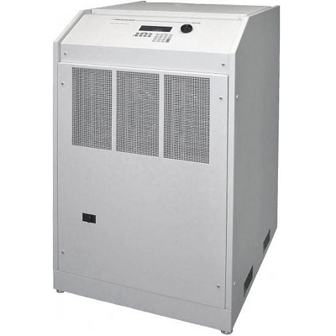
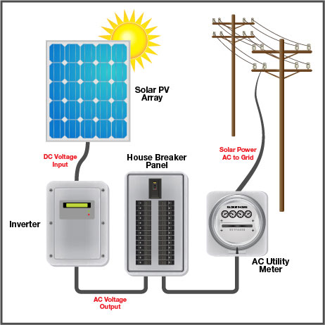
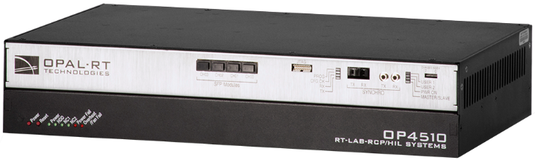
Power Hardware-in-the-Loop (PHIL)
Mapping Box & Sensing
V
a
b
c
Control Signals
n
Ia
Ib
Ic
Unit Under Test (UUT)
Control Signals (Aout) & Feedback (Ain)
Microgrid/Grid Emulation
Current Probes
Real-Time Simulator
Power amplifier 4-quadrant

Slide 12

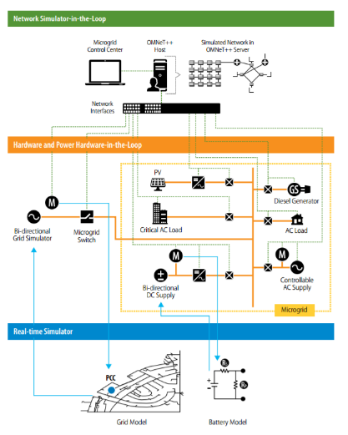














Power Hardware-in-the-Loop (PHIL)
Power Amplifier
Wind
Test line
Electric Vehicles
Hydro-Quebec’s IREQ
Substation
V_{mes} , I_{mes}
Control & Protection Interface
Solar
V_{sim}
Biomass
I_{sim}
Microgrid controller
New technology
Load
Real-Time Simulator

Slide 13
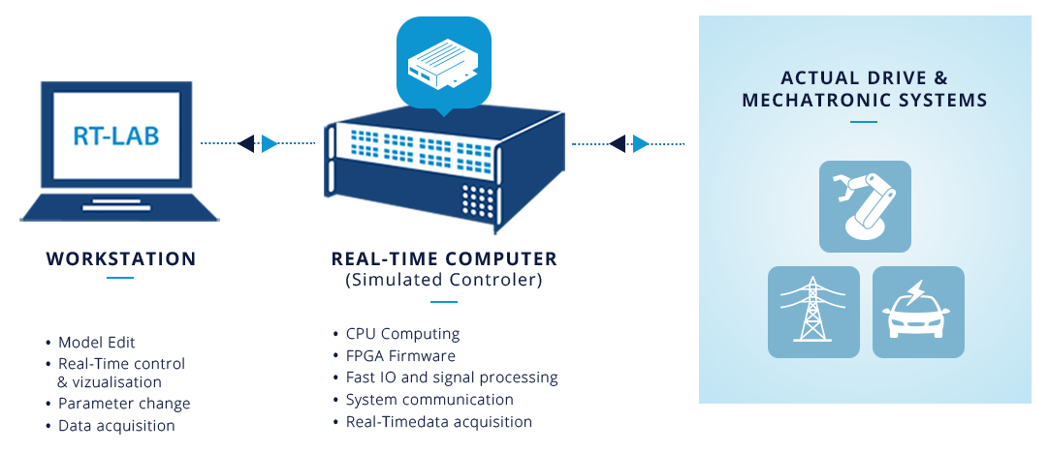
Rapid Control Prototyping (RCP)
RCP stands for Rapid Control Prototyping
Definition: RCP involves using the flexibility of a real-time simulator as a controller connected to real devices to facilitate controller development
Common application area:
  Robotics
  Electric motor control
  Inverter control

Slide 14

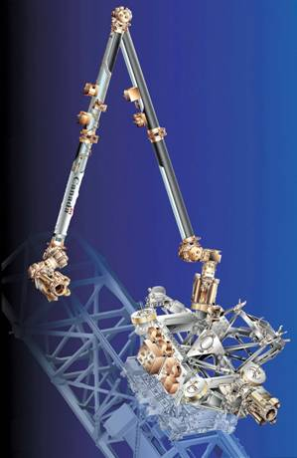
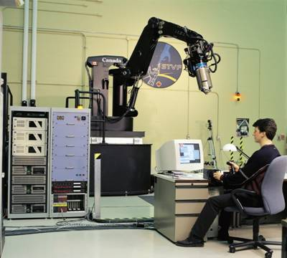
Rapid Control Prototyping (RCP)
Canadian Space Agency
  6 Pentium2 running @ 233Mhz
  Inter-communication FireWire (1394a)
  Simulink Model time step 1 millisecond
14

Slide 15
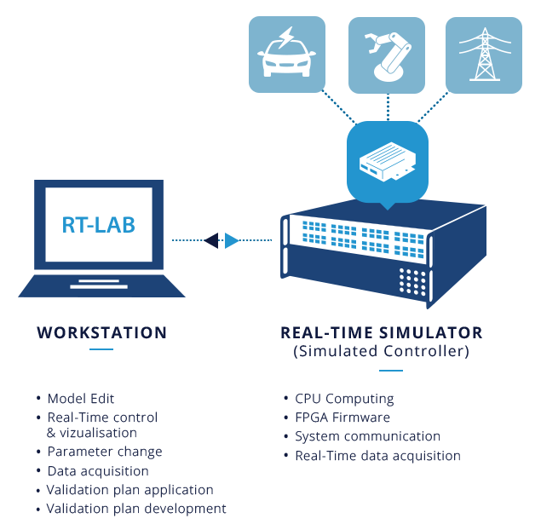
Software-in-the-Loop (SIL)
SIL stands for Software-in-the-Loop
Definition: The testing of production-grade software within the same system as the modeled plant.
Note: SIL does not actually require a time-synchronized simulation and, in many cases, tests can actually be performed faster than real-time with OPAL-RT’s capabilities

Slide 16


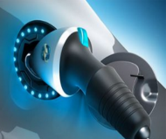





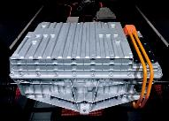
Real-Time Simulation Growth Areas
Onboard Power Systems
More Electric Aircraft (MEA)
Hybrid and Electric Transportation
Microgrid
All Electric Ship (AES)
Energy Conversion (Power Electronics)
Wide-area Monitoring, Protection and Control
Power System Controls
Battery Management System (BMS)

Slide 17
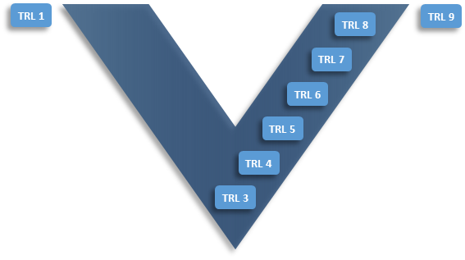
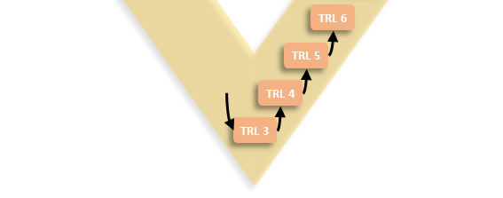
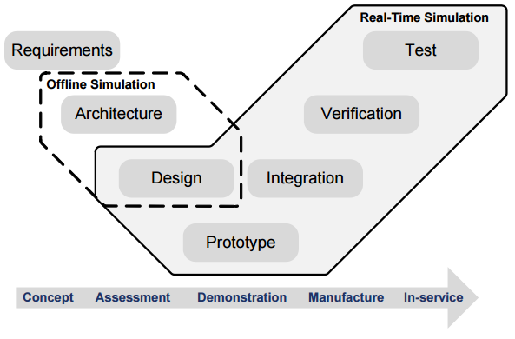
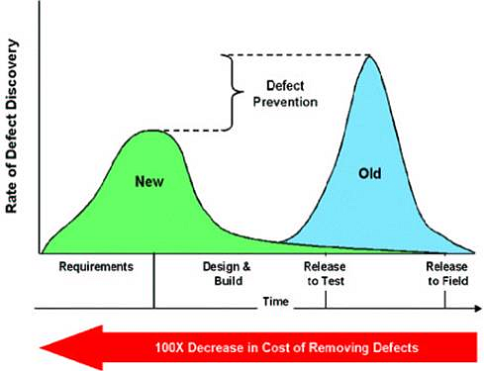
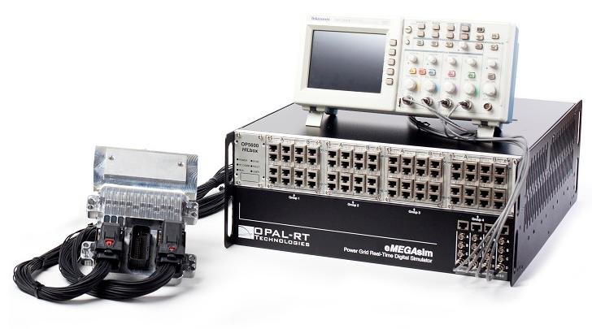
Model-Based Design
V-Cycle/Model:
  Catch design flaws early
  Reduce development cycle
  Test more at lower cost per test
Common auto industry example ECU/e-Motor:
  RCP/SIL:
    Initial control/algorithm development & testing
  HIL/PHIL:
    Embedded device prototype and software testing
    Certification, end-of-line testing
Requirements
Integrated V&V
Concept & System Modeling
Integrated HIL Testing
Design Studies
Unit HIL Testing
Real-Time Implementation
Boehm, Barry. Software Engineering Economics. Englewood Cliffs, NJ: Prentice-Hall, Inc. 1981.

Slide 18
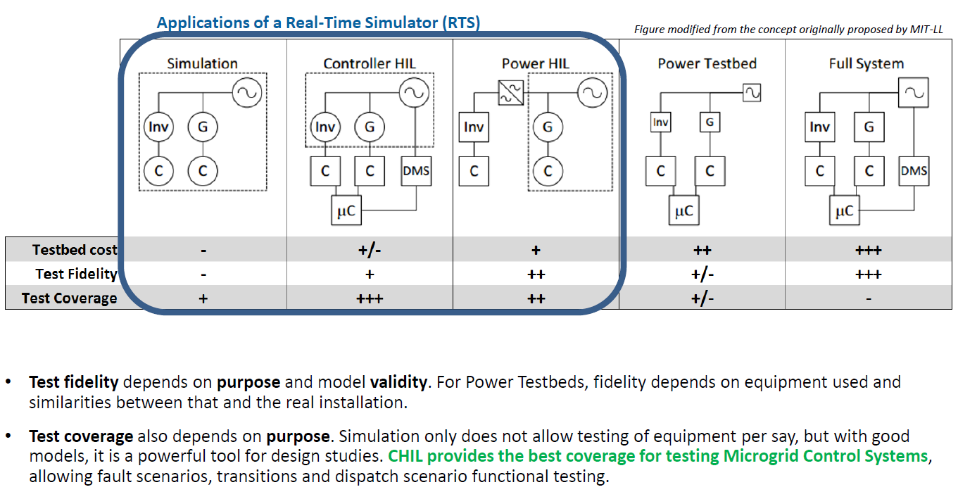
Testbed tradeoffs
    Source: R.O. Salcedo, J.K. Nowocin, C.L. Smith, R.P. Rekha, E.G. Corbett, E.R. Limpaecher, J.M. LaPenta, TR-1203: Development of a Real-Time Hardware-in-the-Loop Power Systems Simulation Platform to Evaluate Commercial Microgrid Controllers, MIT Lincoln Laboratory, Lexington, MA, Feb. 2016

Slide 19
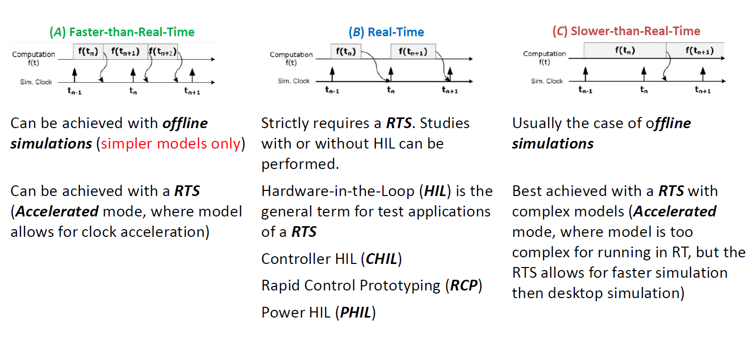
Computational considerations

Slide 20
Computational considerations
Slow
Dynamics
Slow
and Fast Dynamics & Transients
Very Fast Transients
Ultra Fast
Transients
Multi-area
Power Systems
Based on the use on INTEL 3.2 GHz i7
multi-core processors
Benchmark must be done
About 30-50 3-ph busses per core at 50 us
Very
Large
Dyn.
Sim.
Large Power
Systems
Computational Power
Medium-sized
Power Systems
FACTS
Active Filters
Multi-Converters
High-Power Drives
(1 – 10 MW)
Wind Farms
Multi
UAVs &
Vehicles
Interconnected
Mid-Power
Drive Systems
(100 kW)
10-kHz PWM
Mechanical
Systems:
Vehicles,
Robotics,
& Aircraft
Dynamics.
Fuel Cells,
Batteries
Small equivalent
Power Systems
for Control Testing
Very-low-power
Drives (<10 kW)
> 10 kHz PWM
IGBT Protection
Precise Models
High-power Drives (1 – 2 MW))
1- 3 kHz PWM
Trains, Off-Highway Electric Vehicle
Low-power Drives
(100 kW)
10-kHz PWM
Hybrid Vehicles
1 kHz
1000 us
10 kHz
100 us
20 KHz
50 us
40 kHz
25 us
100 kHz
10 us
250 kHz
5 us
1 MHz
1us
Source: Bélanger, Jean & Venne, P & Paquin, Jean-Nicolas. (2010). The what, where, and why of real-time simulation. Planet RT. 37-49.

Slide 21
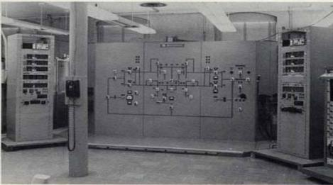
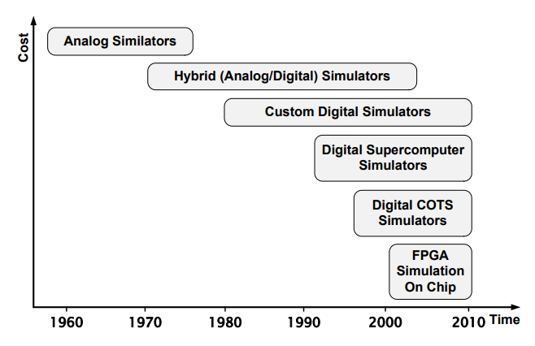
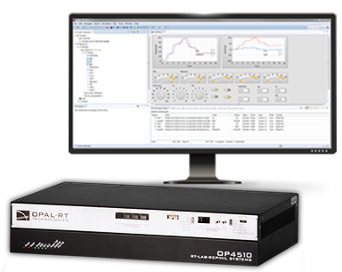
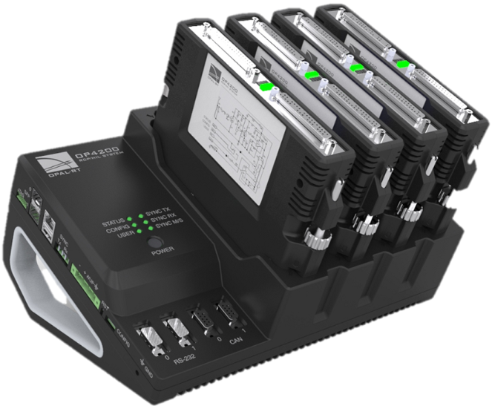
Computational considerations
Source: Bélanger, Jean & Venne, P & Paquin, Jean-Nicolas. (2010). The what, where, and why of real-time simulation. Planet RT. 37-49.

Slide 22
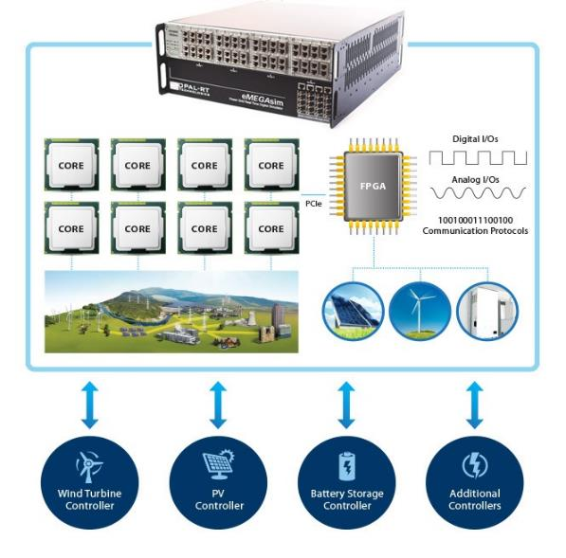
HIL Architecture

Slide 23





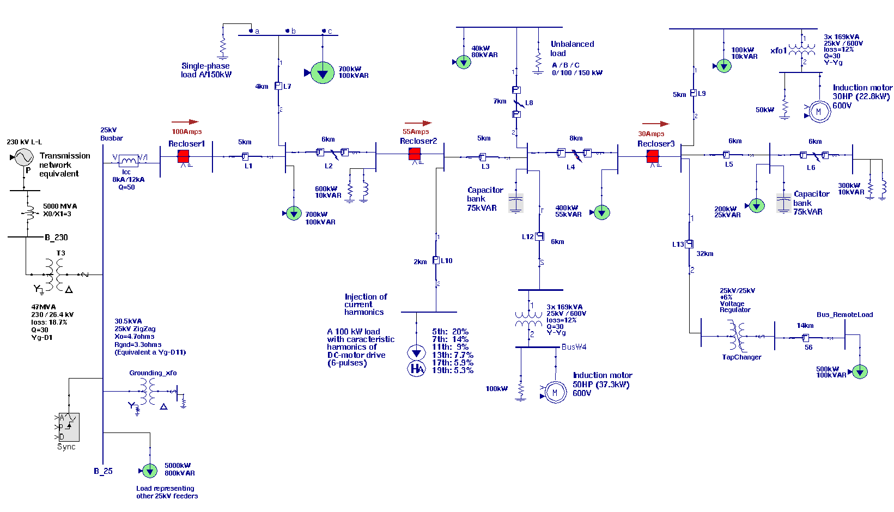
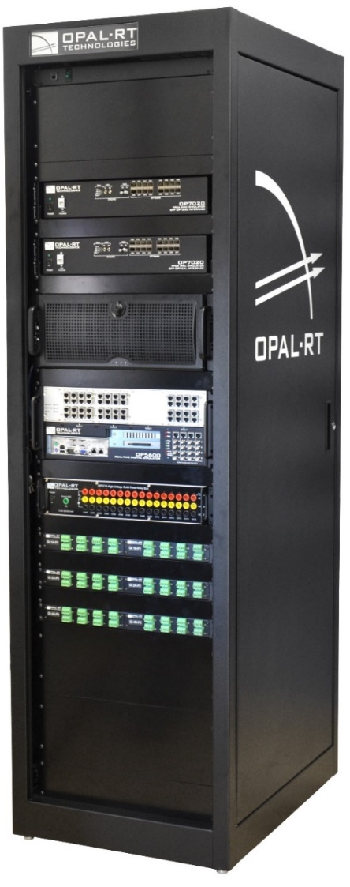
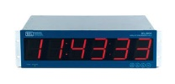


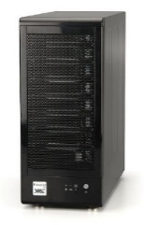
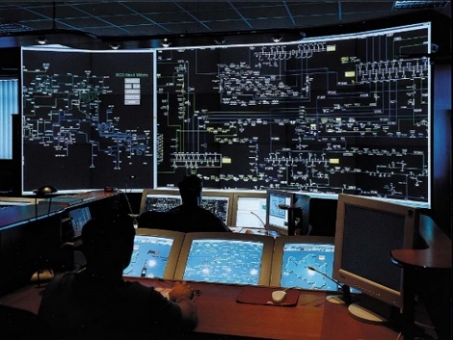
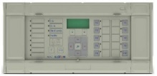



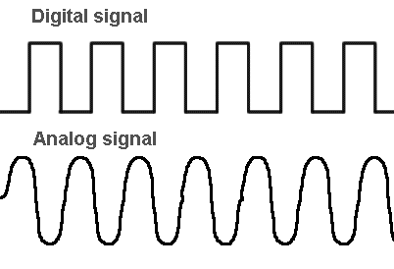


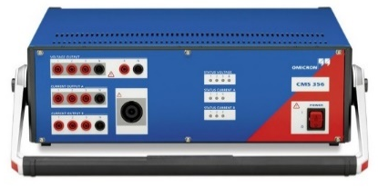
HIL Architecture
Antenna
GPS Clock
RF
Time sync
Time sync
PMU
Communication
Network
Analog out
C37.118
Phasor Data Concentrator(PDC)
Control Center: Control, Applications and HMI
Virtual Devices
IEC61850 SV, GOOSE
Relay
Digital Comm
Synchropasors
Analog out
Analog, Digital IO
Controller
Modbus, DNP3, etc.
To & From Virtual Devices
Commands, Status
Power Amplifier

Slide 24
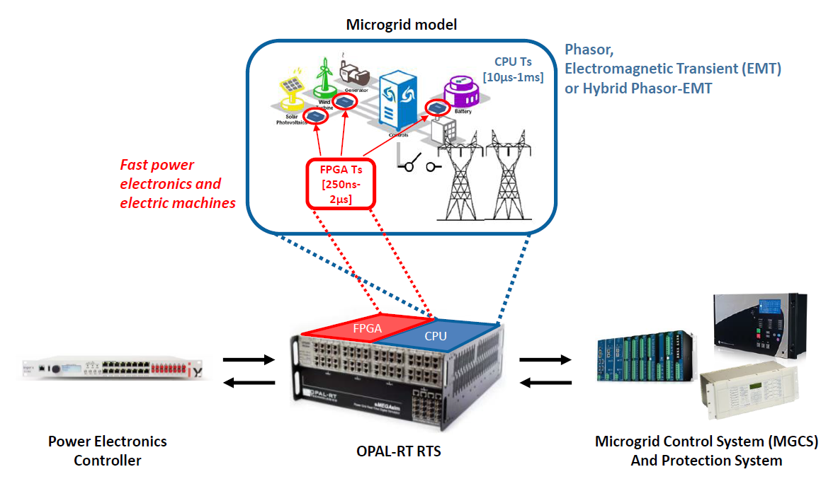
HIL Architecture

Slide 25
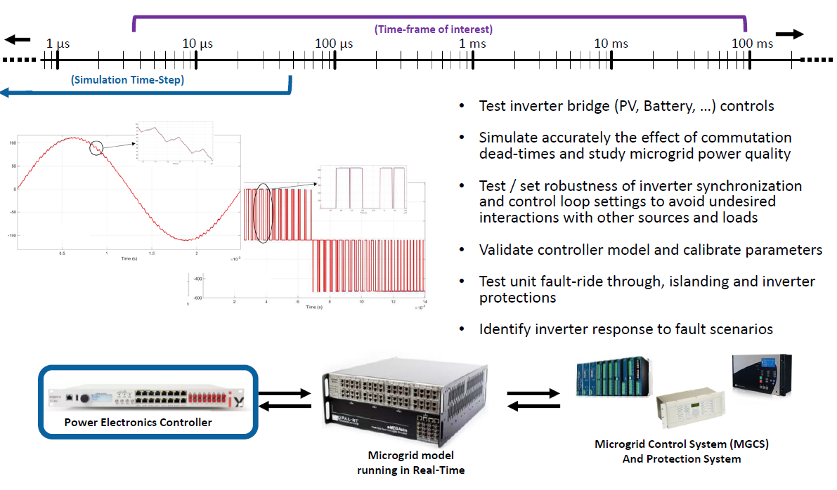
HIL Architecture

Slide 26
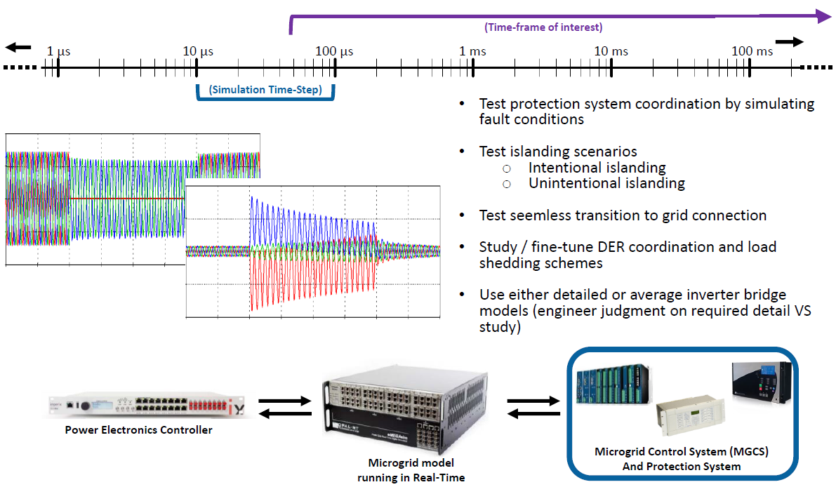
HIL Architecture

Slide 27
Challenges & Approaches

Slide 28
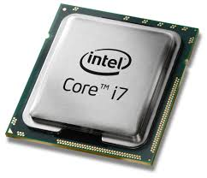

Challenges
While HIL can help, real-time simulation can bring its own sets of challenges especially when considering electrical systems with short lines and power electronics
Complex and computationally intensive models
  Modelling expertise beneficial
  Parallel processing can help; however, short lines limit standard decoupling techniques used for large power systems
Power electronics with high-frequency switching
  Require innovative CPU models, very fast FPGA simulations and I/Os
Require smart grid functionality support
  Communication protocols (IEC61850, Modbus, DNP3, etc.)
Delay
Delay

Slide 29
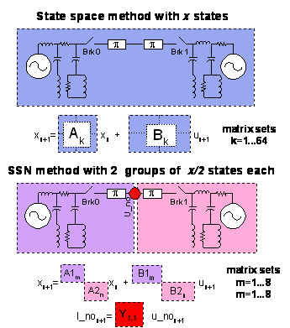
Challenges
Parallel processing is an extremely useful tool achieving real-time electromagnetic transient (EMT) simulation
  In larger systems, long transmission lines are natural decoupling points. No artificial delay.
How can we address the challenge posed by short lines?
  Improve hardware performance or
  Improve solvers
Traditional methods use State-Space or Nodal techniques.
  Why not combine both to reduce computation time?
Delay
Delay

Slide 30
Hybrid ARTEMiS-SSN Solver
State-Space Nodal solver: ARTEMiS-SSN
  Split circuit into groups and iterate:
    Solve using State-Space technique
    Check for admittance at Nodal interface
    Repeat
Advantages vs. Traditional Solvers:
  Very computationally efficient
    Example: solving size 8 vs 64 matrices
  Isolate switches into groups
    Microgrids have many (breakers, inverters, etc.)
  A large system can be solved on a single processor or parallelized for performance boost

Slide 31
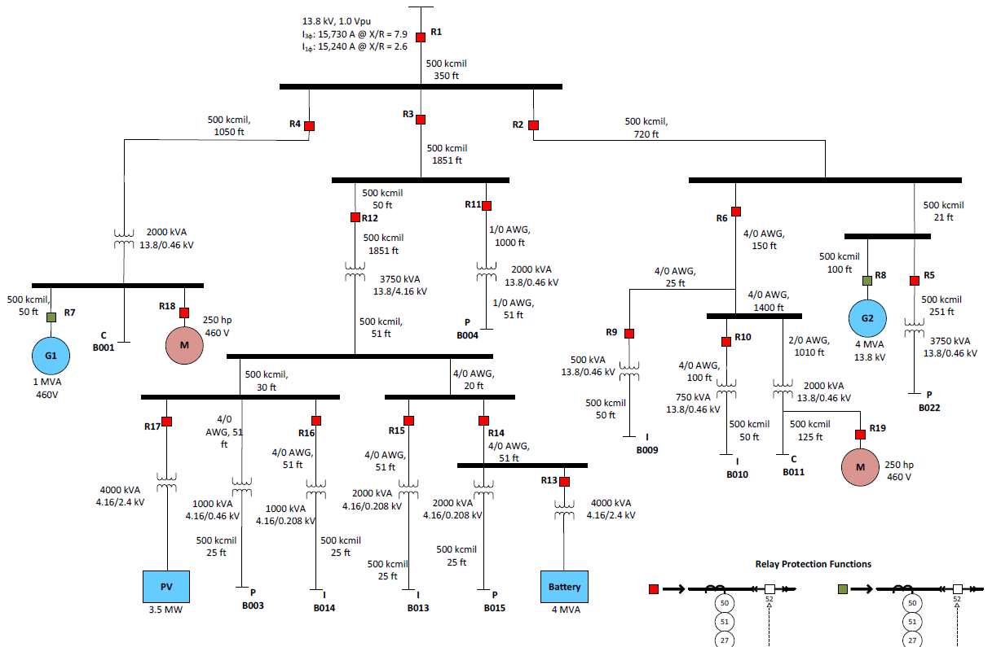
Hybrid ARTEMiS-SSN Solver: Example
Real-world application with
  57 switches (breakers, IGBTs, etc.)
  detailed custom component libraries
  Modbus communication streams
Model runs at 70us on 4 cores on older Xeon processors
  Core 1-2: Microgrid model
  Core 3-4: Detailed protection relays
    Natural delay used
Can run at 50uS on 2 cores using latest generation Xeon processors!
ARTEMiS-SSN technique used with groups selected based
  switch placement (3-12 per group)
  optimal nodal interfaces (e.g. 3 groups at node)

Slide 32
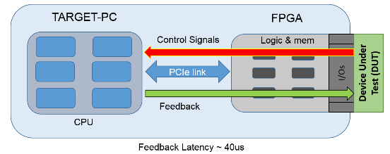
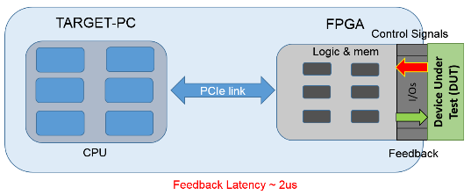
Field Programmable Gate Array (FPGA) vs. CPU simulation
In it’s beginning, Real-Time Simulation was performed on CPUs
  Advantages: Flexible architecture for designing software with high-level code, simulating larger systems across multiple CPUs
  Disadvantages: Computational overhead, I/O process latency
More recent designs of power converters and electric motors operate at higher frequencies and cannot be simulated with high-fidelity on a CPU
  Furthermore, higher I/O latency does not allow for closing the loop
FPGA-based simulation was developed by OPAL-RT to overcome these limitations and meet the challenge
  Advantages: <500ns simulation time steps achievable, much lower I/O latency
  Disadvantages: FPGA expertise required, limited resources available (model size restriction)
CPU-Based Hardware-in-the-Loop Testing
FPGA-Based Hardware-in-the-Loop Testing

Slide 33
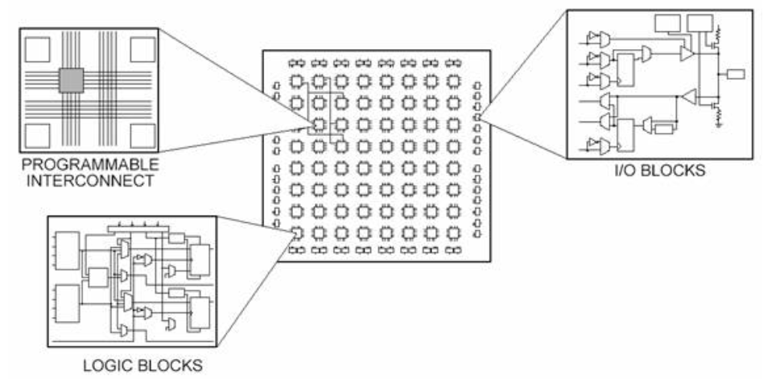
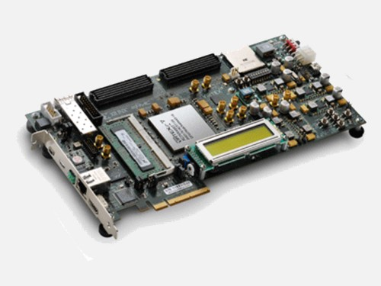
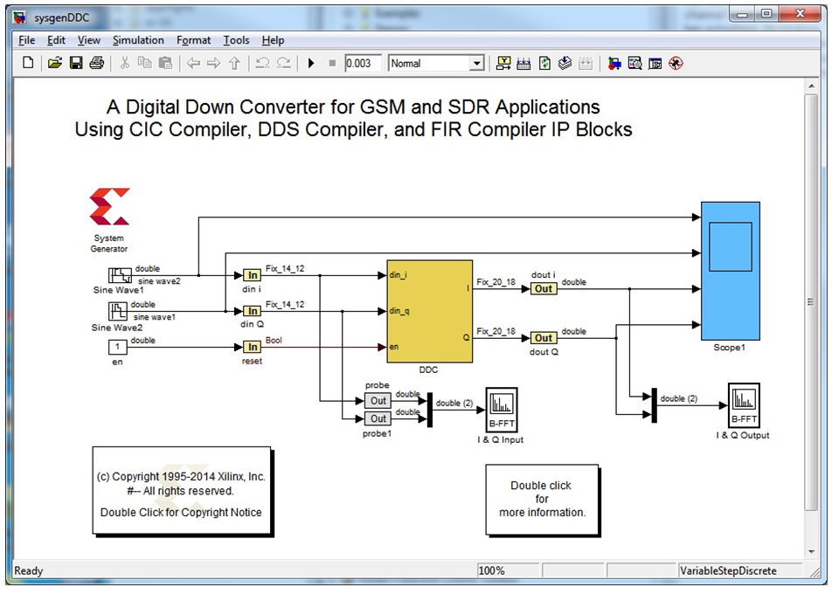
Why use FPGA?
Reconfigurable circuits composed of
  Configurable logic blocks (Flip-flops, LUTs)
  Fixed function logic blocks (DSPs)
  Memory (block RAM)
Useful for countless digital applications including simulation
Applications are implemented at a Hardware-level
  Great for keeping latency low when performing HIL vs. CPUs, GPUs
Cost: Much less expensive than designing/producing an Application Specific Integrated Chip (ASIC)
Cons: Learning curve to program, firmware generation time
Source: National Instruments. http://www.ni.com/white-paper/6983/en/

Slide 34
User Example: Microgrid Controller Challenge

Slide 35
NREL & MIT-Lincoln Lab: Microgrid Controller Challenge
Collaboration between NREL, MIT-LL and industry microgrid controller manufacturers (Eaton, Schneider Electric, SEL, GE) originally reported on in:
  MIT-LL, TR-1203: Development of a Real-Time Hardware-in-the-Loop Power Systems Simulation Platform to Evaluate Commercial Microgrid Controllers
Objective: to provide a test bench with “the ability to quickly and cost-effectively assess the performance of different microgrid controllers as quantified by certain metrics” such as
  Fuel Consumption, power flow management precision at the point of common coupling, load-not-served (LNS) while islanded, peak-shaving kWh, and voltage stability.
Additional applications include:
  system testing and evaluation,
  distributed generation
  prime mover controller testing,
  integration and testing of distribution control systems,
  behavior testing and
  studies of DER controls, detailed power systems analysis, communications testing and integration,
  and implementation and evaluation of smart grid concepts.
35

Slide 36





NREL & MIT-Lincoln Lab: Microgrid Controller Challenge
36

Slide 37



NREL & MIT-Lincoln Lab

Slide 38



NREL & MIT-Lincoln Lab
Test objectives:
  Unit commitment (grid-tied and islanded)
  Peak-shaving, valley-filling, and load-shedding (grid-tied and islanded)
  Diesel generation fuel optimization (grid-tied and islanded)
  Loss minimization (islanded)
  Meet power export requirements (grid-tied)
  Optimized energy-storage control (grid-tied)
  Generator-battery hybridization (grid-tied)
  Power factor support at PCC (grid-tied)
  Two-way communication with commercial generator controllers (grid-tied and islanded)
Condensed 15-minute Sequence:
  First 7.5 mins: Grid-tied
  @7.5 min, 3.5 MW interruptible loads shed
  @8.3 min, islanding, gensets supply power
Differences between controllers
  Power import/export
  Use of ESS
  Fuel Use (Vendor 2 > Vendor 1)
38

Slide 39
User Example: UT Austin CEM

Slide 40


User Example: UT Austin CEM
Strank, S. “EXPERIMENTAL TESTBED TO DE-RISK THE NAVY ADVANCED DEVELOPMENT MODEL”. ELECTRIC SHIP TECHNOLOGY SYMPOSIUM. 2017. URL: https://utw10356.utweb.utexas.edu/sites/default/files/Strank_ADM%20Microgrid%20Testing.pdf

Slide 41
Airplane Power Systems

Slide 42


MORE-ELECTRICAL-AIRCRAFT SIMULATION
MEA encompasses the shift towards Variable Frequency Starter Generation (VFSG) from geared fixed-frequency generation (400 Hz)
OPAL-RT allows engineers to simulate the next generation of aircraft power systems so that vendors and integrators can accelerate system design and integration on a digital test bench.
State-of-the-Art B787 demonstration including:
On CPU (34 uS): 4 VFSG, 4 ATRU 540VDC 18 pulse, 4 TRU 28VDC 18 pulse, 32 three-phase breakers
FPGA (220 ns): 2 x 6-phase inverters, 2 x MTC models

Slide 43
MORE-ELECTRICAL-AIRCRAFT SIMULATION
VIDEO

Slide 44
Cyber vulnerabilities &
Cyber-Physical Simulation

Slide 45

The Modern Grid
Modern power grids are Cyber-Physical System (CPS) composed of electrical and information infrastructure
The grid is becoming “intelligent” through:
  Wide deployment of new technologies
  Substation, transmission and distribution automation
  Increased distributed Energy Resource (DER) integration
  Advanced two-way communication networks
  Development of synchrophasor systems
But… as newer technologies are adopted, the grid is becoming more vulnerable to cybersecurity threats both:
  Malicious and Accidental⁴
Asset Management
Grid Control
Data Collection & Local Control
Communication
Sensors
4 See NIST (http://www.nist.gov/el/smartgrid/cybersg.cfm)

Slide 46









DOS Attack
Denial-of-Service (DoS) Attacks can render a service unavailable either through a direct or indirect attack
  IEC61850 Goose identified as susceptible due to status numbers (Skopik & Smith 2015)
Also refers to physical attacks on communication infrastructure
  Cutting wires
  Wireless jamming
Reference: Skopik F., Smith P.: Smart Grid Security - Innovative Solutions for a Modernized Grid, Elsevier Science Publishing, 2015, ISBN: 978-0-12-802122-4.
46
46

Slide 47



Man-in-the-Middle
Man-in-the-middle (MitM) attacks “impersonate two communication nodes by making them believe that they are talking together” (Skopik & Smith 2015):
  Packet injection/spoofing (IEC61850 Goose, DNP3, MODBUS),
  Packet suppression,
  Recording, replaying and modification of recorded packets
Reference: Skopik F., Smith P.: Smart Grid Security - Innovative Solutions for a Modernized Grid, Elsevier Science Publishing, 2015, ISBN: 978-0-12-802122-4.
47

Slide 48











GNSS Vulnerabilities
GNSS Simulator
GNSS spoofing/meaconing is a threat to PMUs and synchrophasor systems, heavily reliant on time synchronization
  For 60 Hz networks, IEEE C37.118-2014 Standard allows max 26.53 µs pure timing error
Spoof locked
C37.118
Standard
Broken
Spoofer removed
D. P. Shepard, T. E. Humphreys, and A. A. Fansler, “Evaluation of the vulnerability of phasor measurement units to GPS spoofing attacks,” International Journal of Critical Infrastructure Protection, vol. 5, no. 34, pp. 146–153, 2012.
48

Slide 49

CYBER-PHYSICAL SIMULATION

Slide 50
CYBER-PHYSICAL SIMULATION
VIDEO

Slide 51
QUESTIONS
Thomas Kirk, M.A.Sc.
Solutions Engineer
OPAL-RT Technologies
thomas.kirk@opal-rt.com
THANK YOU!!!

