Slide 1


US Navy Electrical Leap Forward…A Vision for the Future
ONR Technology Development
CAPT Lynn J. Petersen USN (Ret)
Advanced Naval Platforms
Office of Naval Research (ONR 331)
Defense Energy Seminar
Naval Postgraduate School
02 November 2018
Distribution Statement A: Distribution is unlimited. Approved for public release, 43-2252-16 oral/visual only.

Slide 2
ONR Technology Development
Overview
ONR Naval Research & Development Framework
Power Electronics & Electromagnetism (6.1)
Adaptive Controls (6.1)
Machinery Controls (6.2)
Advanced Machinery Systems (6.2)
      Medium Voltage Direct Current (MVDC) Risk Reduction
      Applied Silicon Carbide (SiC) Technology
Future Naval Capabilities (6.2-6.4)
Distribution Statement A: Distribution is unlimited. Approved for public release, 43-2252-16 oral/visual only.

Slide 3


A Guiding Vision
Align
To Shared R&D Priorities
Accelerate
Technology-Enabled Capabilities
Allocate
Resources to Speed Results
To Win We Must Be “First to Field Decisive Capabilities”
Notes:
(Alignment Component)
R&D Priorities shared across the R&D Community
Augmented Warfighter : Seamless man-machine teaming
Operational Endurance : Resilient and sustained operation
Integrated & Distributed Forces : Collaboration that spans geography, domains, platforms and partners
Sensing & Sense-Making : Timely knowledge from the sea of data
Scalable Lethality : New Weapons that are multi-domain, integrated, cost-effective, kinetic and non-kinetic
--------------------------------------
(Allocation Component)
Factors to consider…
Technologies develop at varied speeds; projects should pace the speed of technology.
We need to create more institutionalized methods to better advance revolutionary tech.
We need more flexible R&D investment at the tactical level; more balanced at the strategic level.
Be deliberate on tech areas in which to lead (e.g., NNRs) and follow.
Resolve risk smarter
--------------------------------------
(Acceleration Component)
Builds on Alignment and Allocation. Adds agile and responsive business, and empowered people
E.g., FNC process improvements: reduced latency between decision and funding; streamlined decision-makers; closer partnering between R&D and acquisition
E.g., 6.4 assessment: smarter prototyping and experimentation
E.g., Portfolio-based approach to execution: ONR’s Integrated Research Portfolios (IRPs), which are described in the Framework Addendum and will be discussed in separate agenda sessions

Slide 4

It Begins With Research
6.1 Basic Research
Gov’t
Industry
Academia
6.2 Applied Research
Framework Priorities
Scalable Lethality
Augmented Warfighter
Operational Endurance
Sensing & Sense-Making
Integrated & Distributed Forces
6.3 Advanced Technology
Development
Distribution Statement A: Distribution is unlimited. Approved for public release, 43-2252-16 oral/visual only.
Accelerating Knowledge to Technology to Capability

Slide 5
Naval Research: A Framework for Accelerating to the
Navy & Marine Corps After Next
Framework Priorities – Linking Research to Future Force Attributes
Framework Priority | Description
Augmented Warfighter | Enhance date to decision-making speed by incorporating cognitive augmentation & autonomous processing & more efficient human-machine interfaces.
Operational Endurance | Enables maneuverability, energy efficiency, sustained operations & resiliency for warfighters and platforms, including cyber, regardless of the threat & forward operating environments.
Integrated & Distributed Forces | Enhances dynamic synchronized actions & interoperability for naval forces. Supports collaboration spanning geography, domains, platforms & joint partners. Incorporates autonomous & disaggregate systems into the naval forces to increase flexibility & reach.
Sensing & Sense-Making | Drowning in data, yet thirsting fro knowledge, this priority assures awareness of the operating environment & mitigates risk of operational surprise; enables our naval force to operate in concert with the operational environment rather than despite it.
Scalable Lethality | Enables multi-domain, integrated, scalable kinetic & non-kinetic weapon systems for offensive or defensive purposes.

Slide 6




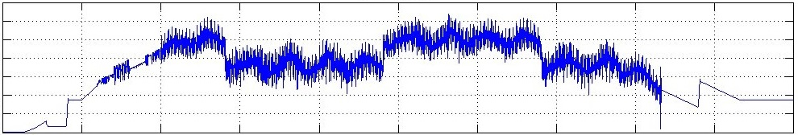

Future Power Demand
MORE POWER
DIFFERENT DEMAND
Step Change Incremental Development of Power Generation vs. Increase In Power Requirement Over Time
New Capabilities Demand Pulse and Stochastic Power
Sensor Demand
Weapon Demand
EW Demand
Incremental
Flight
Upgrades
Available Power: Constant
Sensor Demand
Mission Power Demand: Stochastic
Current Available Power Aboard Ships Cannot Support Dynamic Loads
Increased Warfighting Capability to Overmatch the Threat Demands Power

Slide 7
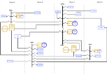




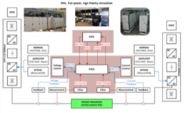
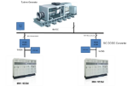

Risk Reduction
Path to Integrated Power & Energy System (IPES)
Component Development & Modeling
ONR S&T
Compact Power Conversion
Advanced Circuit Protection
Multifunction Energy Storage
Robust Combat Power Control
IPES Advanced Development Model
IPES
Reduced Scale Hardware In the Loop
Demonstrations
NSWC Land Based Test Sites (LBTS)

Slide 8
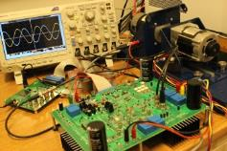
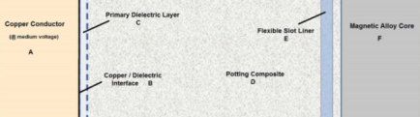
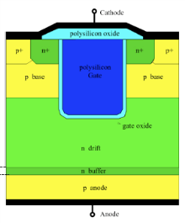
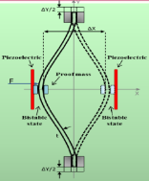
6.1 Program Overview (Power Electronic Devices and Electromagnetism)
Objectives / Goals
Fulfill the power and energy needs of the Navy’s next-generation weapons and platforms by improving
  Education
  Reliability of power electronic devices
  Power density of power systems
  Manufacturing costs
Technical Approach
Revive and Enhance Education - Prepare next generation of electrical engineers
Investigate failure modes of Wide Bandgap (WBG) semiconductors to enable reliable devices
Innovative energy extraction
Advance electromagnetics technologies to enhance capabilities, efficiency, size, weight, power density, reliability, and cost
Naval Relevance / Impact
Navy and Marine Corps require power systems that meet agility, efficiency, scalability, controllability, and security requirements
Reliability of pulsed and continuous duty high power & energy Navy & USMC weapon systems
Recent Accomplishments
Univ of California Davis (Srabonti) FY18 New Start 20 kV, 200 A Gallium Nitride (GaN) epitaxial growth development and characterization science.
Univ of IL (Hubler) demonstrated experimentally micro capacitor energy density in vacuum gaps exceeding energy density of Li-ion batteries (transferring to Dr. Scott Coombe)
Univ of CT (Cao) nano-insulation development improved ac dielectric strength by 50% and thermal conductivity by a factor of 7 (Insulation Workshop: 22-23 August, 2018; ONR)
UT Dallas (Akin) WBG stress testing revealed prominent gate-oxide related failure mechanisms
Naval Postgraduate School (Weatherford) (w/SANDIA, UC Berkeley, Penn State University) GaN Schottky Diodes
(New) Grants/Contracts
Education: (Power Engineering Curriculum: Focus: WBG technology, Common/Differential Mode (CM/DM), EMI); MSEE Power Engineering Program: Texas Tech Univ (TTU)
Power Electronics Devices: Gallium Nitride (GaN) vertical device growth and substrate development. (UC Davis, UI Urbana Champaign, Penn State NPS, and USNA)
Electromagnetics: Machinery Insulation Development and Modeling; (UCONN, OSU, UT Austin)

Slide 9
Education
Objective / Goal
Revive and Enhance Education - Prepare next generation of Navy electrical & power engineers
Meet increasing demands in power-related fields in the Navy and elsewhere
Educate naval officers/civilians to maintain, operate, & sustain naval power systems
Summary of Effort
Develop 19 courses in Electric Power & Energy Systems
Disseminate widely by offering course materials free online to all U.S. universities for classroom and distance learning
Major Participants
Ned Mohan – University of Minnesota; Rob Cuzner-University of Milwaukee; Andy Lemmon/Aaron Brovont-University of Alabama; and Anant Agarwal-The Ohio State University
Consortium of Universities for Sustainable Power (CUSP) – 235 universities participating as of April 2018
Supporting Catholic University Power Engineering Curriculum Development
Recent Accomplishments
15 courses completed
4 courses not yet started; grants initiated
Adopted by USNA and Naval Postgraduate School for core and distance learning curriculum
Over 100 universities are using these materials
Key Milestones / Projected Transition
Near: Publication of all 15 courses in FY18; 4 more by FY21
Mid/Far: Educate/Train Navy Electrical Engineering Workforce with emerging technologies (COMNAVSEA 05Z and NSWC PD technical work force benefiting now!); MSEE Power Engineering Degree Program initiated in FY18 (available FY19)
Power Engineering Curriculum for our Naval Officers and Civilian Workforce is a Critical National Interest!!

Slide 10
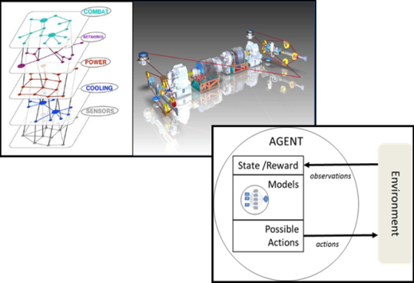
6.1 Adaptive Controls
Objective / Goal
Provide a leap ahead capability for DoD platforms that utilize Distributed Machinery Systems (resources to loads) by implementing advanced resilient control architectures that operate from a ‘Systems of Systems’ perspective.
Focuses on “Getting the human out of the loop”
Technical Summary of Research
Hybrid diagnostic algorithms for higher order nonlinear systems: Chandrasekhar Nataraj (Villanova) Ending FY19
Microgrid modeling and control with multiple distributed energy sources: Wenxin Liu (Lehigh) (transition to RCP FNC)
Correct by construction autonomy protocols for open, reconfigurable shipboard networks: Ufuk Topku (UT Austin)
Adaptive Controls for Navy microgrid circuits: Henry Yeh (CSU Long Beach) Ending FY18
High-speed, scalable, system-level real-time simulation: Andrea Begnini (U of So Carolina)
Distributed verification and validation methods for power system dynamics and control: Kurtis Kredo (CSU Chico) Ending FY18; new FY19 effort planned.
Mixed Initiative, Cooperative Self-Adaption for System of Systems: David Garlan (Carnegie Melon) Ending FY18
Recent Accomplishments
Lehigh (Liu) submitted 5 related transaction papers
UT Austin (Topku) developed a new multi-objective verification method for parametric Markov decision processes
Villanova (Nataraj) developed a novel “Extended Phase Space Topology” method and successfully applied to bearing/gear-train diagnosis
U of So. Carolina (Begnini) achieved 40ns time step for system with 17 converters
Key Milestones / Projected Transition
Near: Semi-Annual Controls Workshops in FY15-18 (Government, Industry and Academia)
Far: Feeds into: 6.2 Machinery Controls; Navy Combat Power and Energy System (CPES); UxV considerations

Slide 11
6.2 Machinery Controls
Objective / Goal
Enable the implementation of Autonomous Cognitive Capabilities for next generation naval ship machinery systems. To enable understanding, design, operation and affordability of increasingly complex, integrated, and interdependent systems
Technical Summary of Research
Observability of Network Controlled Multi-Converter Power Systems: Karen Miu (Drexel) (New Start FY17)
Active Diagnosis of Navy Machinery: David Scheidt (JHU/APL) (Ending FY18)
Integrated Active and Predictive Condition Monitoring for All-Electric Drivetrain Systems: Jing Sun (U of Mich) (Next Controls Workshop: Ann Arbor, September, 2018)
Distributed Autonomy, Resiliancy, and Optimality in Navy Microgrids: Ali Davoudi (UT Arlington) (New Start FY17)
Development of Universal Controller Architecture for SiC Based Power Electronic Building Blocks: Herb Ginn (U of So Carolina) (New Start FY18)
Exergy Control: Gordon Parker (Michigan Tech)
Recent Accomplishments
JHU/APL (Scheidt) developed resilient fitness criteria for auxiliary systems; centralized auxiliary system planner developed and tested
U of Mich (Sun) developed condition monitoring-oriented reduced order thermal model for electric machine
U of So Carolina (Ginn) instantiated soft core processors within FPGAs and communicated between them at a full 10GBit/sec using the Aurora protocol
Key Milestones / Projected Transition
Near: Case study setups and initial algorithm evaluation by FY18 supporting Robust Combat Power and Control FNC;
Far: Transition to Navy Combat Power and Energy System (CPES);

Slide 12
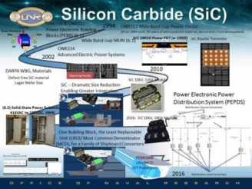
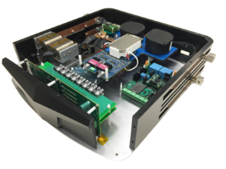
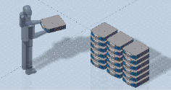
6.2 Advanced Machinery Systems Program Overview
(MVDC Risk Reduction and Applied SiC Technology)
Objectives / Goals
Fulfill the power and energy needs of the Navy’s next-generation weapons and platforms by improving
  Reliability of power electronic devices
  Power density of power systems
  Risk reduction for future application of MVDC Systems
Technical Approach
Develop, mature and demonstrate devices, components, and systems architectures to enable low risk, power dense MVDC application for future warships
Investigate performance of Wide Bandgap (WBG) Silicon Carbide semiconductors to enable reliable power converter modules
Reduce logistics; Increase maintainability, commonality of Least Replaceable Unit (LRU) WBG converters
Naval Relevance / Impact
Navy and Marine Corps require power systems that meet agility, efficiency, scalability, controllability, and security requirements
Reliability of pulsed and continuous duty high power & energy Navy & USMC weapon systems
Recent Accomplishments
GE (Raju) and VA Tech (Boroyevich) Demonstrated PEBB 1000 LRU power density of 6.5 MW/m3 ; PEBB model created for S3D
Wolfspeed (Cree) achieved world record 10 kV/240A MOSFET Half Bridge Module @ 100 kHZ switching frequency
FY18 New Start: NPS, UC Santa Cruz Collaboration (PhD Thesis: LCDR Damian Oslebo) Pulse vs Fault Characterization
USNA/NPS Internships
USNA/NSWC Collaboration

Slide 13
ONR Shipboard Power & Energy Roadmap
N E A R T E R M
2009 | 2010 | 2011 | 2012 | 2013 | 2014 | 2015 | 2016 | 2017 | 2018 | 2019 | 2020 | 2021 | 2022 | 2023 | 2024 | 2025 | 2026 | 2027
ONR S&T
Swampworks CNT Power Cables
Electric Weapon & Sensor Enablers
Swampworks Energy Storage
ONR FNC P&E 15-02 Multifunction Energy Storage
Future FNCs
OSD Hybrid Energy Storage (HESM)
OSD Thermally Enabling Architectures for Pulse Power Systems (TEAPPS)
Swampworks Arch Studies
ONR pre-FNC P&E 18-Robust Combat Power Control
Adv. Electric Architecture
ONR FNC P&E 08-01 Compact Power Conversion
ONR FNC P&E 14-01 Advanced Circuit Protection
Power & Energy S&T (ESRDC, Energy Conversion, Power Electronics, Controls, Thermal)
Basic / Applied Res.
ONR Swampworks
ONR FNC
OSD
Notes:
Our S&T investments fall into the following 3 areas:
Electric Weapon & Sensor Enablers
Advanced Electric Architecture
Basic / Applied Research

Slide 14
ONR Technology Development
Summary:
ONR Naval Research & Development Framework
Power Electronics & Electromagnetism (6.1)
Adaptive Controls (6.1)
Machinery Controls (6.2)
Advanced Machinery Systems (6.2)
      Medium Voltage Direct Current (MVDC) Risk Reduction
      Applied Silicon Carbide (SiC) Technology
Future Naval Capabilities (6.2-6.4)
Distribution Statement A: Distribution is unlimited. Approved for public release, 43-2252-16 oral/visual only.

Slide 15

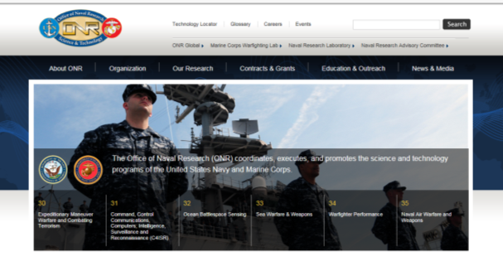



Staying In Touch
www.onr.navy.mil
  Social Media:
  www.youtube.com/usnavyresearch
  www.twitter.com/usnavyresearch
  www.facebook.com/officeofnavalresearch
  www.flickr.com/usnavyresearch
  www.navalstem.navylive.dodlive.mil
  www.futureforce.navylive.dodlive.mil
Distribution Statement A: Distribution is unlimited. Approved for public release, 43-2252-16 oral/visual only.

