Slide 1
Nord Stream 2: Implications and Outcomes for US-German Relations and the NATO Alliance
SAS-163
Special Study Team
SMA STRATCOM – 3 March 2021
Dr. Arnold C. Dupuy, Team Lead
Dr. Daniel Nussbaum, Co-Team Lead
Dr. Ion Iftimie
Prof. Paul Michael Wihbey
Dr. David R. Dorondo

Slide 2
Introduction
Dr. David Dorondo
Thanks to SMA and US STRATCOM Academic Alliance.
NS 2 Special Study Team within NATO STO SAS-163 (NESA).
Précis: German Political Context; Deterrence Implications and Ukraine; Market-sector Analysis / German-Russian Relations; Great Power Competition; Impact on NATO.

Slide 3
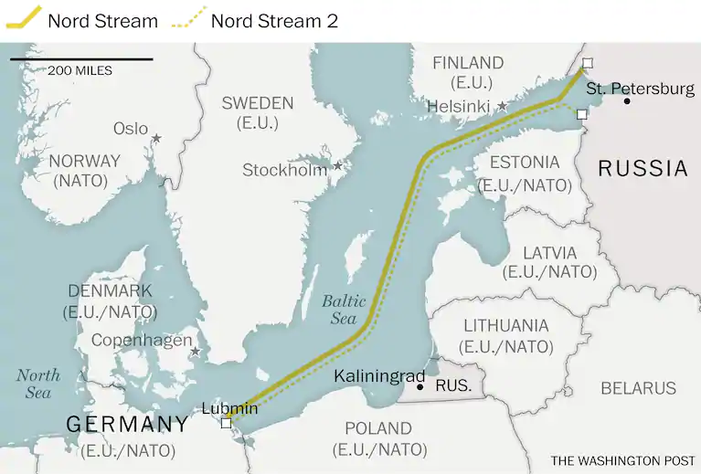
Nord Stream 2: Geo-strategic Setting – David Dorondo
Notes:
NATO has been concerned with energy security for decades; both politically and operationally

Slide 4
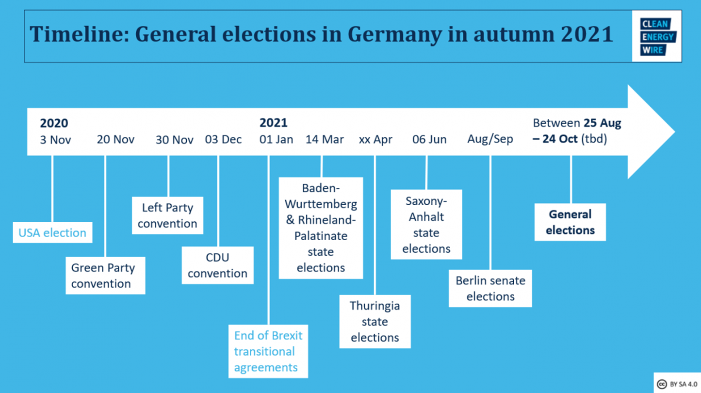
“Superwahljahr 2021” – David Dorondo
Notes:
Pipelines exist in UK, Spain, Italy and Turkey

Slide 5
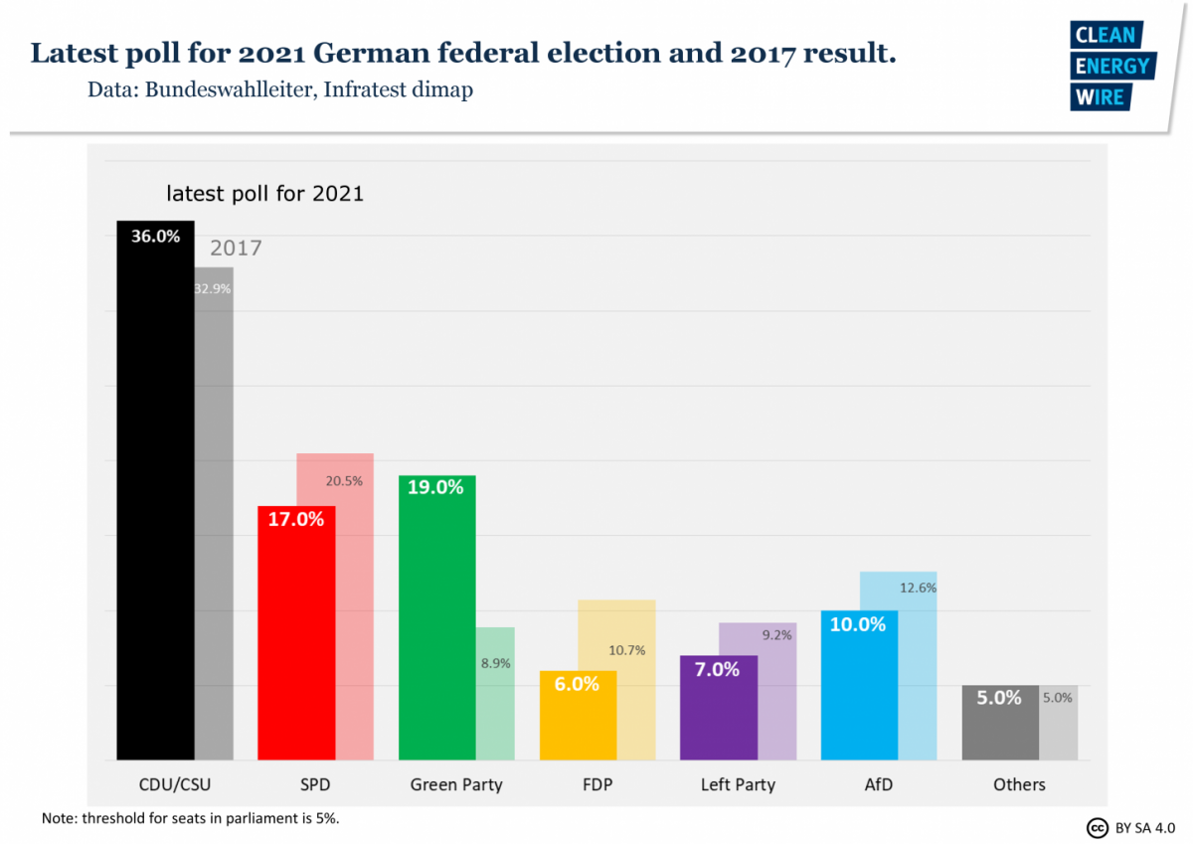
Prospects for German Elections and NS 2 – David Dorondo

Slide 6
Pipeline Politics in Central and Eastern Europe:
Its Impact on the NATO Alliance
SAS-163
Special Study Team
Ion A. IFTIMIE

Slide 7
Pipeline Politics and Deterrence
Council on the Future Tasks of the Alliance (The Harmel Report) (December 1967)
  “…to maintain adequate military strength and political solidarity to deter aggression and other forms of pressure …”
    A more flexible response to the East-West confrontation
  Ukraine as an “exposed area” on the Eastern flank
  2009 Russia–Ukraine gas dispute all Russian gas to Europe through Ukraine were halted for 13 days;
    Is peace in Ukraine is dependent on current Russian (economic) dependence on Ukrainian pipelines?

Slide 8
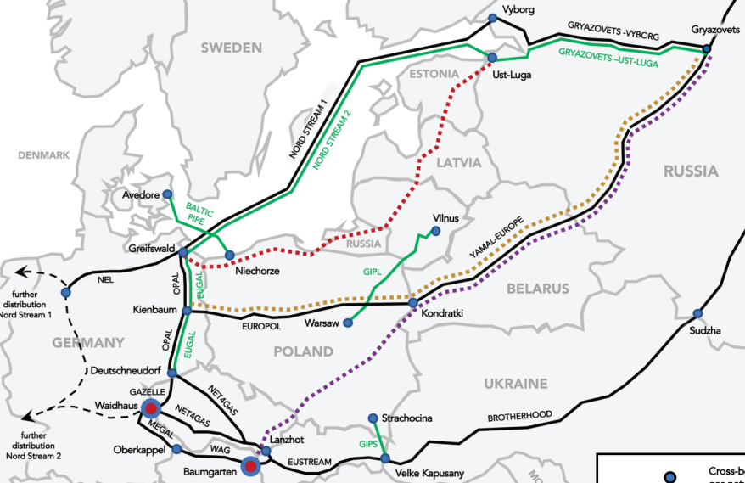
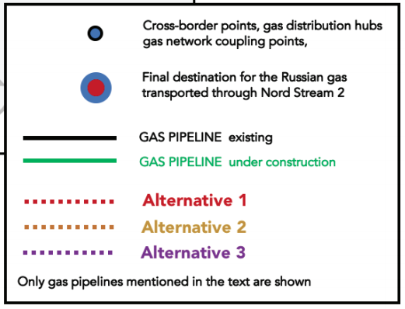
Source: P. Przybyło, Economy and Energy Programme, Warsaw, 2019

Slide 9
Russian gas exports to Europe and Turkey by route, %
Source: Naftogaz of Ukraine, Eustream, Gazprom, ENTSO-G

Slide 10
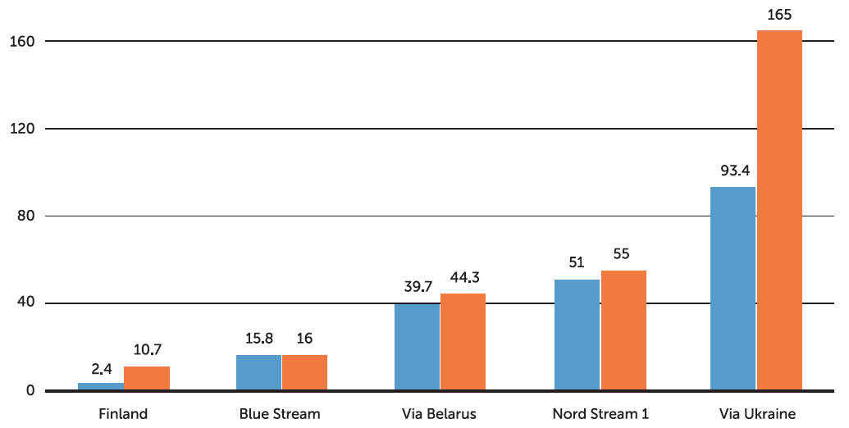
Capacity utilization of main supply routes of Russian gas to Europe in 2017, bcm
Source: Gazprom (2018)

Slide 11
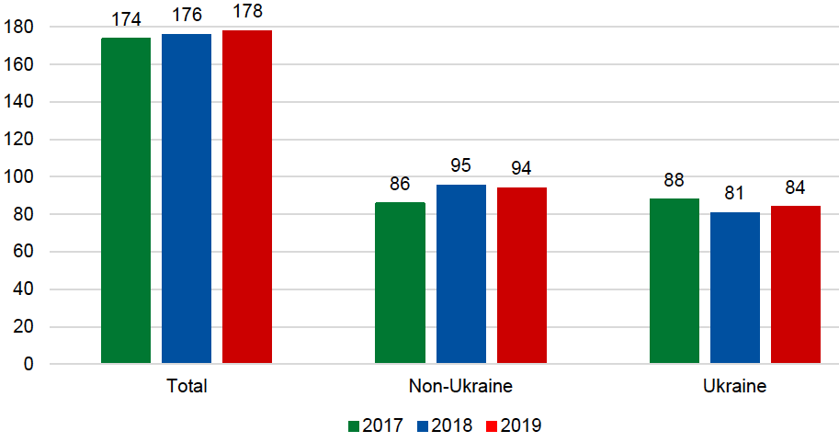
Russian pipeline exports to Europe by delivery route (bcm/y)
Source: S Pirani and J Sharples, Energy Insight 64, Oxford Institute for Energy Studies, 2020

Slide 12
Ukraine and NATO Efforts to Strengthen Energy Security
NATO’s 1991 Strategic Concept. Article 12 states:
“…Alliance security interests can be affected by other risks of a wider nature, including acts of terrorism, sabotage and organised crime, and by the disruption of the flow of vital resources.”
Russia expected to reduce flow through Ukraine to 40 bcm/year for the period 2021-24 → Implications for Strategic Concept
The 2021 Munich Security Conference did not address the Nord Stream 2 issue
Notes:
$15 billion from the tariffs over the next five years

Slide 13
Marketing and Commercial Calculations and Trends: Nord Stream 2
Impact of Energy Geopolitics on NATO
SAS-163 Special Study Team, March 3, 2021
Prof Paul Michael Wihbey, Executive Director,
Institute on the Geopolitics of Energy & Strategic Resources
Washington DC

Slide 14
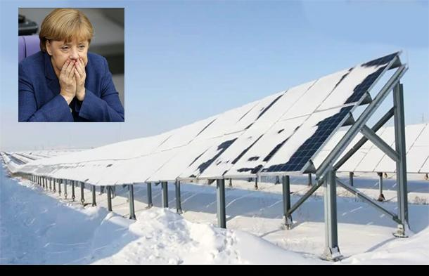
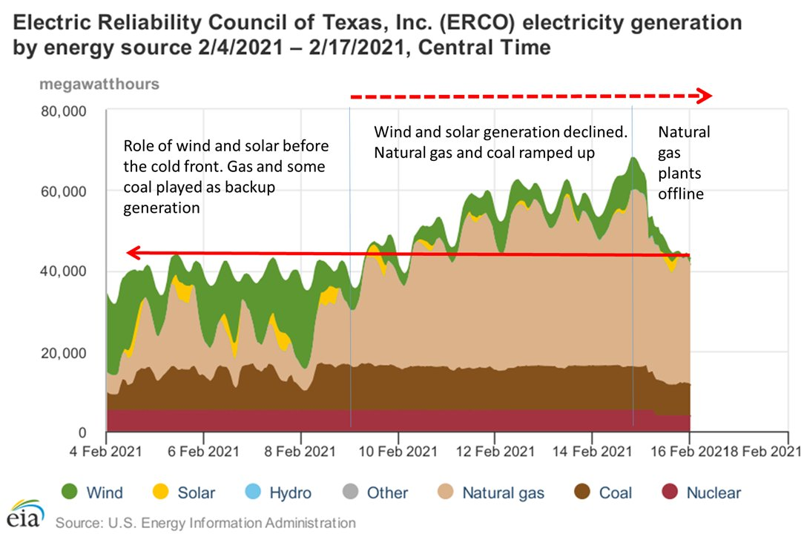

Slide 15
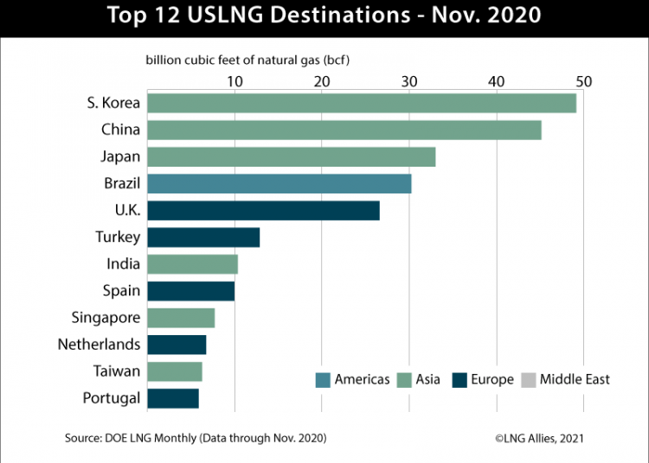
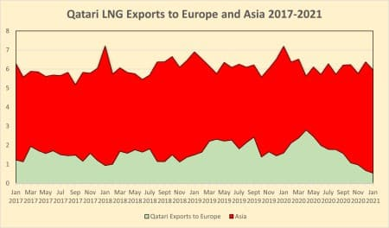

Slide 16
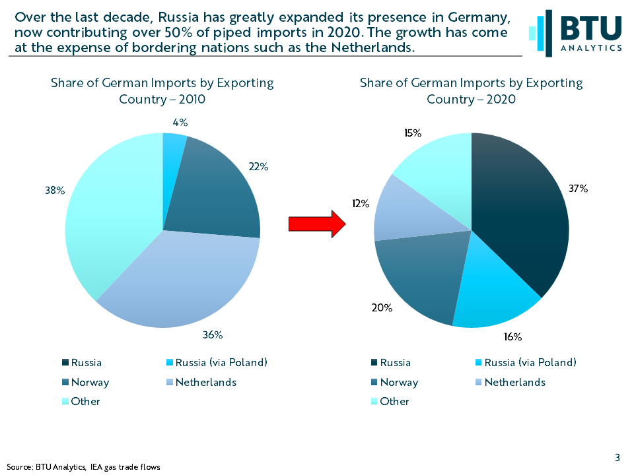
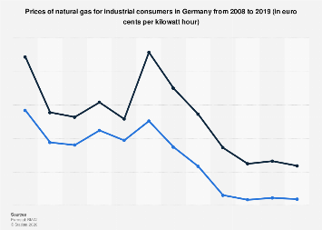

Slide 17
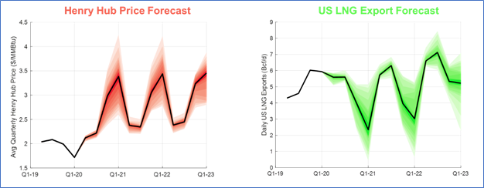

Slide 18
Conclusions:
--- Paul Michael Wihbey

Slide 19

Great Power Competition Aspects of NS2
Dr. Daniel Nussbaum
Energy Academic Group
dnussbaum@nps.edu

Slide 20
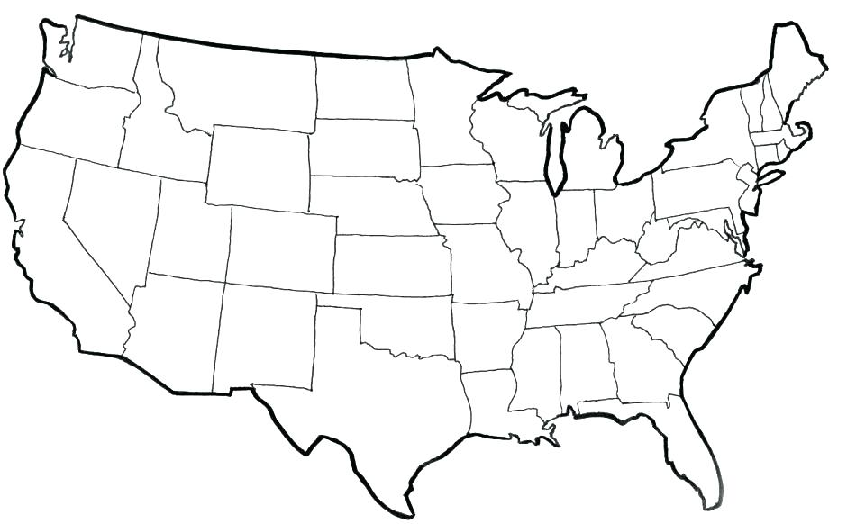

Naval Postgraduate School (NPS)
America's national security research university
1909 | Founded at U.S. Naval Academy
1951 | Moved to Monterey, CA Operations Research Curriculum
Facilities of a graduate research university
Faculty who work for the U.S. Navy, with clearances
Students with fresh operational experience
65 M.S. and 15 Ph.D. programs
679 faculty
1432 resident students includes
  (182 international / 47 countries)
  983 distributed learning students

Slide 21
Energy Academic Group
  Established in 2012
  Mission:
    Bring together an interdisciplinary group of NPS faculty to provide coordination and awareness for EAG’s three pillars in support of energy activities at NPS
  EAG’s three pillars:
    Education-- Conduct graduate level energy education for NPS students, Naval Officers, and other DoD personnel
    Research--Coordinate energy-related research for NPS faculty and studen
    Outreach --remote outreach efforts to develop energy partnerships among DoD, USG, academia, industry, and international partners
  Highly educated team capable of coordinating and advancing Naval energy needs

Slide 22
Our research falls into 4 general categories, and there are theses associated with almost every one of these projects:
Optimization & Efficiency Research
  OTTER (Optimized Transit Tool Easy Reference)
    Developed within EAG as a tool for the Surface Fleet to optimize fuel usage during transits
    Works within existing operational constraints and can still provide double digit % savings on average (16-20% in tests)
    Continues to be enhanced and we are working on rollout and uptake within the fleet
  Bulk Fuel Delivery in Support of Expeditionary Advance Base Operations
    Explores different means of delivering bulk fuel to the high water mark to facilitate and sustain USMC operations
Critical Energy Infrastructure Protection & Resilience
  Table Top Exercise (TTX) in Ukraine on Hybrid Warfare and CEIPR
  TTX planning for CEPS (Central European Pipeline System) – FY19
  Hurricane recovery and reconstruction efforts in US Virgin Islands – system modelling
  Critical Energy Infrastructure Protection and Resilience (CEIPR)
Renewables and Emerging Technologies
  Smart grids, Forward Basing, Remote Charging (viability)
Awareness & Behaviour Change
  Energy video, ADL, Behaviour studies

Slide 23
EAG Professional Development
Current Short Courses and Support to Sponsors
  Course Topics:
    Energy Security Strategic Overview
    Energy Security – Regional Focus (tailored for delivery)
    Critical Energy Infrastructure (CEI) Protection & Resilience
    Energy Efficiency in Military Operations
    Energy Awareness (ADL)
  Sponsors:
    OSD, ONR, NETSAFA, OPNAV, SECNAV, NATO School Oberammergau (NSO), NATO Energy Security Center of Excellence (ENSECCOE)
  Locations:
    CONUS - Monterey, San Diego, DC
    OCONUS - Lithuania, Ukraine, Azerbaijan, Georgia, Kuwait, Indonesia

Slide 24
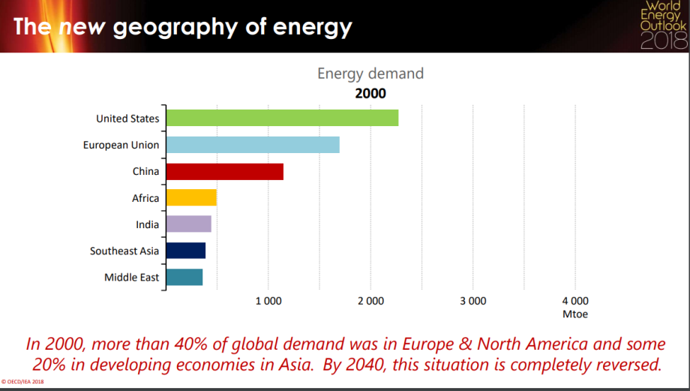
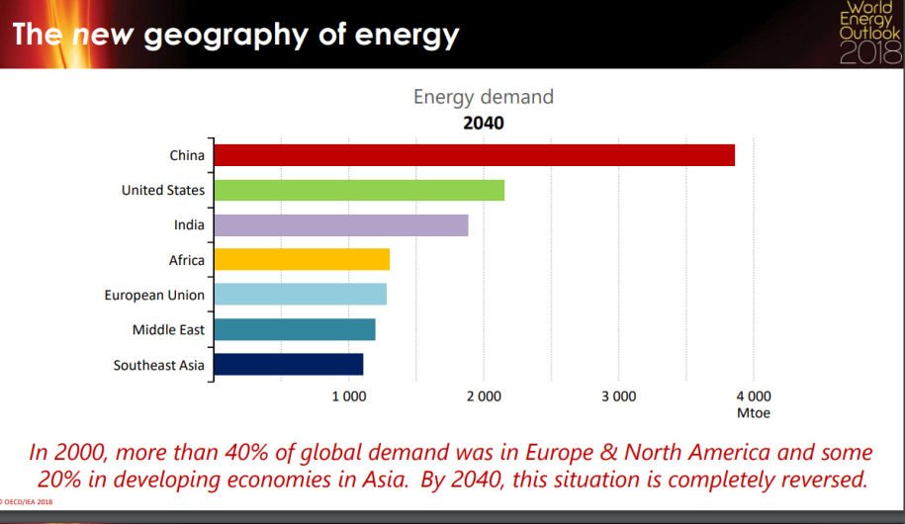

Slide 25
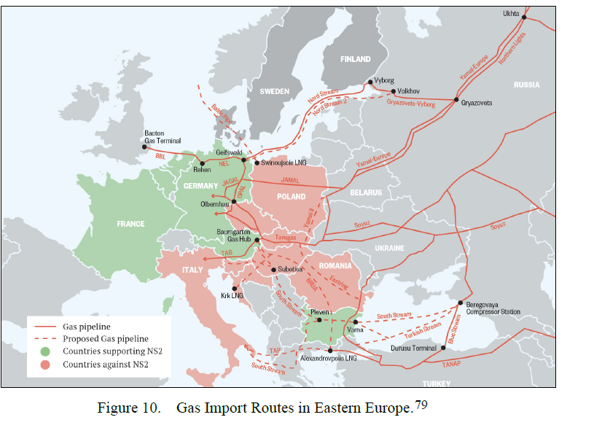
The Geopolitics of it All

Slide 26
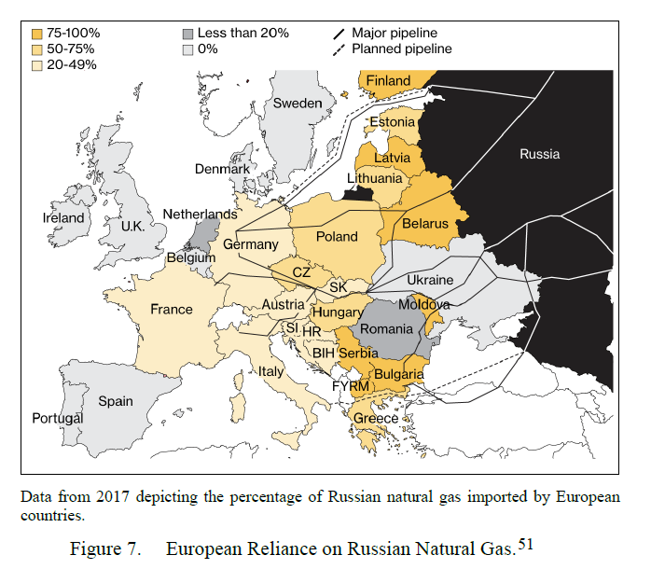
The Geopolitics of it All

Slide 27
Recommended Reading

Slide 28
Recommended Reading

Slide 29
Nord Stream 2: Its Impact on the NATO Alliance
SAS-163
Special Study Team
Dr. Arnold C. Dupuy

Slide 30
Considered fundamental questions regarding Nord Stream 2:
The German and regional political foundation
Pipeline politics, deterrence and collective defense
Private sector markets and possible alternatives
Great power competition
Impact on the NATO Alliance

Slide 31
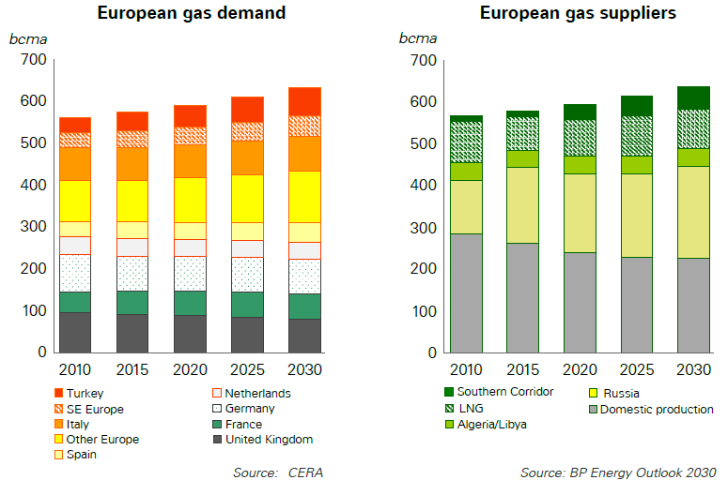
European Gas Demand and Suppliers to 2030

Slide 32
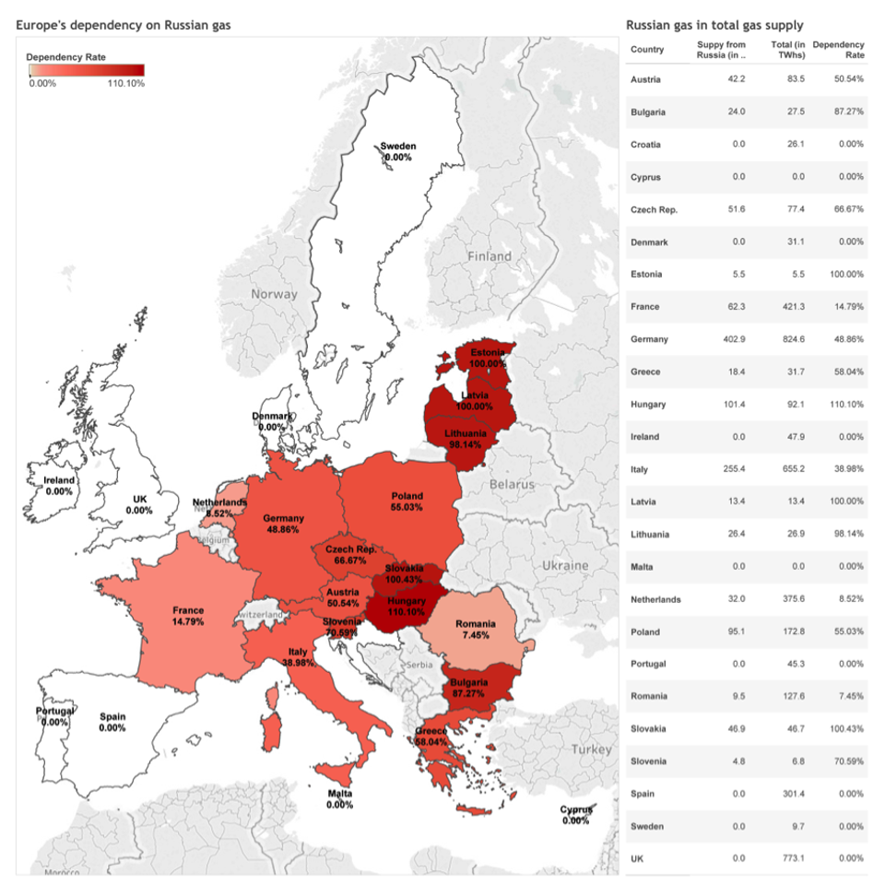
EU/NATO Dependence on Russian Natural Gas
Notes:
Political, economic and military importance of natural gas. (relatively new)

Slide 33
Structural Precedents
Committee on Non-Military Cooperation (The Three Wise Men) (December 1956)
  Pearson (CA), Martino (IT) and Lange (NO)
  Acknowledged the importance of non-military cooperation
    Political and economic cooperation
    Reinforced by the Suez Crisis of November 1956
Council on the Future Tasks of the Alliance (The Harmel Report) (December 1967)
  “…to maintain adequate military strength and political solidarity to deter aggression and other forms of pressure …”
    A more flexible response to the East-West confrontation
  Consider “Exposed areas”: the South-Eastern flank and the Mediterranean
Notes:
NATO has been concerned with energy security for decades; both politically and operationally

Slide 34
NATO Operational Energy Precedents
NATO Pipeline System (NPS)
  Started in 1958
  12,000 km
  Military priority, though in use by civilian entities
Central European Pipeline System (CEPS)
  The largest pipeline within the NPS
  The NPS is dedicated to petroleum, not natural gas
Notes:
Pipelines exist in UK, Spain, Italy and Turkey

Slide 35
NATO Efforts to Strengthen Energy Security
NATO’s 1991 Strategic Concept. Article 12 states:
“…Alliance security interests can be affected by other risks of a wider nature, including acts of terrorism, sabotage and organised crime, and by the disruption of the flow of vital resources.”
Subsequent Strategic Concepts and Summits have strengthened energy security
The 2018 Brussels Summit communique does not mention Nord Stream 2
Notes:
This has been strengthened over the years
No mention of NS2 in any recent communiques

Slide 36
NATO Energy Security Organizations
Hybrid Threats and Energy Security Section
  Formed in 2010
  Located in Brussels
Energy Security Center of Excellence (ENSECCOE)
  Formed in 2012
  Located in Vilnius, Lithuania
Notes:
Michael Ruhle and COL Romas Petkevicius

Slide 37
Nord Stream 2: Implications for the NATO Alliance
“The arrival of Russian infrastructure into a NATO country puts all NATO members at risk…The U.S. relationship with Germany is a cornerstone of the transatlantic alliance. But allowing the completion of Nord Stream II is not a constructive path forward for this partnership.” (Sens. Jeanne Shaheen (D., NH) and Jim Risch (R., ID) February 12, 2021
Notes:
Bi-partisan support.
Risch, Shaheen Urge Biden Administration to Fully Implement Nord Stream II Legislation | United States Senate Committee on Foreign Relations

Slide 38
Nord Stream 2: Implications for the NATO Alliance
Secretary of Defense Lloyd Austin attempted to calm member states’ nerves:
February 18, 2021 at the NATO Summit
February 16, 2021 Washington Post OPED
  Never mentioned NS 2
  The fundamental problem is not addressed
Notes:
These considerations will weigh heavily on the Alliance’s civilian and military leadership.

Slide 39
Key Points Regarding NATO Energy Security Efforts
NATO action is limited by member state sovereignty
Primarily focused on petroleum products for military operations
  As well as political and economic concerns
Natural gas is not a military operational commodity
  Operational implications in contemporary operations as a source of power generation
  Trade in natural gas has political, economic and military (operational) implications
Notes:
Geared toward a petroleum or liquid fuels-based structure
Trade in natural gas does have political and economic implications and is hampered by member state sovereignty

Slide 40
Nord Stream 2: Implications for the NATO Alliance
Stability: Security-related implications in Eastern Europe
  Ukraine, Poland, Slovakia, Hungary, and Romania, as well as the Baltic States
Cohesion: Adverse affects of a dramatic split between Germany and some Central and Eastern Europe allies
  Not to mention a US-German split
Credibility: NS 2 could force an even more rancorous debate further weakening NATO’s standing
Deterrence: Energy sales to Russia are funding the very state the Alliance is trying to deter
Notes:
These considerations weigh on the Alliance’s civilian and military leadership.
Deterrence as the underlying theme of the panel.

Slide 41
Thank you
Arnold C. Dupuy
Acdupuy@vt.edu

