Slide 1
Reconstructing Ukraine’s Energy Infrastructure: Policies for a Sustainable, Resilient Post-war Economy
Rick Geddes Visiting Fellow, Hoover Institution Professor, Cornell Jeb E. Brooks School of Public Policy Founding Director, Cornell Program in Infrastructure Policy (CPIP)
rrg24@cornell.edu
NPS Defense Energy Seminar Series
Tuesday, October 15, 2024

Slide 2
Outline:
Russia targeting of Ukraine’s energy infrastructure
Now is the time to develop and prepare policies to efficiently rebuild Ukraine’s infrastructure (and dictate terms)
Review six policy recommendations (which apply across sectors generally):
Rely on variable rates, user fees, or prices wherever possible to fund infrastructure
Rely on private sector capital via PPPs as much as possible to combine project elements and provide infrastructure financing
Standardize and bundle projects to achieve project scale as fast as possible
Ensure all infrastructure contracts include “future proofing”
Incorporate value capture as much as possible
Improve public-sector capacity and implement “PPP units”

Slide 3
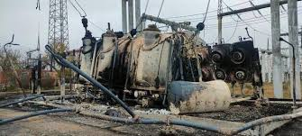
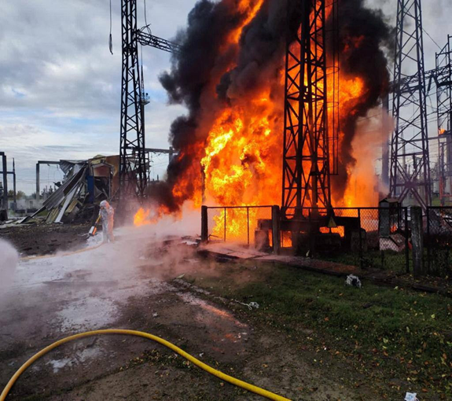
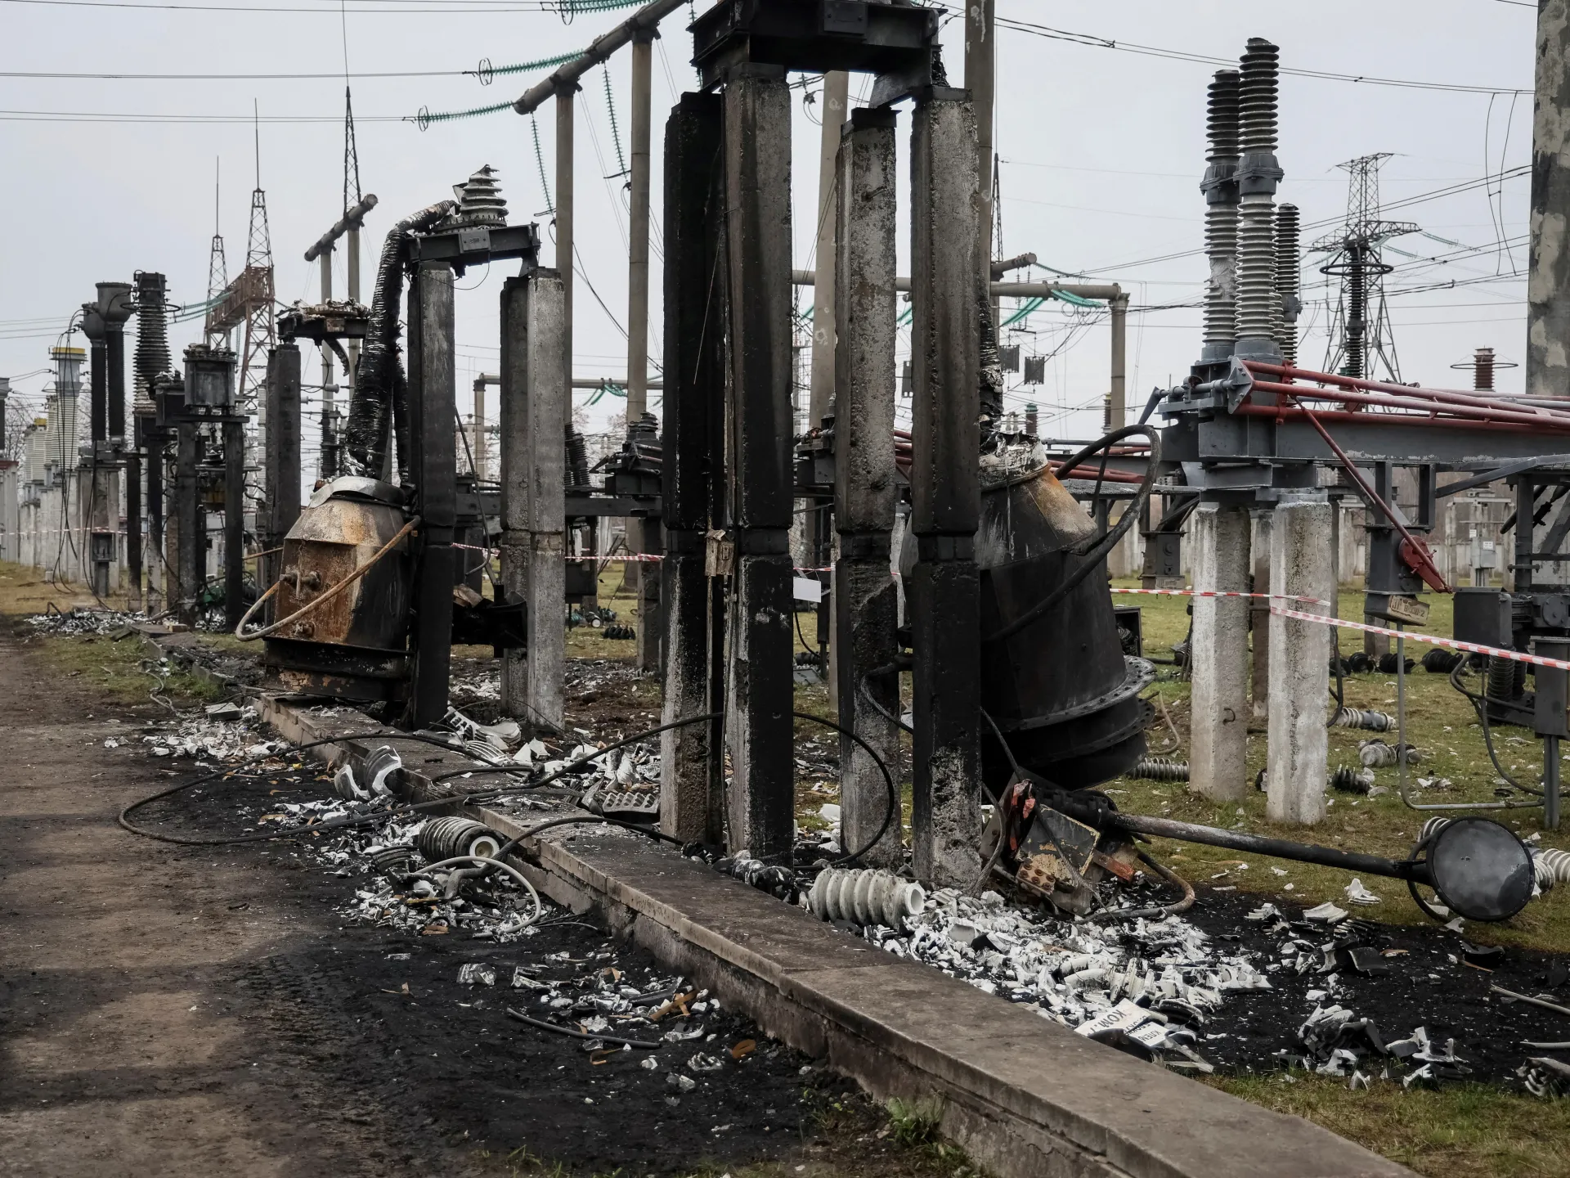
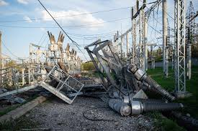
Russia has strategically targeted Ukraine’s energy infrastructure

Slide 4
Russia is targeting Ukraine’s energy infrastructure
Dixi Group Study, October 2, 2024
“As a result of the occupation and attacks in 2022-2023, Ukraine’s power system lost about 21 GW of capacity. In 2024, the losses from the missile and drone campaign are estimated at more than 9 GW of thermal and hydro generation. In addition to generation, Russia also regularly strikes at critical power grid nodes in order to destabilize the power system and limit the ability to transmit electricity within the country, as well as complicate its imports. It is obvious that the enemy will strike again, perhaps even before the beginning of winter,” said Oksana Zuieva, senior open data expert at DiXi Group.

Slide 5
Key questions:
Given that large amounts of western aid are likely to flow into Ukraine after the war, what policies should be requested to ensure that donors get the most infrastructure services per dollar spent?
Can we apply lessons learned from infrastructure delivery in other countries when rebuilding Ukraine?
Ukraine reconstruction offers a unique opportunity to adopt efficient policies that are sometimes opposed by well-organized pressure groups. How can we best seize the opportunity?

Slide 6
Key element of infrastructure recovery: how will it be paid for? Differentiate the funding source based on correlation to use: 1. Some type of direct user fee closely related to use (price, toll, rate, or fee) 2. Some type of targeted tax roughly correlated to use (e.g. tax- increment financing) 3. Some type of broad tax unrelated to infrastructure use (e.g. sales tax, income tax, etc.)

Slide 7
Policy Recommendation 1: Rely on user fees/rates to fund (not finance) infrastructure
Per-unit user fees are common in funding infrastructure:
Price per kWh of electricity, rate per gallon of water, per minute of cell phone use, per mile of road usage
Create user fees that are variable and as closely related to use of the service as possible
A variable price or rate sends “price signals” to both demanders and suppliers
This brings in market forces on both the demand and the supply sides of the market.
Sets the stage for private investment on the supply side

Slide 8
Policy Recommendation 2: Rely on private capital to finance recovery using public-private partnerships or PPPs
Ukraine’s infrastructure needs are enormous while trillions of dollars are available (“sitting on the sidelines”) from institutional investors for “bankable” projects
Institutional investors includes public and private pension funds, sovereign wealth funds, insurance companies, university endowments, mutual funds
The main mechanism to facilitate private investment in infrastructure is a public-private partnership (PPP) that contains a financing element (i.e., an “F” in project delivery)

Slide 9
Policy Recommendation 2: Rely on private capital to finance recovery using public-private partnerships or PPPs (continued)
PPP is a contract between a public-sector project sponsor and a private partner (usually via a Special Purpose Vehicle or SPV) that facilitates private–sector participation in project delivery
Must have three key elements:
1. The bundling together of major project delivery components in some combination: design, build finance, operation, maintenance (DBFOM).
2. The significant transfer of risk from taxpayers (who would bear project risk by default if no private participation) to private investors.

Slide 10
Policy Recommendation 2: Rely on private capital to finance recovery using public-private partnerships or PPPs (continued)
3. A long-term relationship between the public-sector project sponsor/asset owner and the private-sector partner (i.e., the SPV)
Benefits of PPPs are now well-recognized (no deferred maintenance)
Investing in post-war Ukraine has social benefits
Pre-war: Ukraine was developing one of the most progressive PPP laws in the EU

Slide 11
Risk Transfer in PPP Contracts: degree of risk transfer depends on type of contract

Slide 12
Policy Recommendation 3: Standardize and Bundle Projects * Infrastructure delivery is often project-specific * A public-sector project sponsor announces a Request for Proposals (RFP) specific to that project * This approach is often slow and costly * Best to standardize projects and bundle them into a single larger procurement

Slide 13
Policy Recommendation 3: Standardize and Bundle Projects (continued) * Bundling will lower transaction costs, accelerate delivery, and attract more large, international bidders * Best example: Pennsylvania Rapid Bridge Replacement Program * Quickly replaced 558 structurally deficient rural bridges in one contract * Bond (credit) contracts should also be standardized

Slide 14
Policy Recommendation 4: Ensure all infrastructure contracts include “future proofing” * Resilience will be key to Ukraine’s future infrastructure * Will be both natural and human-made threats to its infrastructure for foreseeable future * Greater resilience can be achieved through public-private partnership (PPP) contracts that include an operation & maintenance provision (such as a DBOM)

Slide 15
Policy Recommendation 4: Ensure all infrastructure contracts include “future proofing” (continued) * PPP contracts can be “future proofed”: “A future-proofed contract is one that anticipates and addresses potential changes, risks, and opportunities that may arise during the contract lifecycle.” * Such contracts can define various risks and place the cost of bearing that risk on a private-sector partner * One key risk is the risk of not adopting future technologies! * Future-proofed contracts can help Ukraine to “bounce forward” (rather than just bouncing back) to greater resilience!

Slide 16
Policy Recommendation 4: Ensure all infrastructure contracts include “future proofing” (continued) * Infrastructure is undergoing a large “quiet technological revolution” that can enhance resilience * Examples include sensors, IoT, materials, more elastic concretes, better designs * Building back after a disaster (or renovating old infrastructure) provides an opportunity to incorporate new designs, materials and technologies into existing infrastructure

Slide 17
Benefits of future-proofed contracts where private partner bears technology risk * Private partner may be in a better position to manage resilience-related risks than public asset owner * Private partner may have better access to new technologies and more capital to deploy them * Private partner may have more global experience in confronting various hazards than public owner

Slide 18
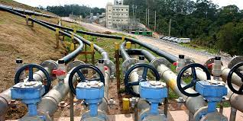
Policy Recommendation 5: Utilize Value Capture
Define Value Capture: Using innovative delivery and technology to release value latent in extant infrastructure
Released value can often be used to finance the installation of the technology!
Methane from landfills:

Slide 19
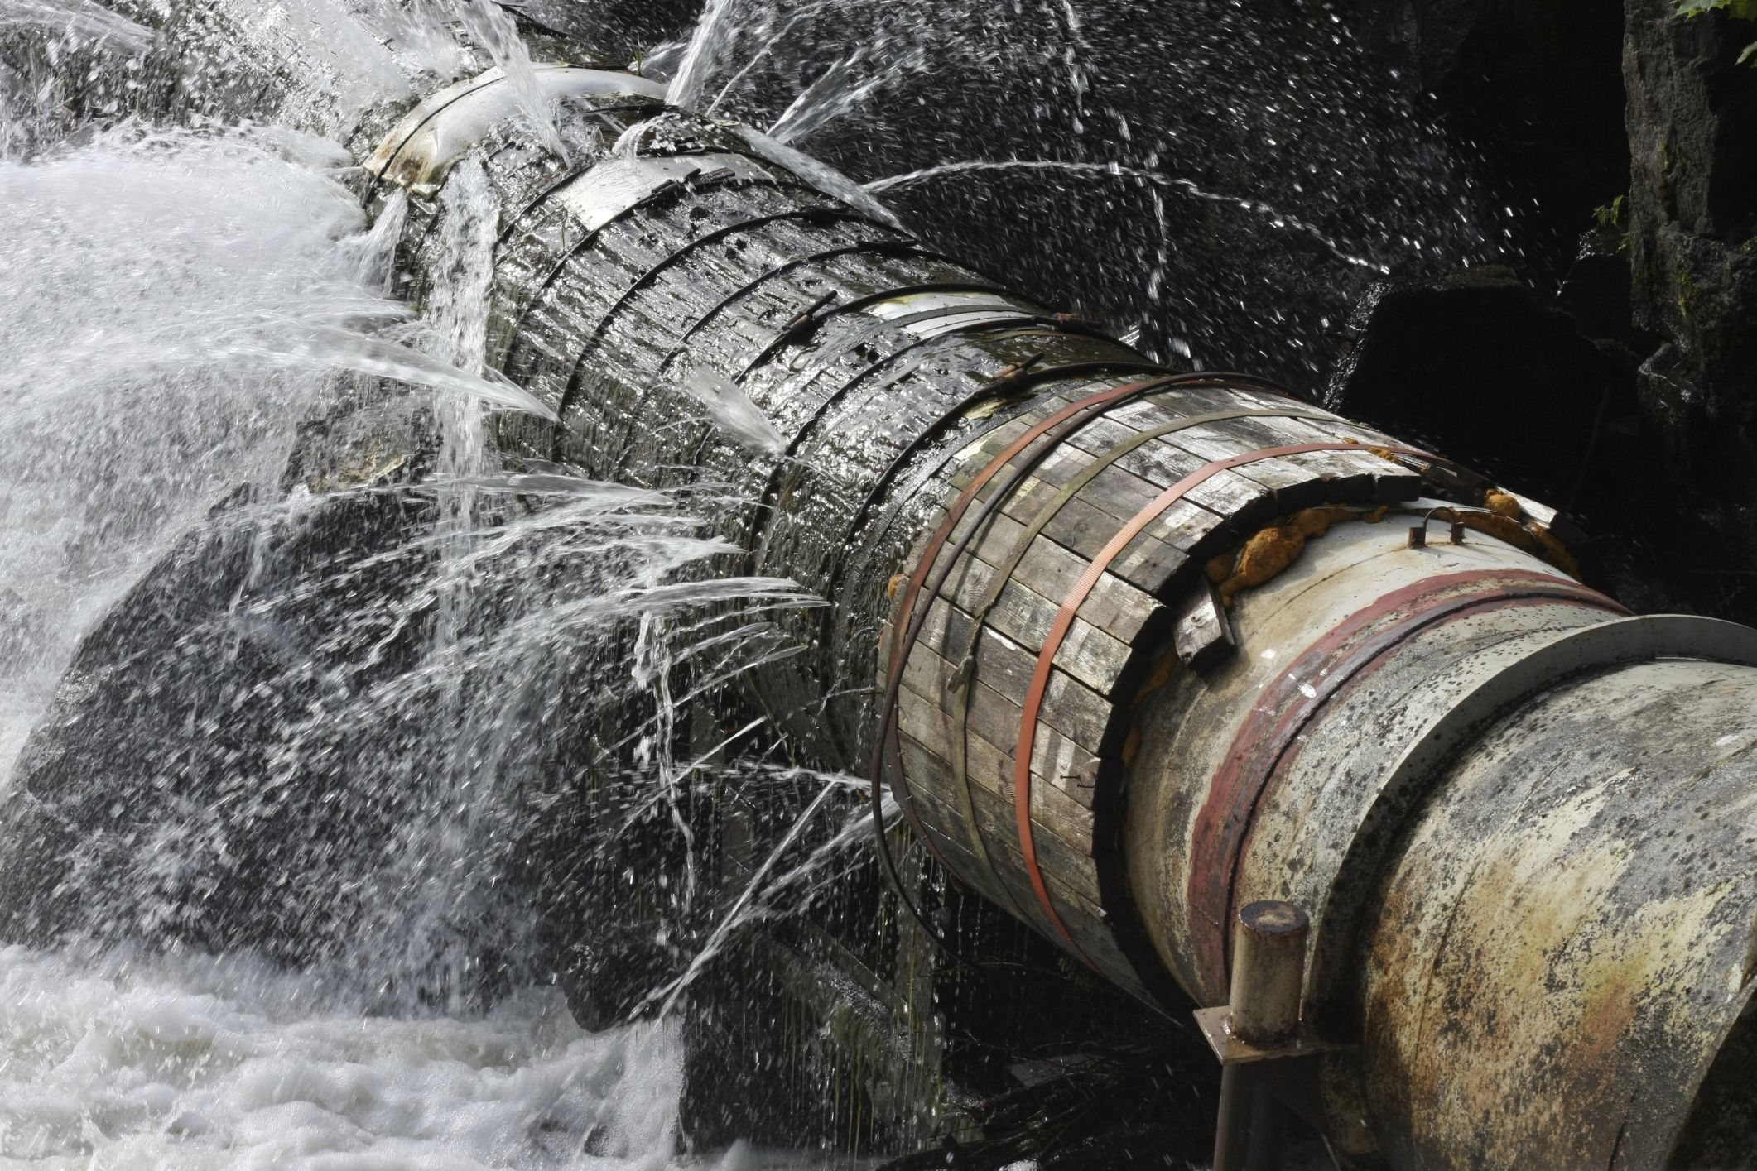
Policy Recommendation 5: Utilize Value Capture (continued)
Ukraine has enormous opportunities for value capture because:
Size and extent of Ukraine infrastructure across sectors
Much its infrastructure was Soviet-era pre-war
Poor techniques used for decades for operation and management
War damage offers the chance to rebuild in a smart way!

Slide 20
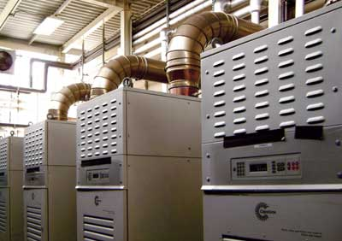
Local Example Value Capture Deal Ithaca (NY) Area Wastewater Treatment Facility
Ithaca partnered with Johnson Controls using a 20-year performance contract in biogas-to-energy conversion
Benefits include:
* Lower GHGs
* Lower plant power costs
* Plant sells power to the grid
* City gets processing (“tipping”)
fees from other towns
* Low (or no) upfront costs to
City!
* Installation paid for my bonding
against lower electric bills!

Slide 21
Innovations in Methane Capture!

Slide 22
Recommendation 6: Adopt PPP Units Major challenge to adopting these policies: Public-Sector Capacity * Ukraine reformed its infrastructure delivery in the post- Soviet era by decentralizing control (outside of Kyiv) * Many relatively new public-sector asset owners do not have experience with modern management techniques * Large role for PPP units and public-sector executive education

Slide 23
Major challenge to adopting these policies: Public-Sector Capacity (continued) * A Public-Private Partnership (PPP) unit is an organization that helps facilitate, promote, and assess PPPs. * PPP units can be government agencies or semi- independent organizations that are partially or fully supported by the government. * PPP units help governments manage the risks associated with PPPs

Slide 24
How can Better Infra Policy Help Recovery in Ukraine?

Slide 25
Thank you!!

